Slide 1

Candidates for volcanoes under the ice of Antarctica detected by their gravito-topographic signal
Jaroslav Klokocnik 1, Jan Kostelecky 2, 3,
Ales Bezdek 1, Ivan Pesek 4
1 Astronomical Institute, Czech Academy of Sciences, Ondrejov, Czech Republic
2 Research Institute of Geodesy, Topography and Cartography, Zdiby, Czech Republic,
3 Department of Geodesy and Mining Surveying, Faculty of Mining and Geology, Ostrava, Czech Republic
4 Department of Geomatics, Faculty of Civil Engineering, Czech Technical University in Prague, Prague, Czech Republic
Notes:
Satellite dynamics (…) and physical geodesy, use of their theory and numerical results s/c….

Slide 2
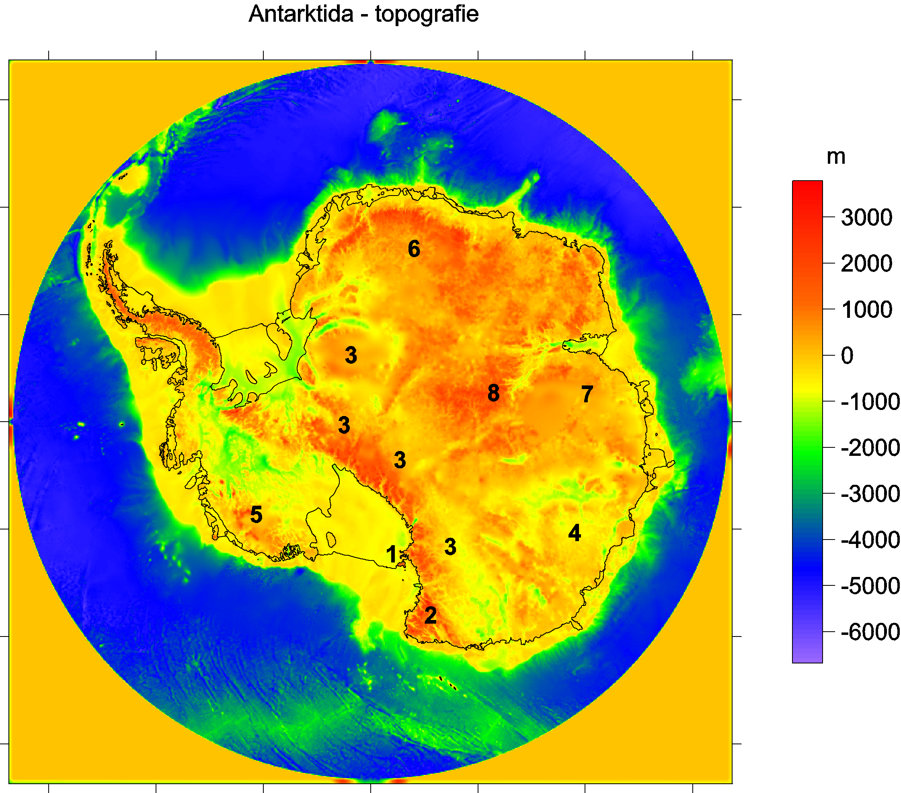
Bedmap2 bedrock topography
Ross shelf glacier
and Ross Island,
2 Victoria Land
3 Transantarctic Mountains
4 Wilkes Land
5 Marie Byrd Land
Queen (Dronning)
Maud Land
7 Princess Elizabeth Land
Gamburtsev Mountains
(under the ice).
Lake Vostok
9

Slide 3
Notes on theory
2. Data – Earth´s gravity field models,
bedrock topography model of A. and
their combination
3. Typical gravitational signal of volcanoes
4. Subglacial volcanoes in Antarctica

Slide 4

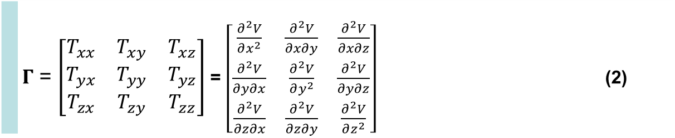
Disturbing static gravitational potential outside the Earth masses in spherical harmonic expansion
 | $$T\left(r,φ,λ\right)=\frac{GM}{r}\sum_{l=2}^{∞}{\sum_{m=0}^{l}{{\left(\frac{R}{r}\right)}^{l}\left({C^{′}}_{l,m}cos mλ+S_{l,m}sin mλ \right)}} P_{l,m}\left(sin φ\right)$$
where GM is a product of the universal gravitational constant and the mass of the Earth (also known as
the geocentric gravitational constant), r is the radial distance of an external point where T is computed,
R is the radius of the Earth (which can be approximated by the semi-major axis of a reference ellipsoid),
P_{l,m} (sin φ) are the Legendre associated functions, l and m are the degree and order of the harmonic expansion,
(φ, λ) are the geocentric latitude and longitude, C’_{l,m} and S_{l,m} are the harmonic geopotential coefficients
(Stokes parameters), fully normalized, C’_{l,m} = C_{l,m} – C^{el}_{l,m}, where C^{el}_{l,m} belongs to the reference ellipsoid.
The spherical approximation of the gravity anomaly Δg is computed
$∆g=−\frac{∂T}{∂r}−2\frac{T}{r}$
or one can use the gravity disturbance (it is the same but without the second term).
Gravity gradient tensor Γ (the Marussi tensor) is a tensor of the second derivatives of
the disturbing potential T:
 | $Γ$ = $\left[\begin{matrix}T_{xx} & T_{xy} & T_{xz} \\ T_{yx} & T_{yy} & T_{yz} \\ T_{zx} & T_{zy} & T_{zz}\end{matrix}\right]$ = $\left[\begin{matrix}\frac{∂^{2}V}{∂x^{2}} & \frac{∂^{2}V}{∂x∂y} & \frac{∂^{2}V}{∂x∂z} \\ \frac{∂^{2}V}{∂y∂x} & \frac{∂^{2}V}{∂y^{2}} & \frac{∂^{2}V}{∂y∂z} \\ \frac{∂^{2}V}{∂z∂x} & \frac{∂^{2}V}{∂z∂y} & \frac{∂^{2}V}{∂z^{2}}\end{matrix}\right]$ (2)
Notes:
Legendre associated functions,… free-air gravity anomaly, gravity disturbance

Slide 5
A.H.Saad, The Leading Edge, 942-950, Aug. 2006

Slide 6


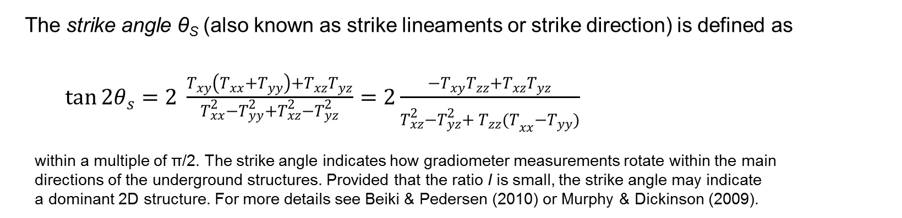
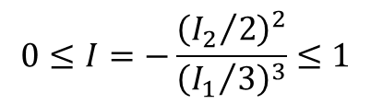
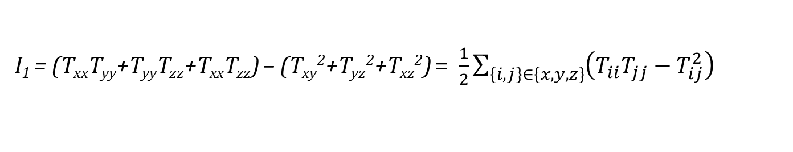
Under any coordinate transformation, Γ preserves
just 3 INVARIANTs
$I_{0}=trace \left(Γ\right)=T_{xx}+T_{yy}+T_{zz}=$ 0
I₁ = (T_{xx}T_{yy}+T_{yy}T_{zz}+T_{xx}T_{zz}) – (T_{xy}²+T_{yz}²+T_{xz}²) = $\frac{1}{2}\sum_{\left\{i,j\right\}∈\left\{x,y,z\right\}}{{\left(T_{ii}T_{jj}−T_{ij}^{2}\right)}_{}}$
I₂ = det (Г) = (T_{xx}(T_{yy}T_{zz}-T_{yz}²) + T_{xy}(T_{yz}T_{xz} – T_{xy}T_{zz}) + T_{xz} (T_{xy}T_{yz}-T_{xz}T_{yy}).
Pedersen & Rasmussen (1990) showed that the ratio I of I₁ and I₂ defined as
$$0≤I=−\frac{{\left({I_{2}}/2\right)}^{2}}{{\left({I_{1}}/3\right)}^{3}}≤1$$
lies between zero and unity for any potential field. If the causative body is strictly 2D, then I =0.
The strike angle θ_{S} (also known as strike lineaments or strike direction) is defined as
$\tan{2θ_{s}}=2 \frac{T_{xy}\left(T_{xx}+T_{yy}\right)+T_{xz}T_{yz}}{T_{xx}^{2}−T_{yy}^{2}+T_{xz}^{2}−T_{yz}^{2}}=2\frac{{−T}_{xy}T_{zz}+T_{xz}T_{yz}}{T_{xz}^{2}−T_{yz}^{2}+{{ T}_{zz}^{}(T}_{xx}^{}−T_{yy}^{})}$
within a multiple of π/2. The strike angle indicates how gradiometer measurements rotate within the main
directions of the underground structures. Provided that the ratio I is small, the strike angle may indicate
a dominant 2D structure. For more details see Beiki & Pedersen (2010) or Murphy & Dickinson (2009).

Slide 7
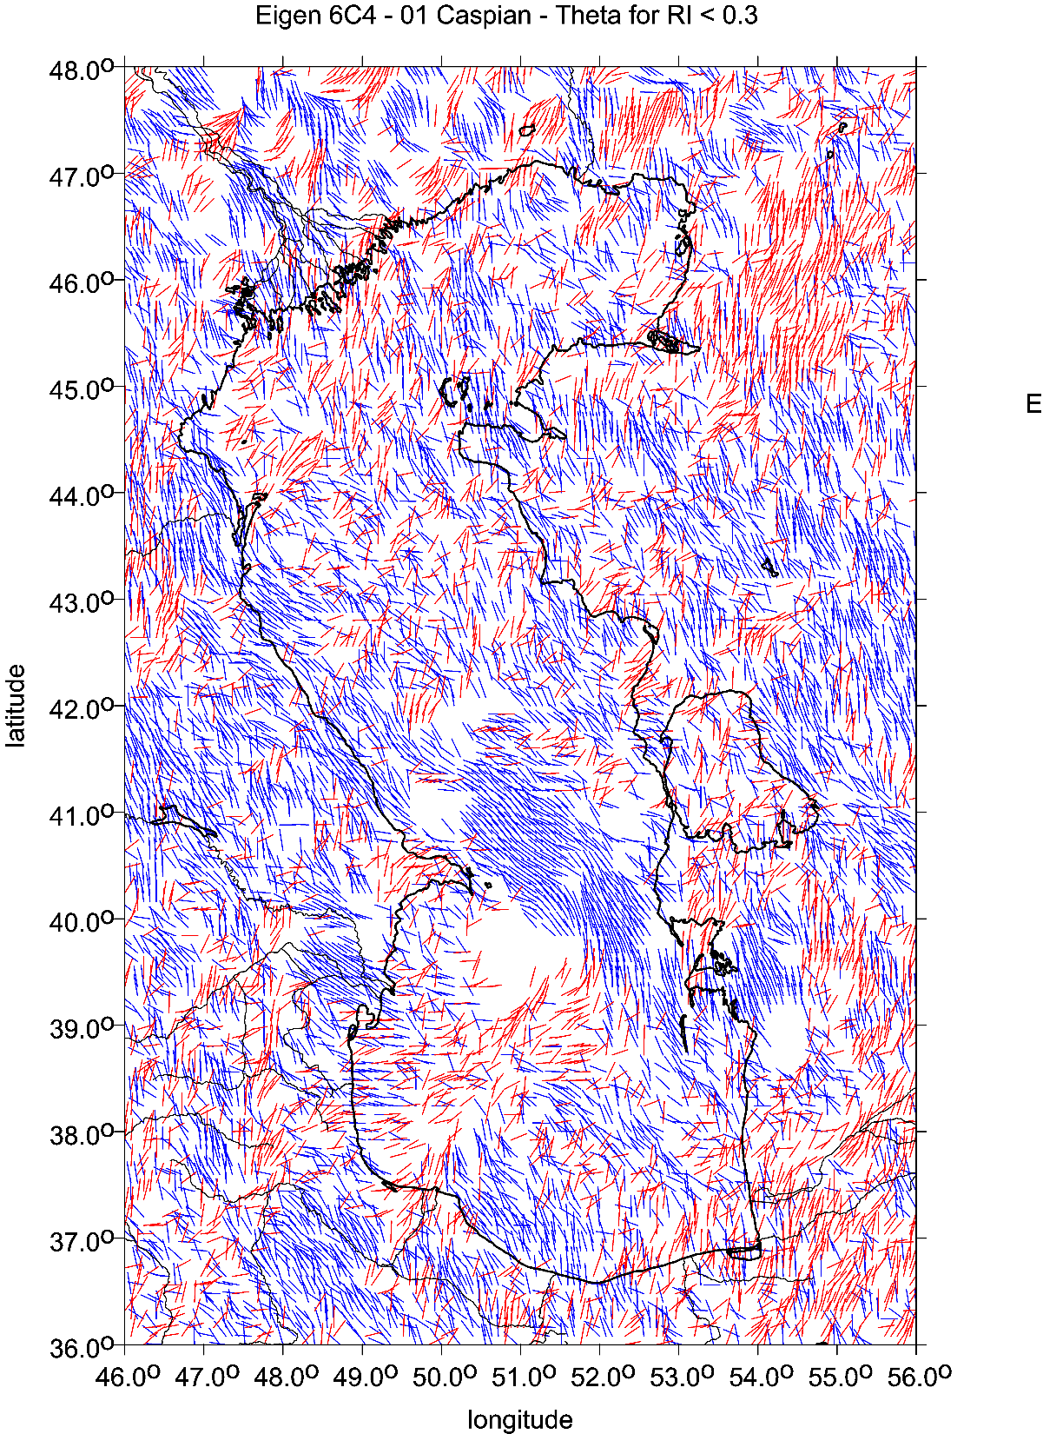

Slide 8
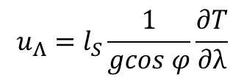



Virtual deformations (Kalvoda et al. 2012, Klokočník et al. 2013)
Virtuální deformace ukazují, jak by se příslušný materiál roztekl, kdyby byl dokonale tekutý
directions of such a deformation due to “erosion” brought about solely by “gravity origin”.
If there would be a tidal potential T, then the horizontal shifts (deformations) would exist due to it
and they could be expressed
in north-south direction (latitude direction) … [left] and in east-west direction (longitudinal direction) … [right]
where g is the gravity acceleration 9.81 m⋅s⁻²,
l_{S} is the elastic coefficient (Shida number) expressing the elastic properties of the Earth as a planet (l_{S} = 0.08),
φ and λ are the geocentric coordinates (latitude and longitude) of a point P where we measure T
The apparatus of mechanics of continuum to derive the main directions of the tension is applied (see, e.g., Brdička et al. 2000).
The tensor of (small) deformation E is defined as a gradient of shift. It holds that
The tensor E can be separated into two parts:
where e is the symmetrical tensor and Ω the anti-symmetrical tensor of deformation, respectively. The symmetrical tensor is
and the parameters of deformation are:
Δ = e₁₁ + e₂₂ total dilatation a = ½ (Δ + γ) major semi-axis of ellipse of deformation
γ₁ = e₁₁ - e₂₂ pure cut b = ½ (Δ – γ) minor semi-axis of ellipse of deformation
γ₂ = 2e₁₂ technical cut α = ½ atan(γ₂ / γ₁) direction of main axis of deformation
γ = (γ₁² + γ₂²)^{1/2} total cut
.
$$u_{Φ}=l_{S}\frac{1}{g}\frac{∂T}{∂φ}$$
$$u_{Λ}=l_{S}\frac{1}{gcos φ}\frac{∂T}{∂λ}$$
$$E=\left(\begin{matrix}ε_{11} & ε_{12} \\ ε_{21} & ε_{22}\end{matrix}\right)=\left(\begin{matrix}\frac{∂u_{x}}{∂x} & \frac{∂u_{x}}{∂y} \\ \frac{∂u_{y}}{∂x} & \frac{∂u_{y}}{∂y}\end{matrix}\right)$$
$$E=e+Ω= \left(e_{ij}\right)+\left(Ω_{ij}\right)$$
$e=\left(\begin{matrix}e_{11} & e_{12} \\ e_{21} & e_{22}\end{matrix}\right)=\left(\begin{matrix}ε_{11} & {(ε}_{12}+ε_{21})/2 \\ {(ε}_{12}+ε_{21})/2 & ε_{22}\end{matrix}\right)$

Slide 9
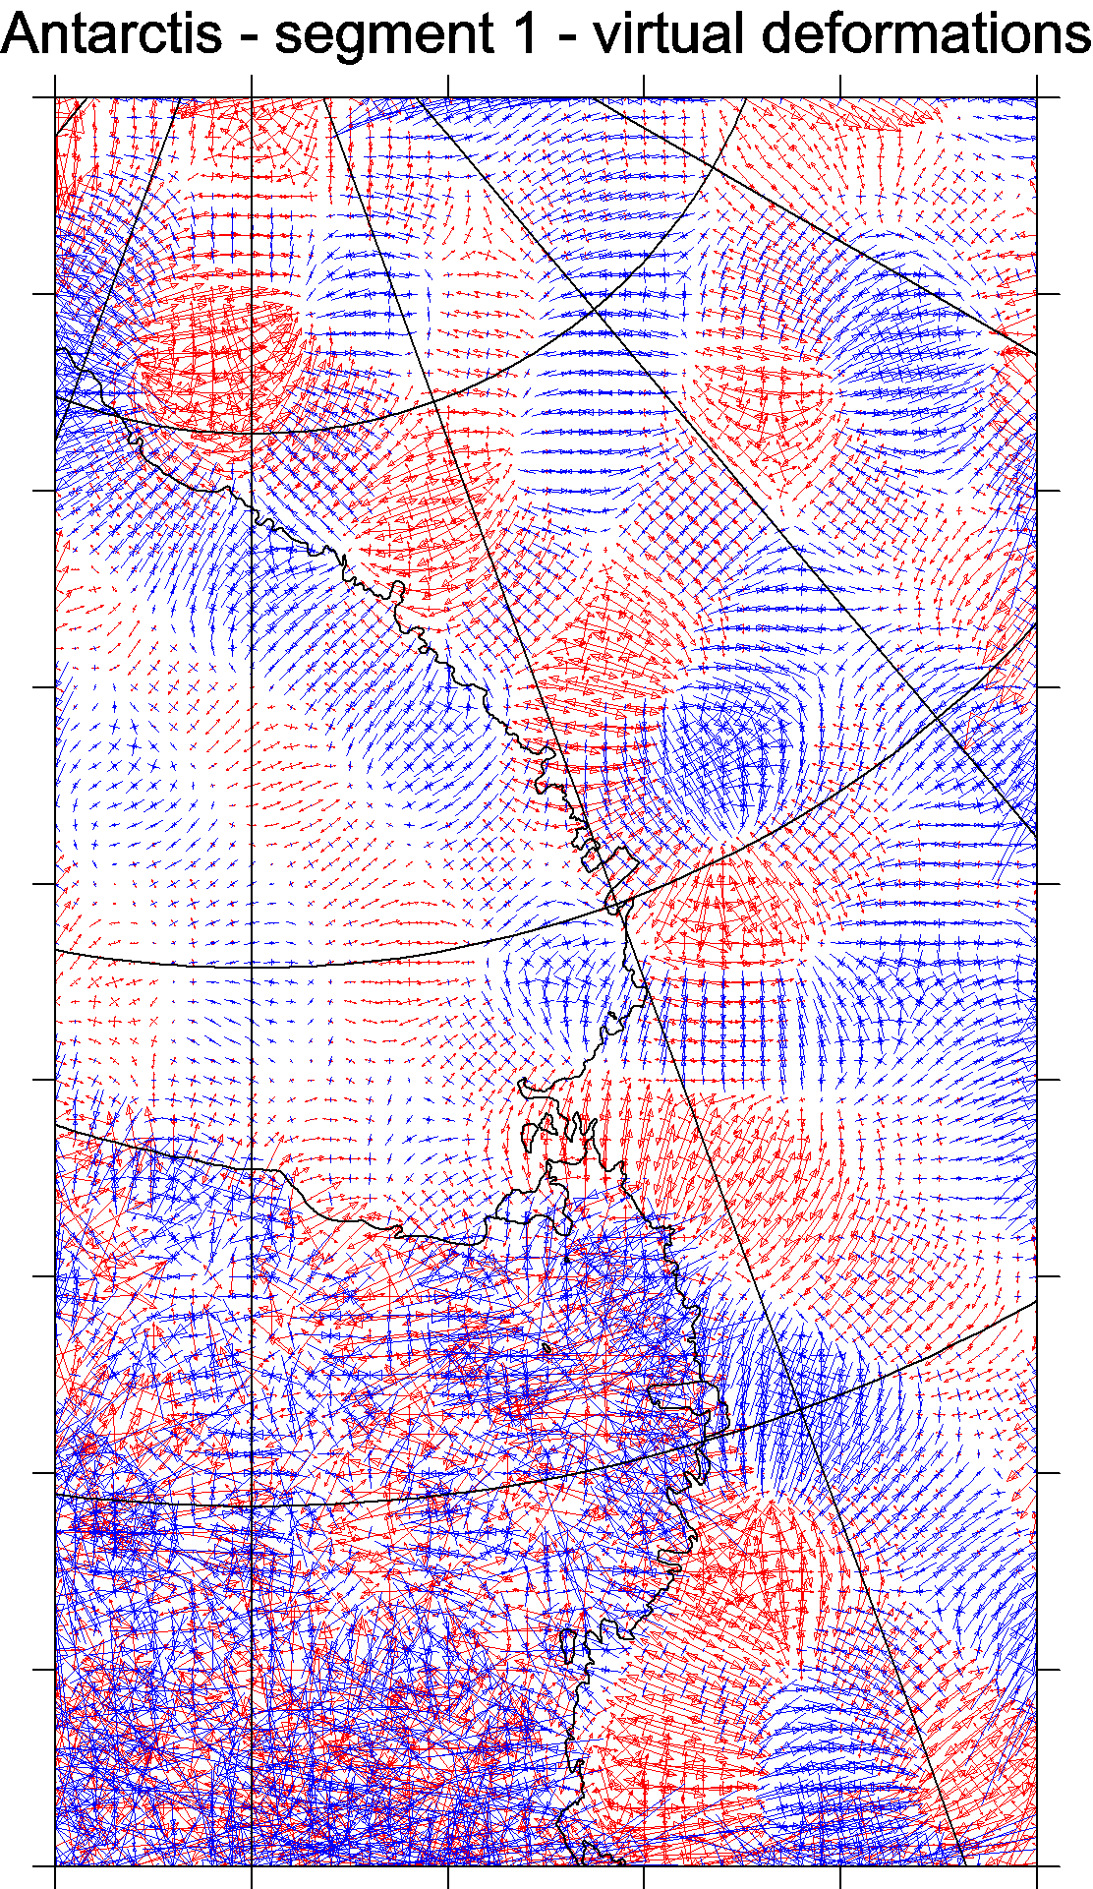
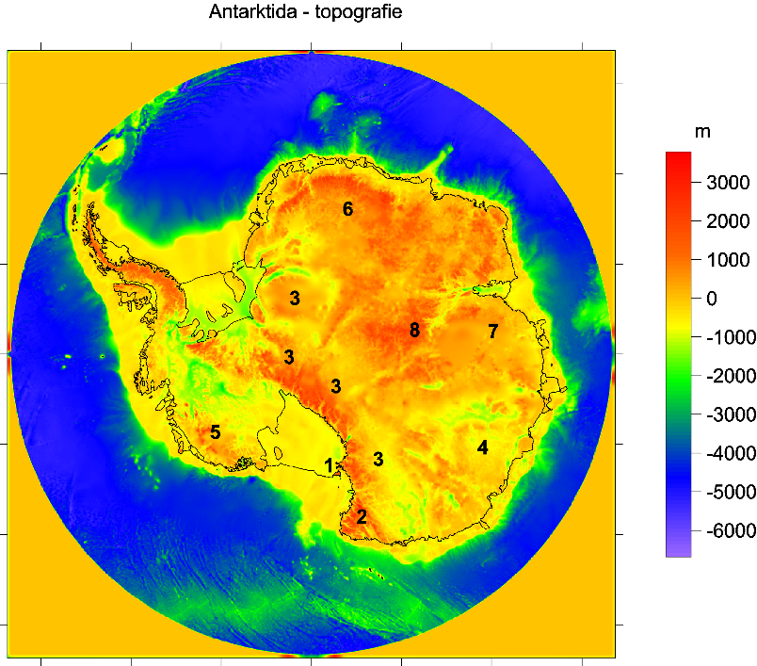
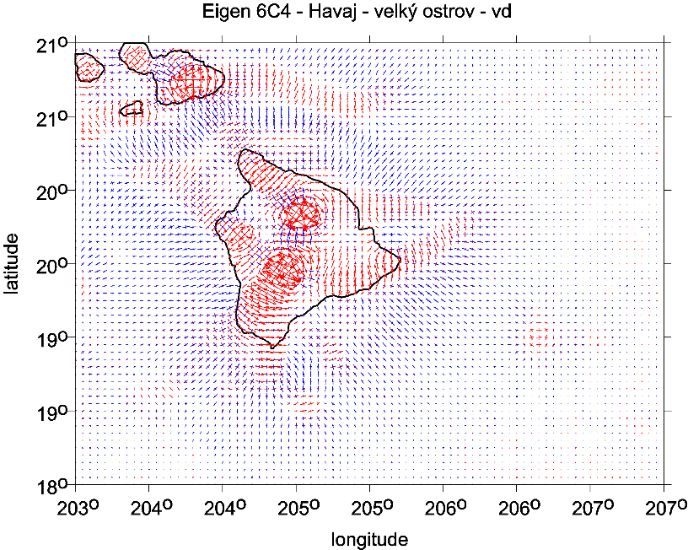

Slide 10
Using the harmonic geopotential coefficients of the global gravitational model EGM 2008, the following physical quantities are computed: the gravity anomalies Δg (or disturbances) [scale 1mGal = 10-5 ms-2], the full Marussi tensor Γ of the second derivatives of the disturbing potential [1E = 1 Eötvös = 10-9 s-2], namely its radial component, sometimes denoted Tzz or Trr, the invariants of the gravity field I0, I1, I2 = det(Γ), computable from the components of the Marussi tensor, their specific ratio I and the strike angle θ. These quantities are known from theory of Pedersen & Rasmussen (1990) and Beiki & Pedersen (2010). A “virtual deformation” has been added (Kalvoda et al. 2013, following Brdička et al 2000). Some of these quantities are functionals of the geopotential in a mathematical sense and some of them are not. Therefore, they are concisely designated in the paper as aspects of the geopotential.
Numerical stability
in computations of second derivatves and other gravity aspects derived from them
to very high degree and order
Many authors … Fukusima (2012),
Bucha and Janák (2013) A MATLAB-based graphical user interface program for computing functionals of the geopotential up to ultra-high degrees and orders ,
Computers &Geosciences 56(2013)186–196

Slide 11
Plotting
Plotting is important for visualizing our results; we make use of strongly non-linear scales to emphasize various features which otherwise might remain hidden.
A note about the units of plotted aspects:
mGal (miligals) for the gravity anomalies and/or disturbances,
E … Eötvös for the second order potential derivatives,
components of Marussi tensor.
The invariants I1 and I2 have units [s⁻⁴] and [s⁻⁶] and their ratio I is dimensionless.
The strike angle θ is expressed in degrees and its demonstration in red means its direction to the East and in blue to the West of the local meridian.
The virtual deformations (vd) are dimensionless and express a direction of dilatation (red) or compression (blue). These units are used in all figures presented below.
1mGal = 10⁻⁵ ms⁻², 1E = 1 Eötvös = 10⁻⁹ s⁻²

Slide 12
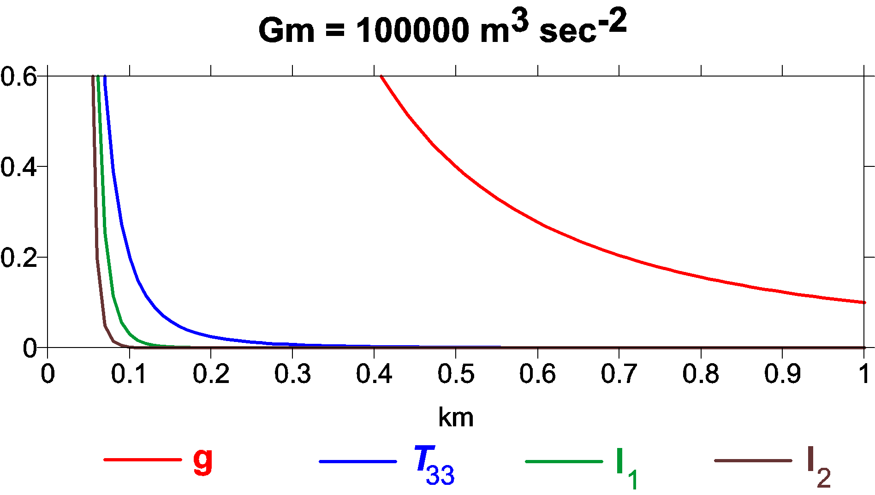
Comparison of sensitivity of various functions of the disturbing potential mass point case / an illustrative simplification x axis depth beneath surface [km], y axis reference value of functionals for given gravitational constant GM describing respective point mass body

Slide 13
Data – recent gravity field models
satellite bedrock topography and
their combination
EGM 2008 *
EIGEN 6C4 **
BEDMAP 2 bedrock topography ***
Pavlis, N. K., Holmes, S. A., Kenyon, S. C. & Factor, J. K. 2008a. An Earth Gravitational Model to degree 2160: EGM 2008. EGU General Assembly 2008,
Vienna, 13–18 April 2008.
Pavlis, N. K., Holmes, S. A., Kenyon, S. C. & Factor, J. K. 2008b. EGM2008: An overview of its development and evaluation. National Geospatial-Intelligence Agency, USA, conf.: Gravity, Geoid and Earth Observation 2008, Chania, Crete, Greece, 23–27 June 2008.
Pavlis, N. K., Holmes, S. A., Kenyon, S. C. & Factor, J. K. 2012. The development and evaluation of the Earth Gravitational Model 2008 (EGM2008). J. Geophys. Res. 17, B04406, doi: 10.1029/2011JB008916, 2012.
** Förste Ch., Bruinsma S., Abrykosov O., Lemoine J-M. et al 2014. The latest combined global gravity field model including GOCE data up to degree and order 2190 of GFZ Potsdam and GRGS Toulouse (EIGEN 6C4). 5th GOCE user workshop, Paris 25 – 28, Nov. 2014.
*** Fretwell P, Pritchard H, Vaughan D, Bamber J, et al. 2013. Bedmap2: improved ice bed, surface and thickness datasets for Antarctica. The Cryosphere, 7, 375–393, 2013,
doi: 10.5194/tc-7-375-2013; https://secure.antarctica.ac.uk/data/-bedmap2/

Slide 14
cont./pokrač.
SatGrav RET 2014
Hirt Ch. et al 2016,
A new degree-2190 (10 km resolution) gravity field model for Antarctica
developed from GRACE, GOCE and Bedmap 2 data,
J Geod 90: 105-127.
Resolution 10 km
Precision 10miliGal (not everywhere)

Slide 15
The Gravity Field Model EIGEN-6C4
EIGEN-6C4 is a high resolution static global combined gravity field model up to degree and order 2190. It has been elaborated jointly by GFZ Potsdam and GRGS Toulouse (Foerste et al. 2014) and contains the following satellite and ground data:
LAGEOS (for degrees of harmonics from 2 to30)
high orbiting geodynamic satellite: 1985 – 2010
Previous gravity model GRACE RL03 GRGS (deg. 2 - 130):
ten years 2003 – 2012
GOCE-SGG data, processed by the direct approach incl. the gravity gradient components T_{xx}, T_{yy}, T_{zz} and T_{xz} throughout whole life of the GOCE satellite. The GOCE polar gaps were stabilized by the
- Terrestrial data (max degree 370): DTU12 ocean geoid data and an EGM2008 geoid height grid for the continents.
The combination of these different satellite and surface data sets has been done by a band-limited combination of normale equations (to max degree 370), which are generated from observation equations for the spherical harmonic coefficients. The resulted solution to degree/order 370 has been extended to degree/order 2190 by
a block diagonal solution using the DTU10 global gravity anomaly data grid.

Slide 16
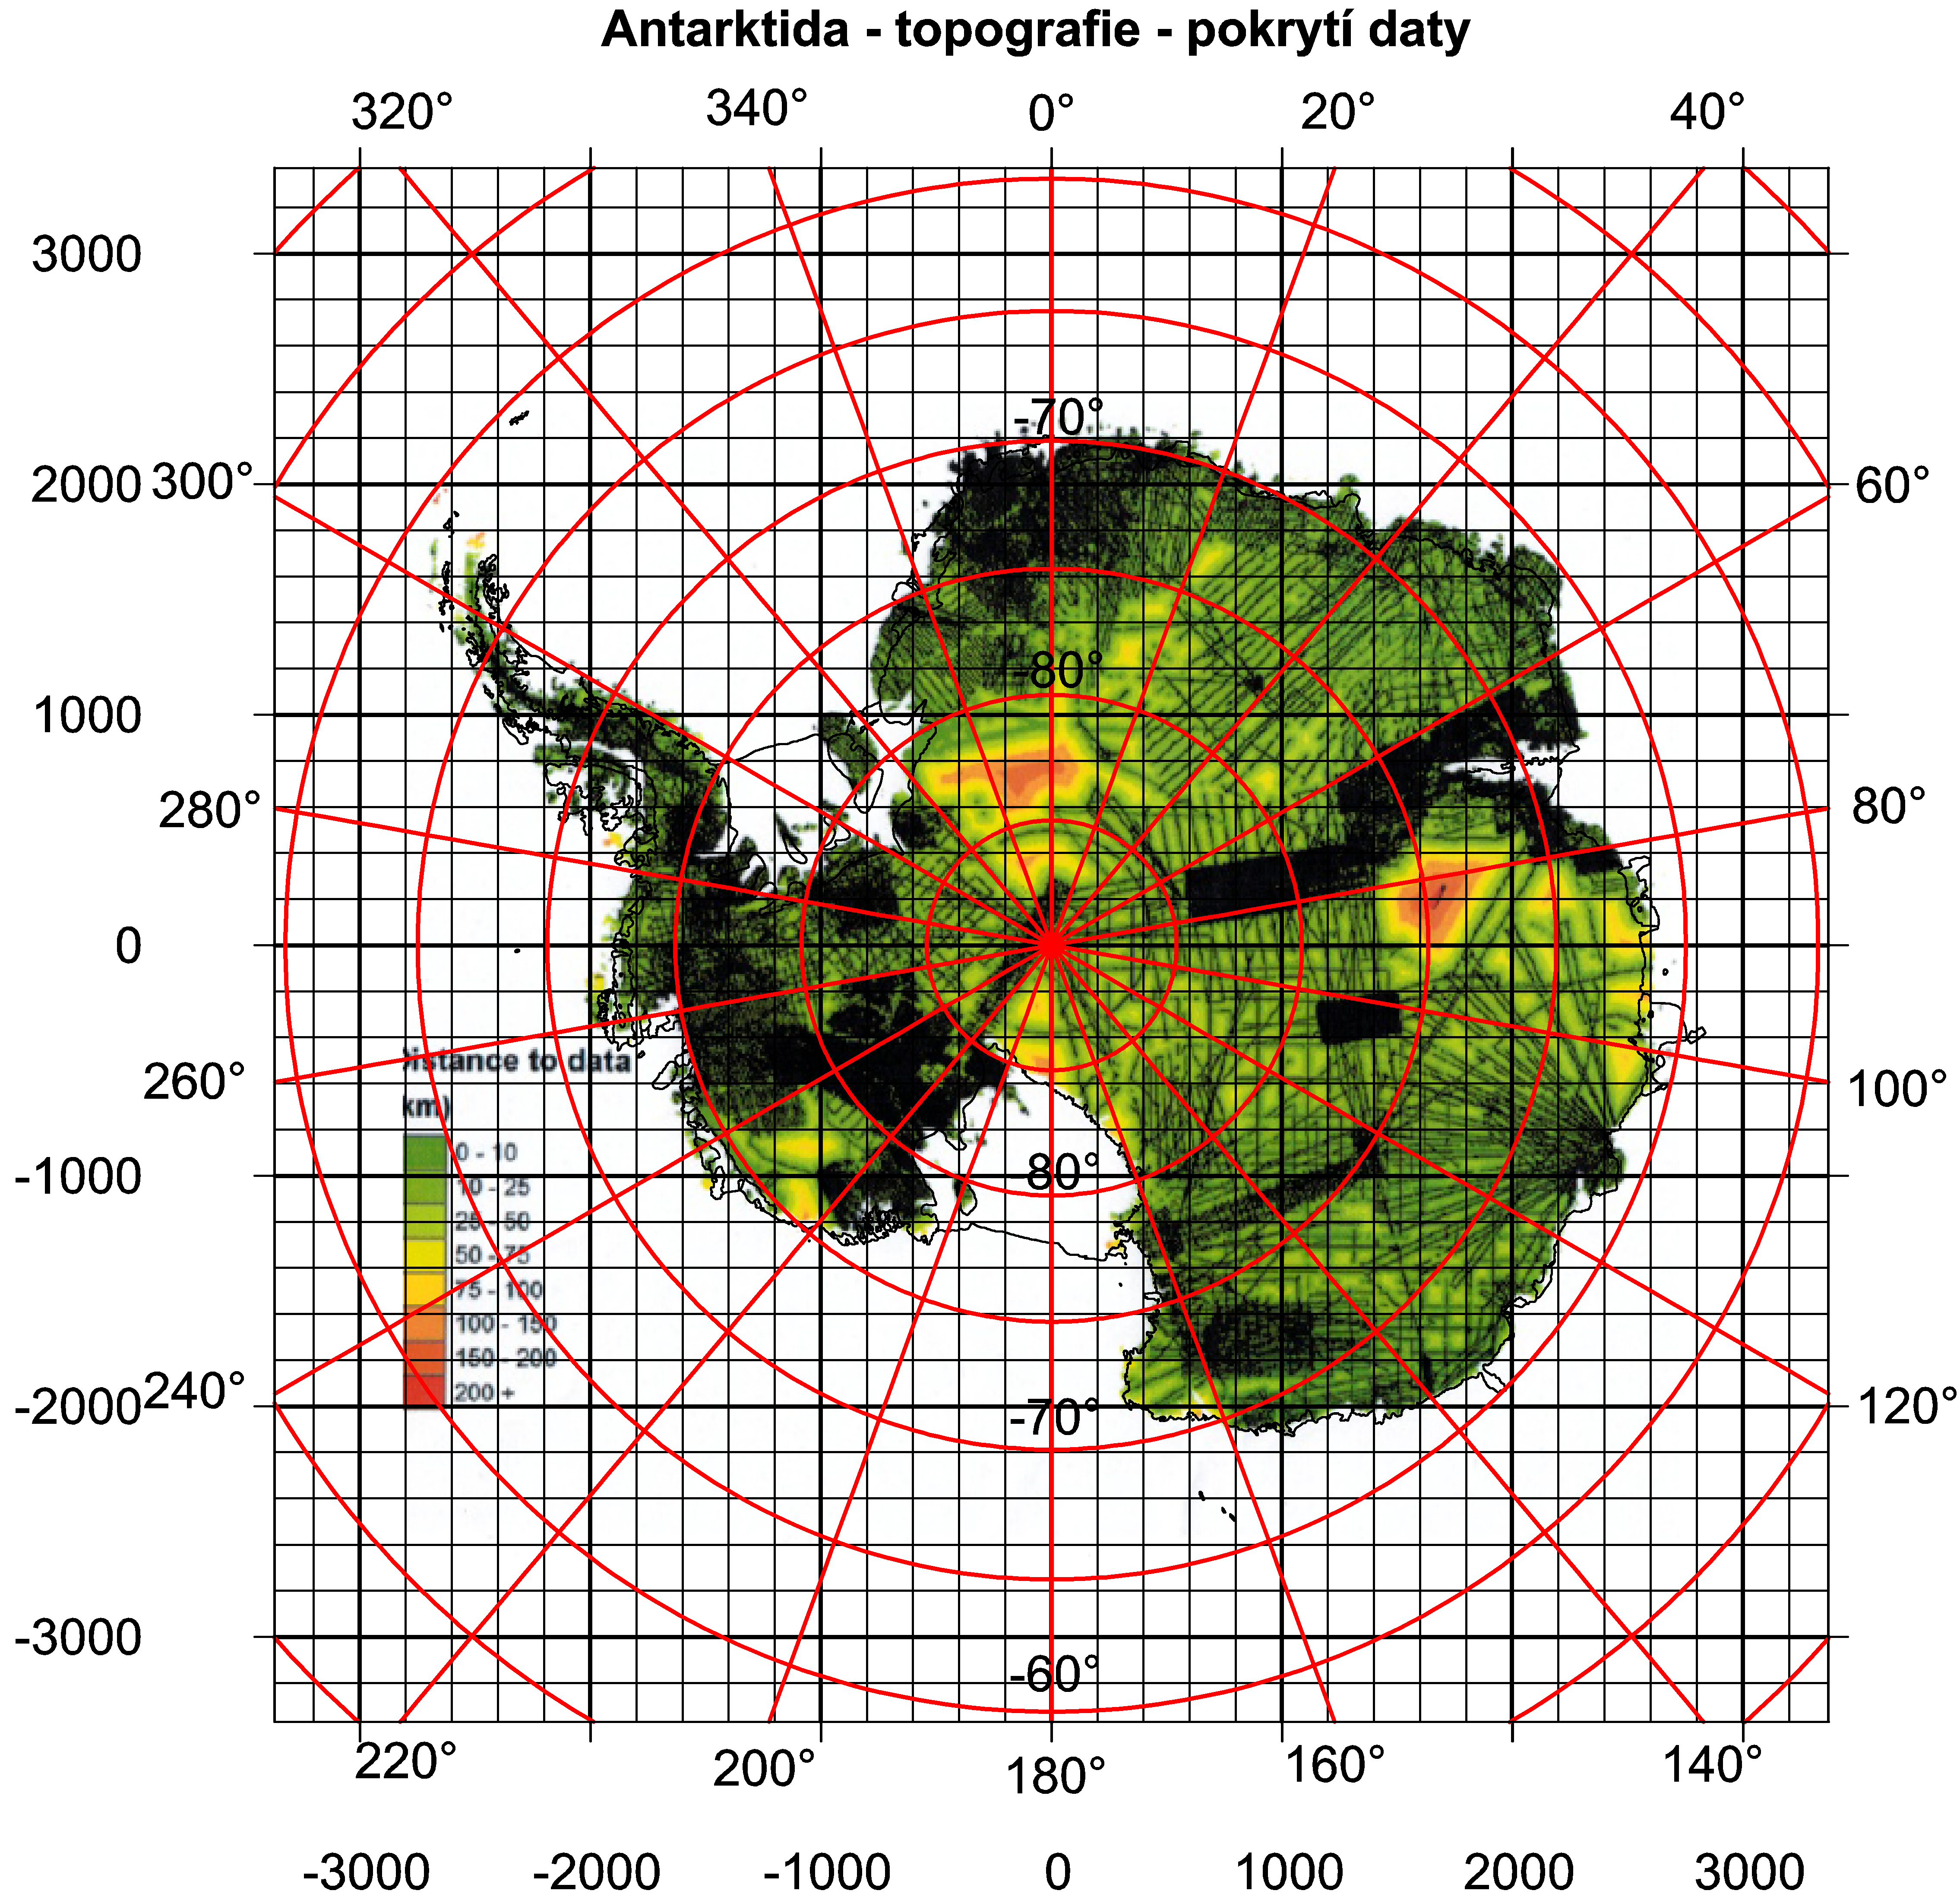
Kritická obhlídka dat

Slide 17
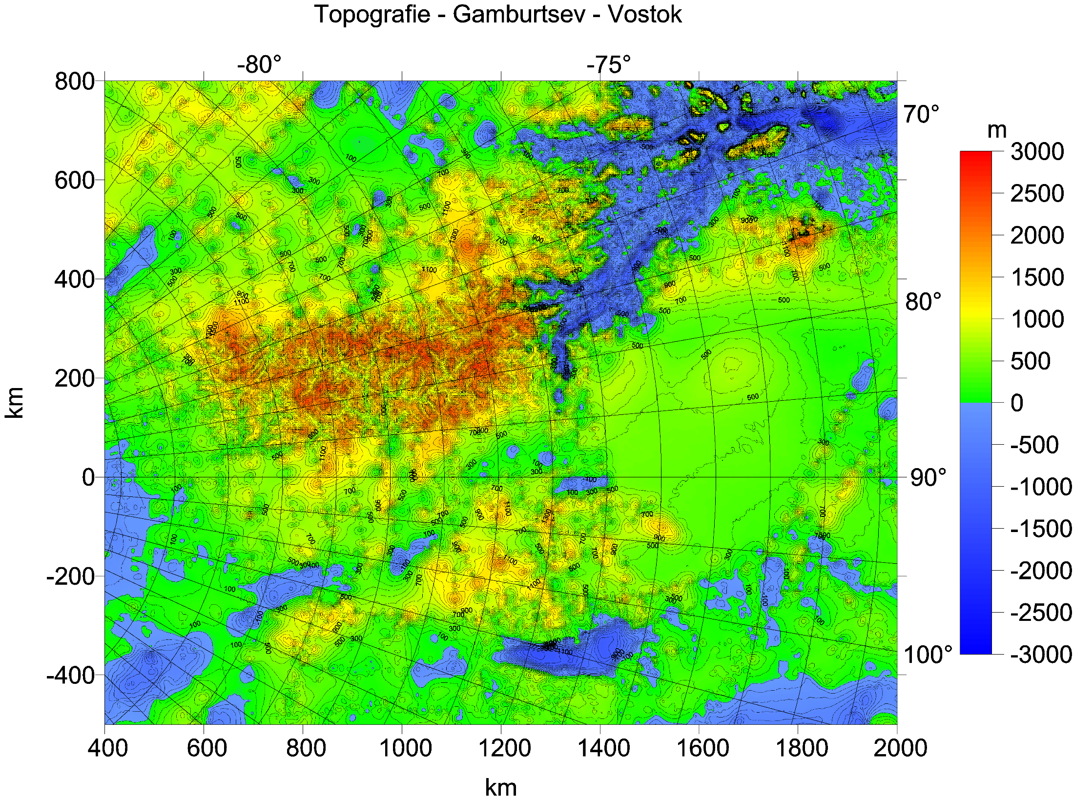

Slide 18
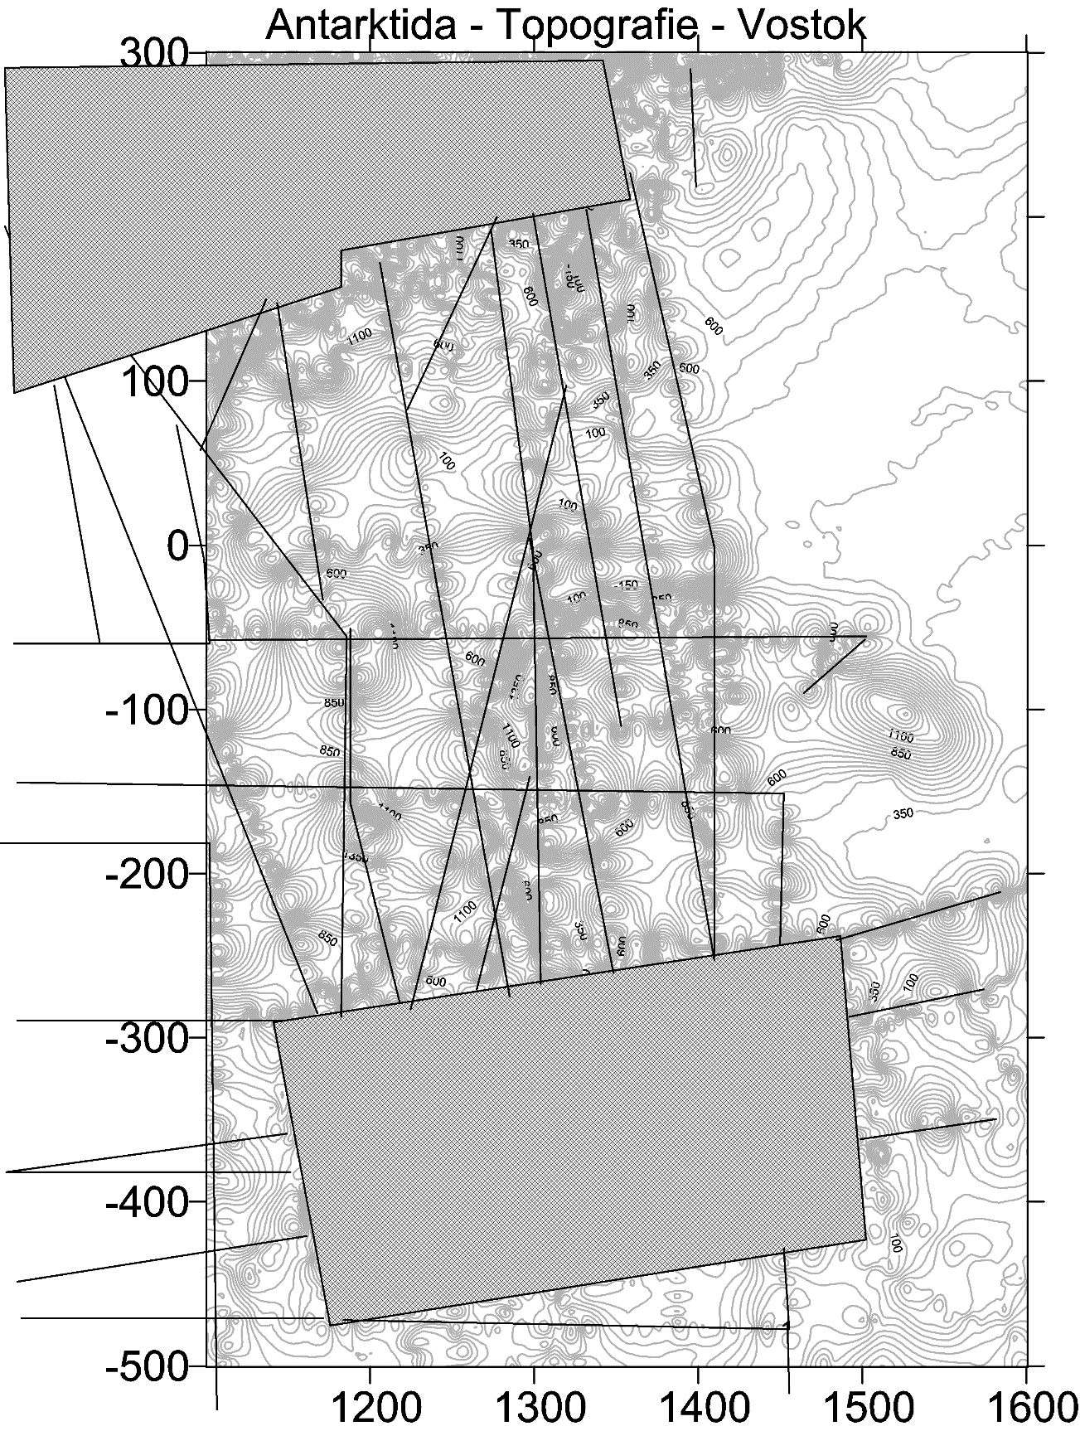
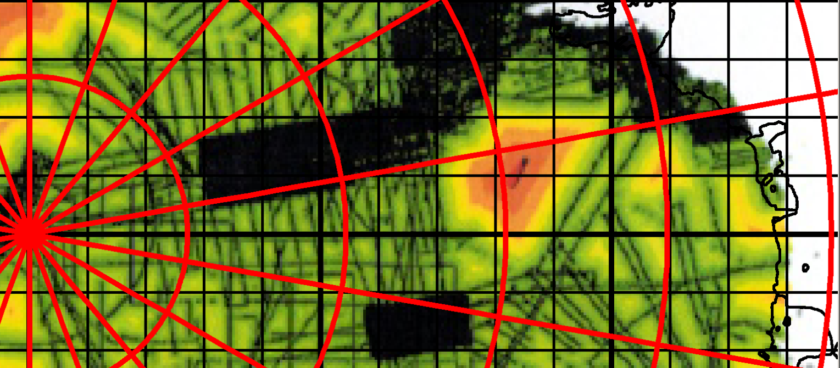

Slide 19
Examples of typical gravitational signal (trace, signature) of volcanoes

Slide 20
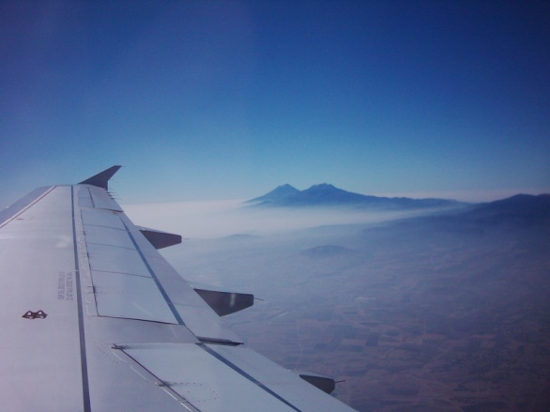
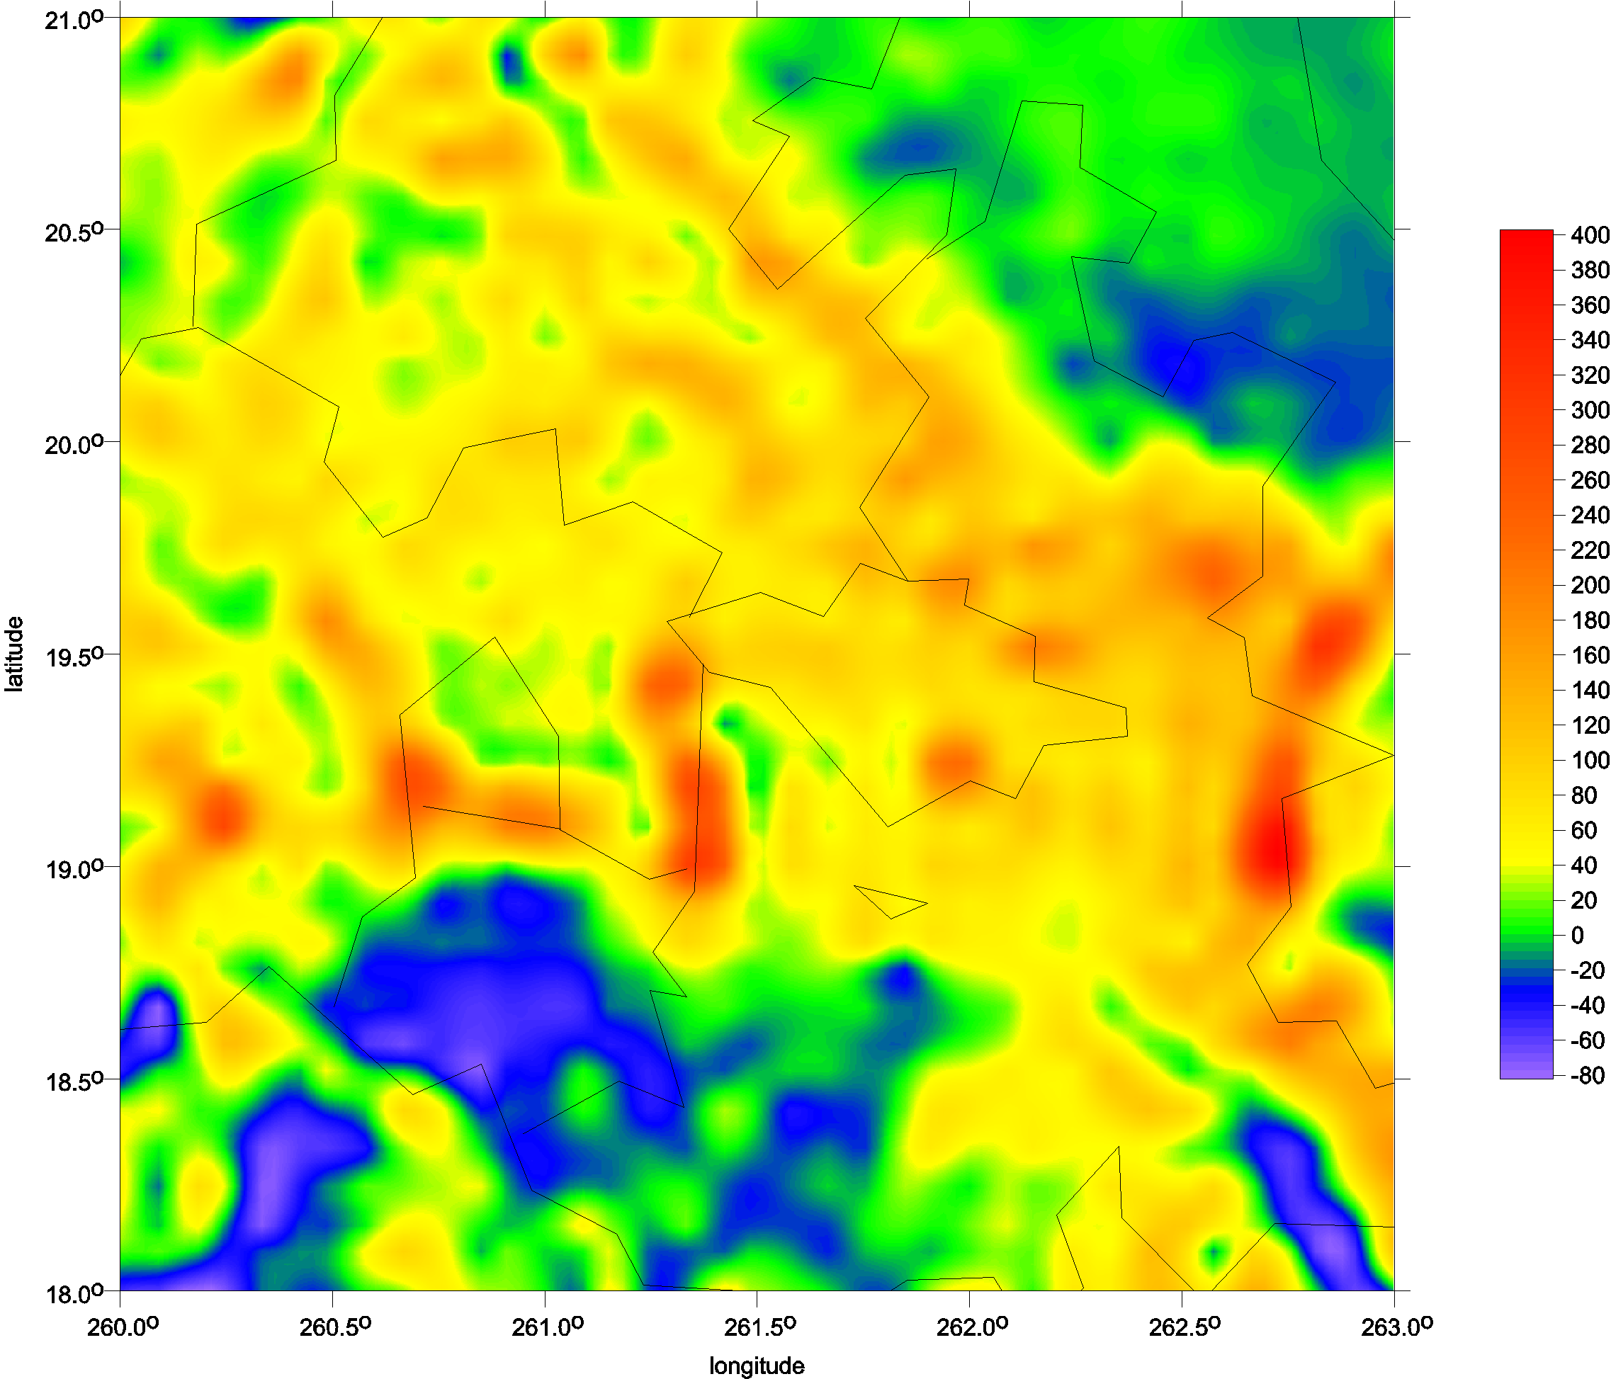
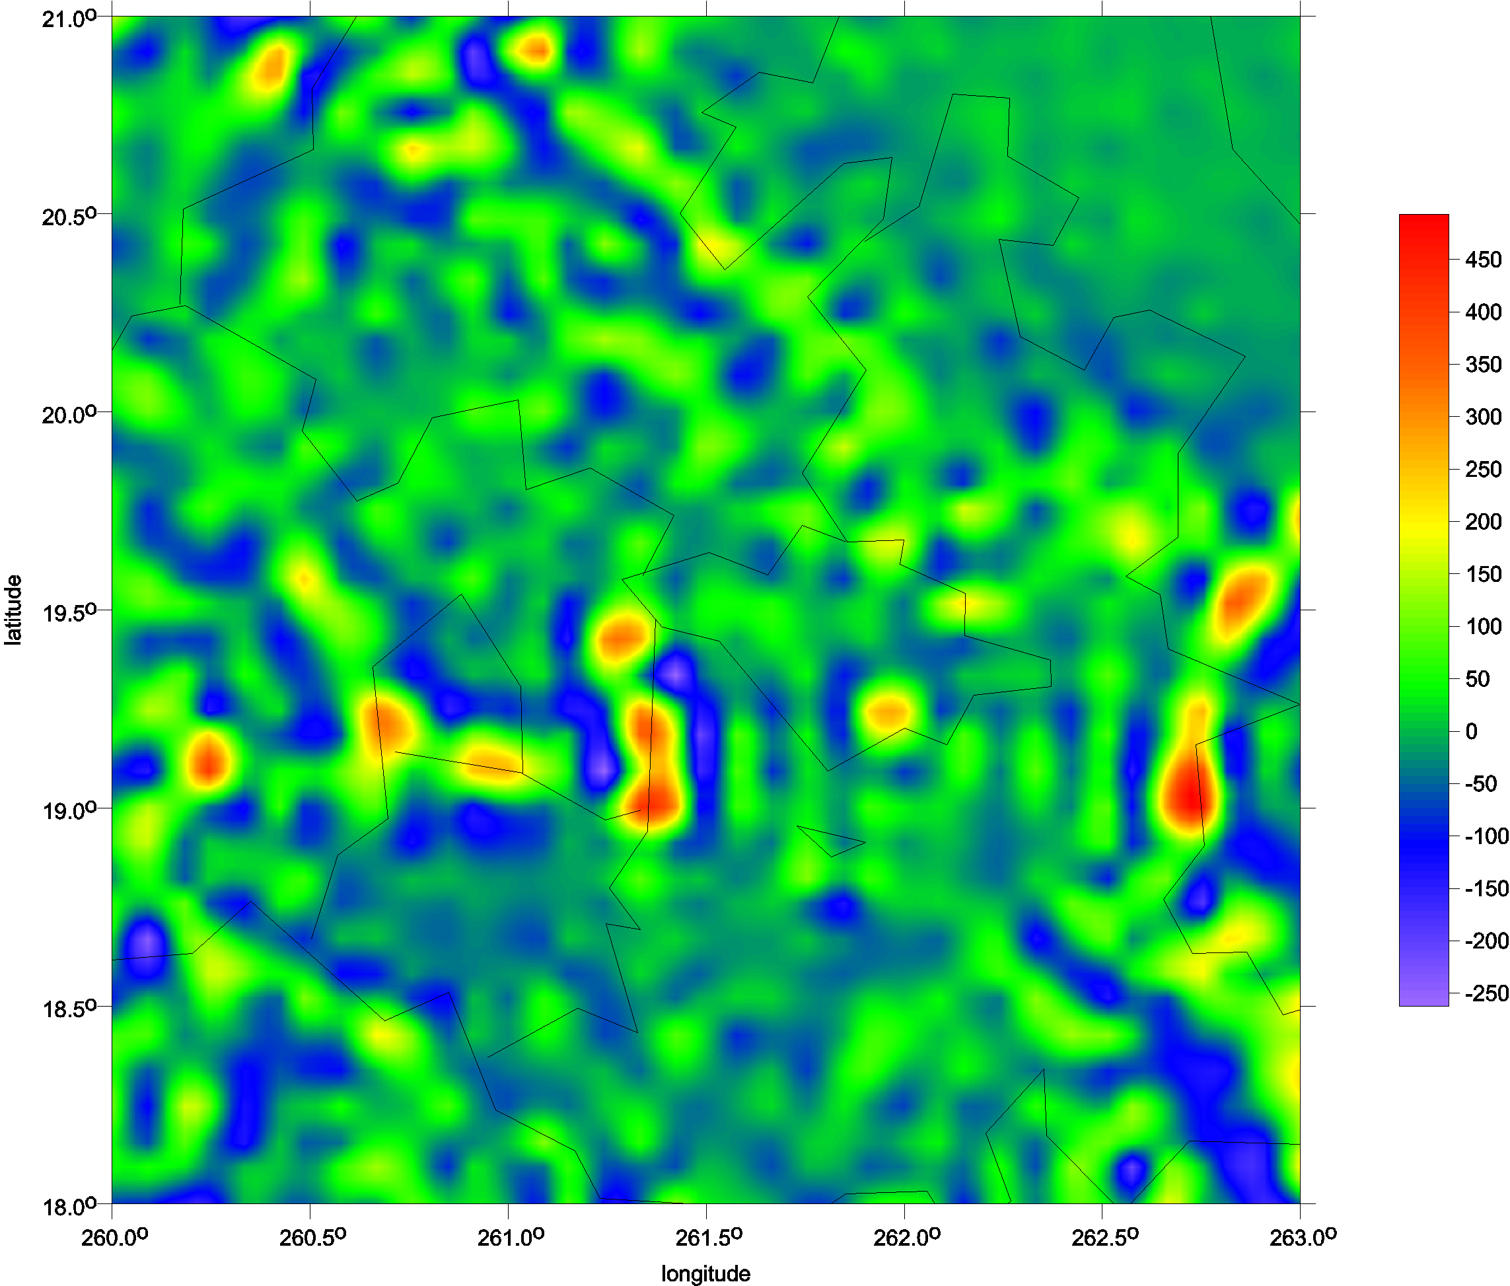
Typical volcanoes
Popokatepetl and Iztaccihuatl
Popocatepetl
Itzaccihuatl
∆g
T_{zz}

Slide 21
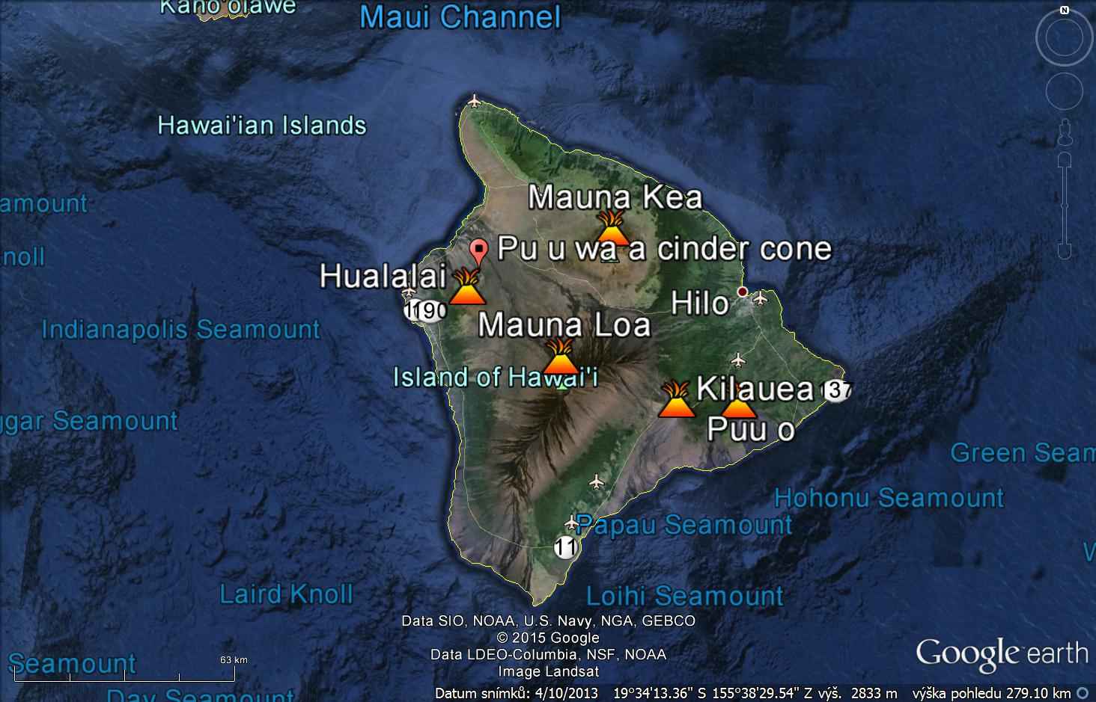
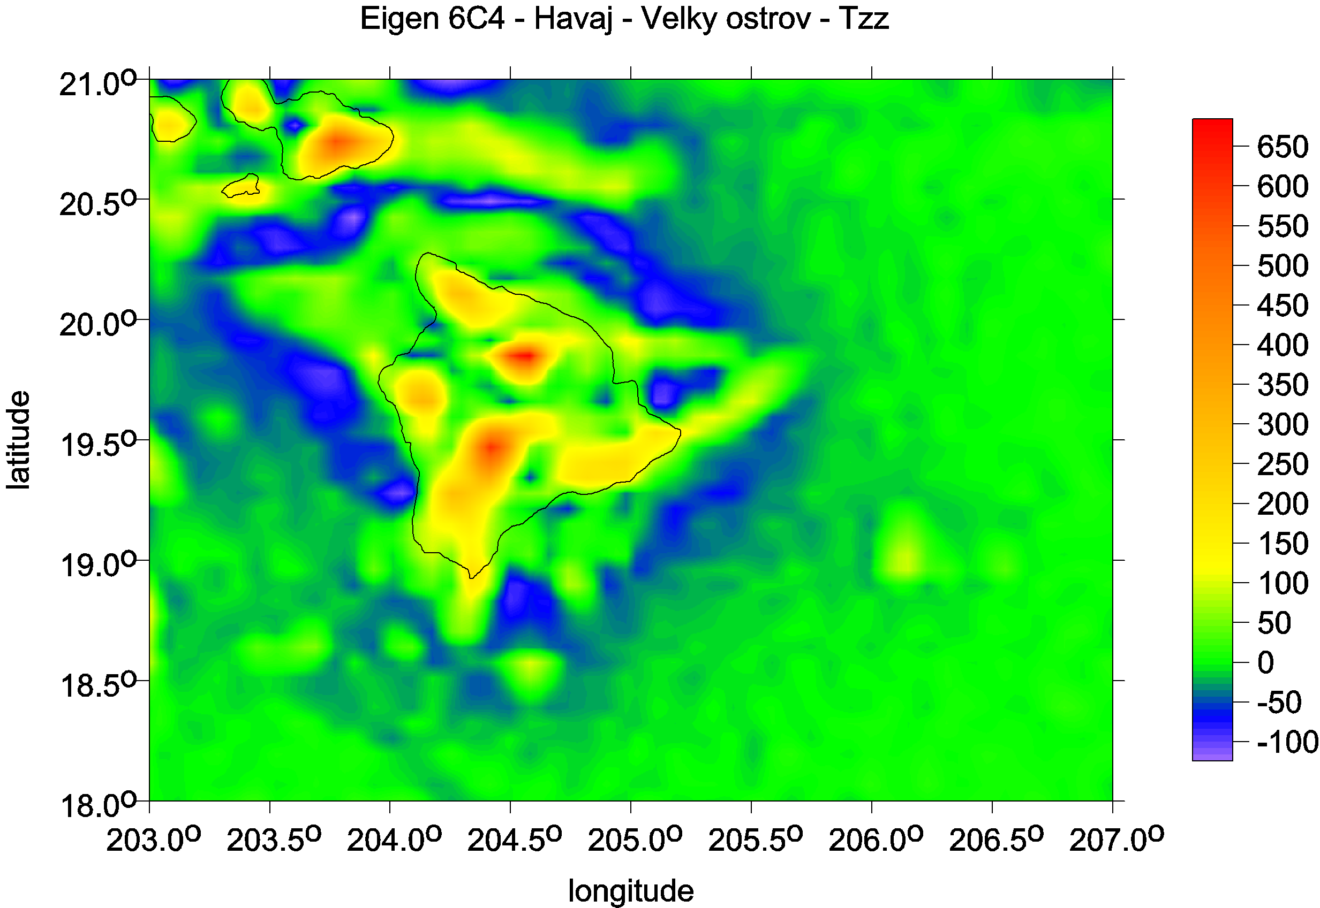
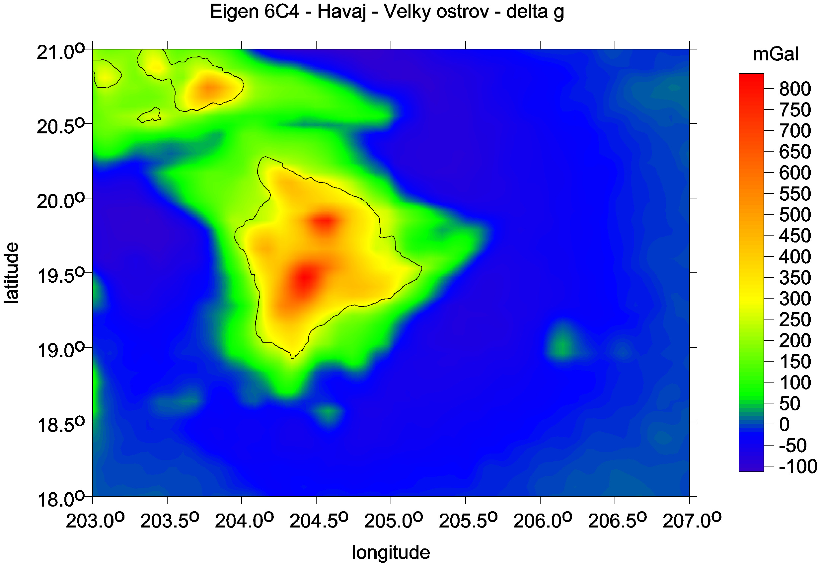
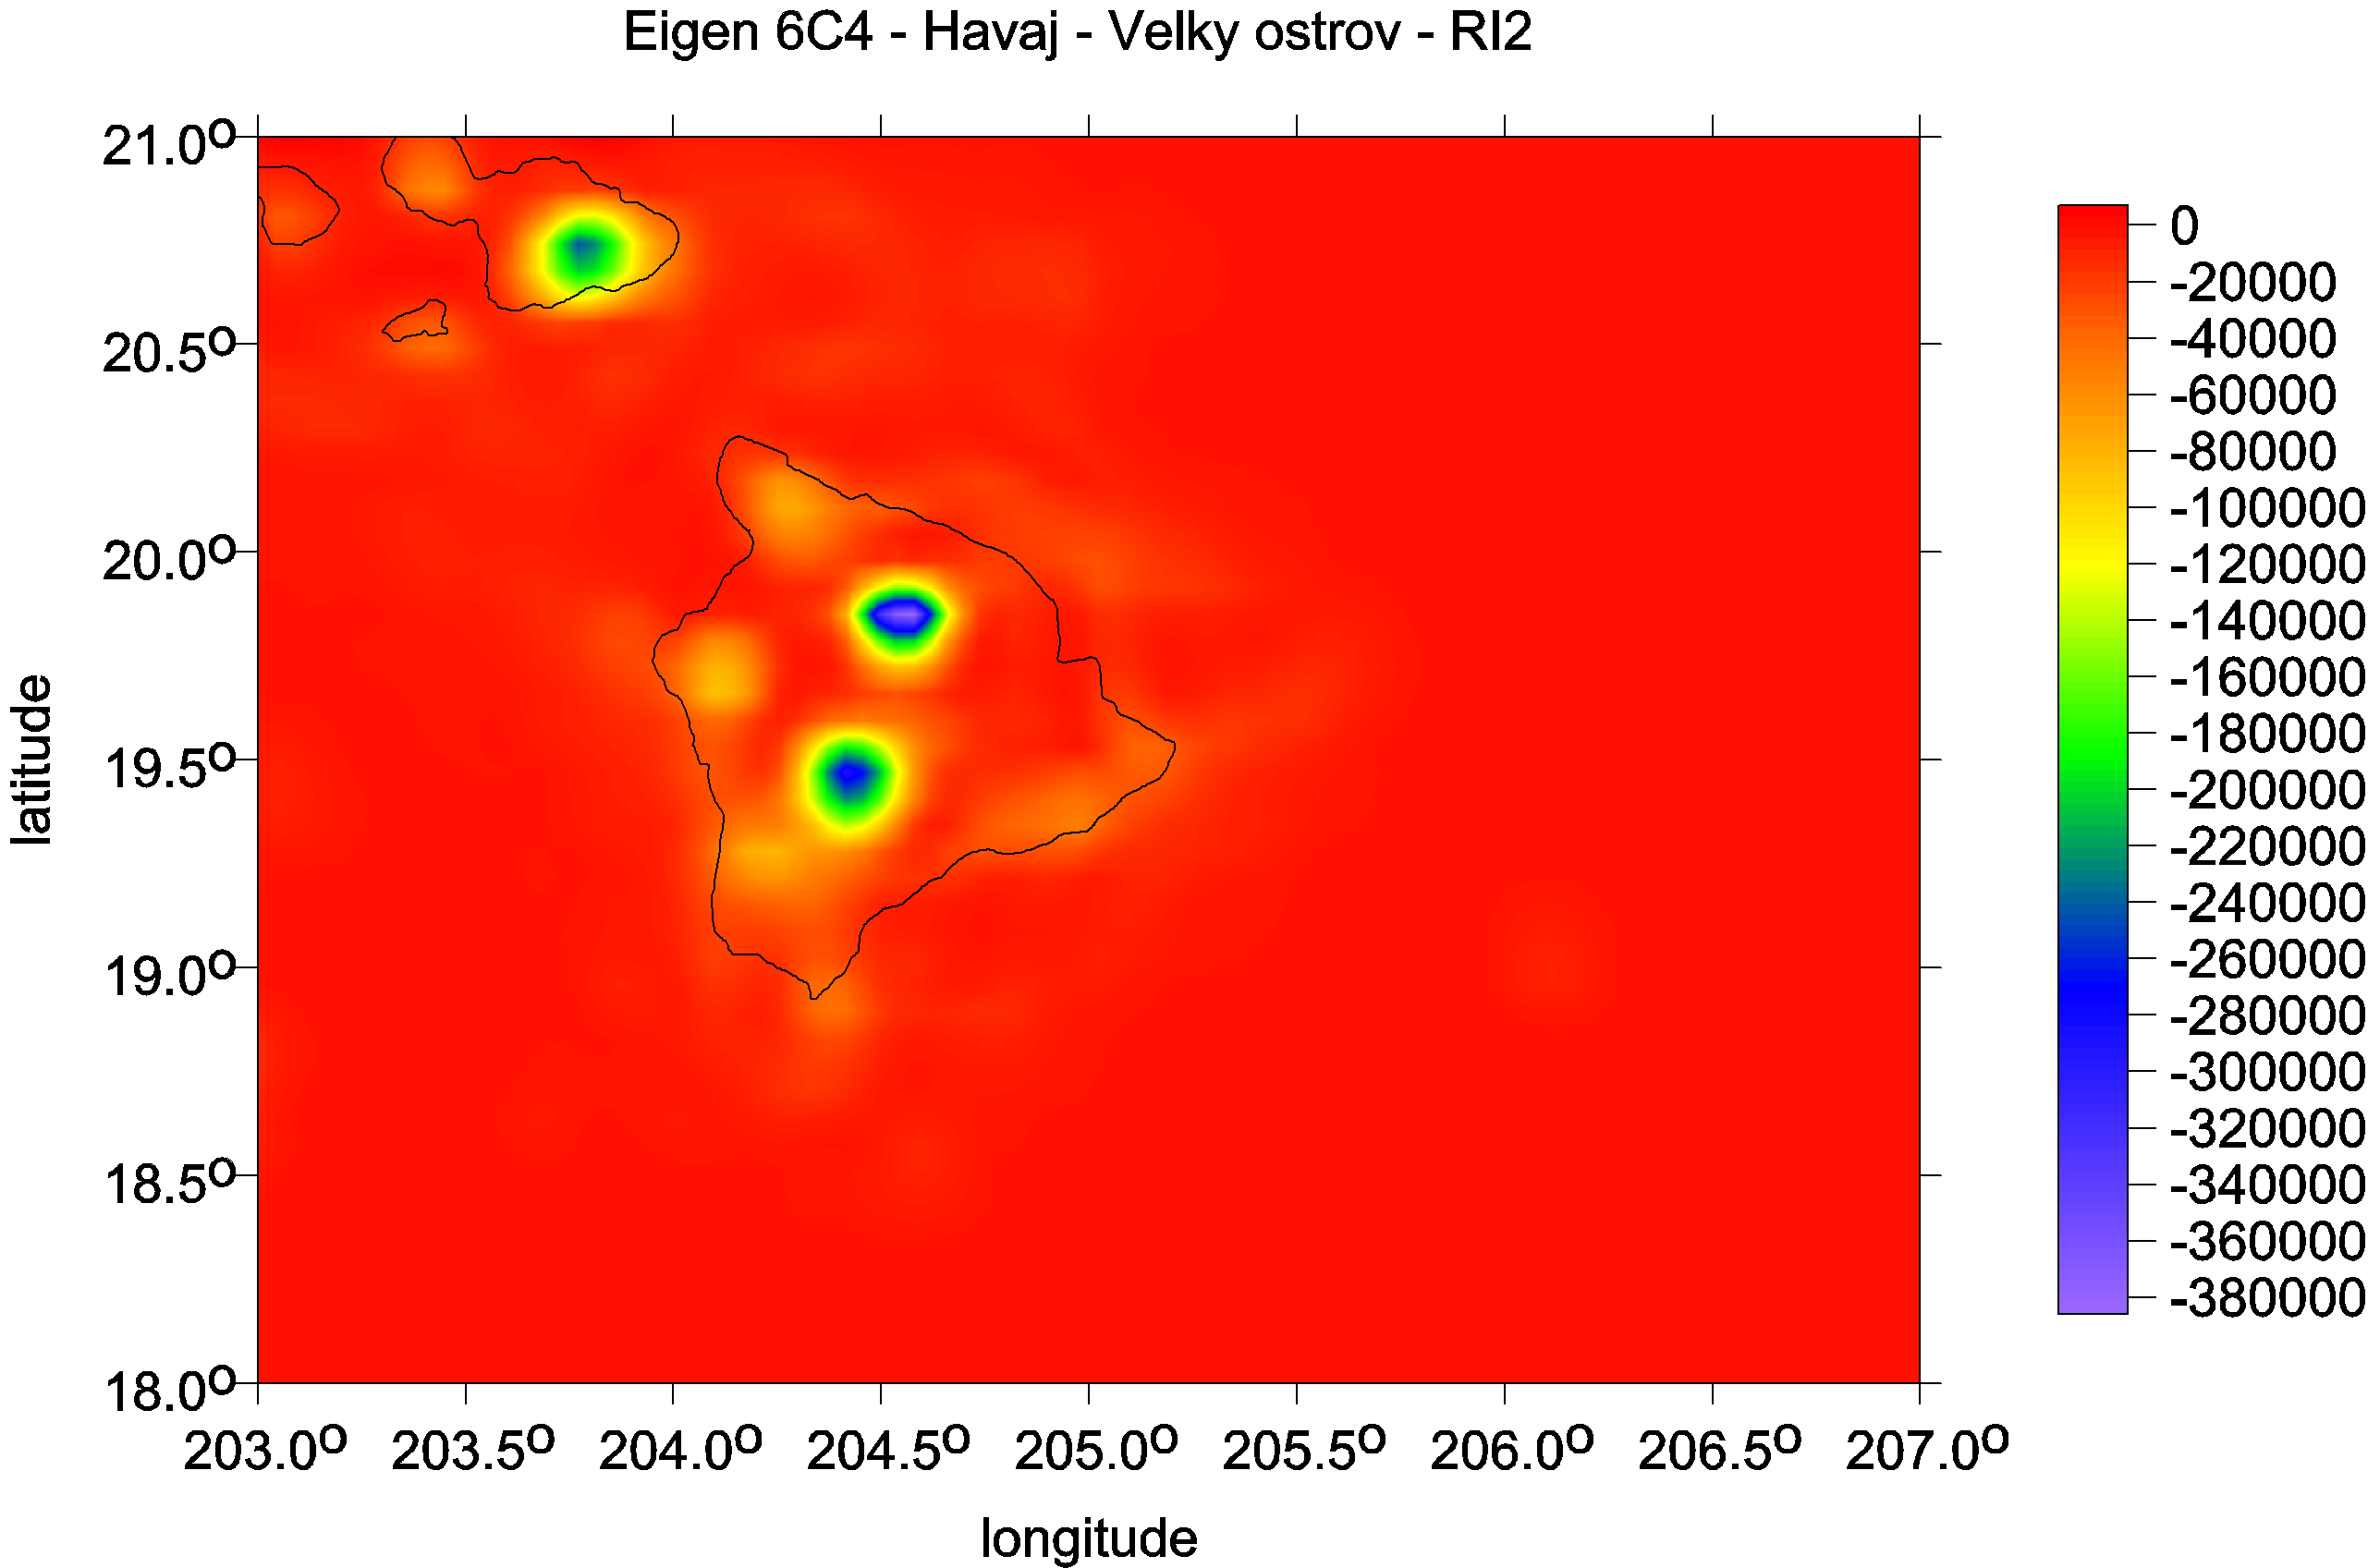
Hawai, the Big island

Slide 22
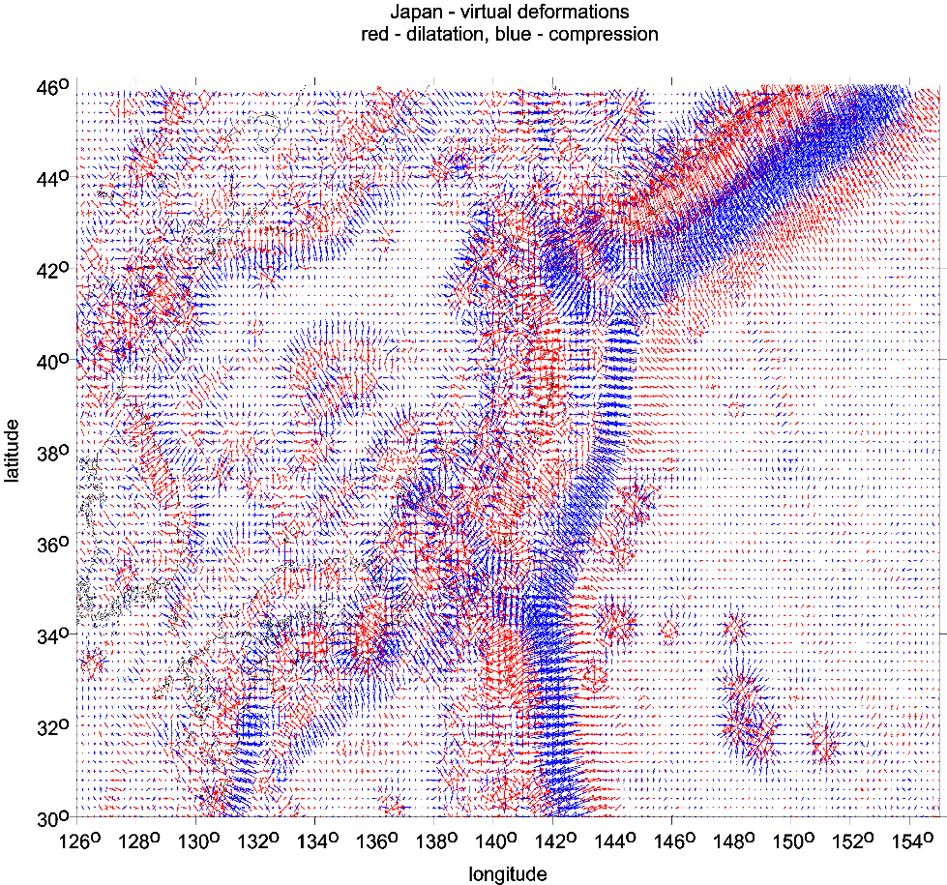
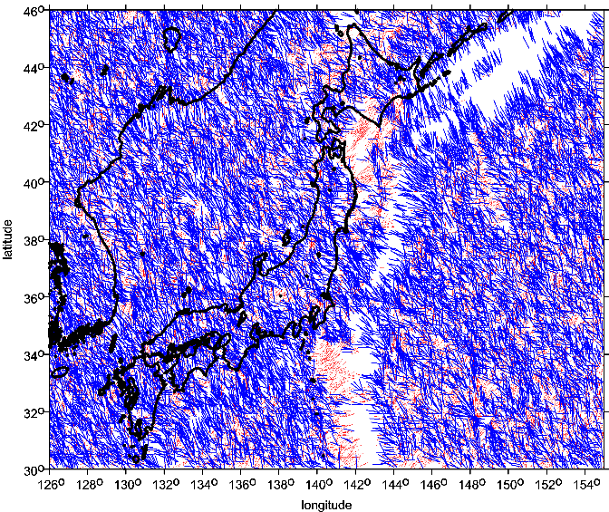
subduction zone, volcanoes under sea SE of Japan
virtual deformations
The strike angle θ_{S} for the ratio I > 0.3.

Slide 23
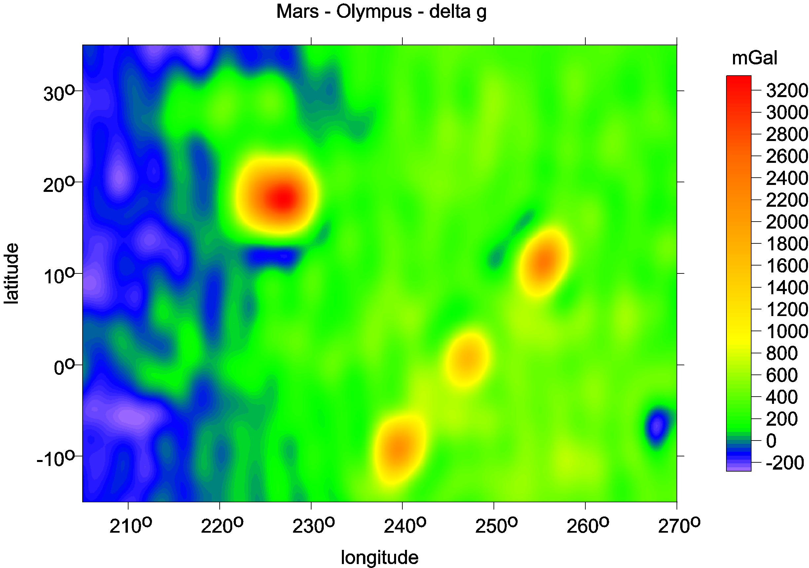
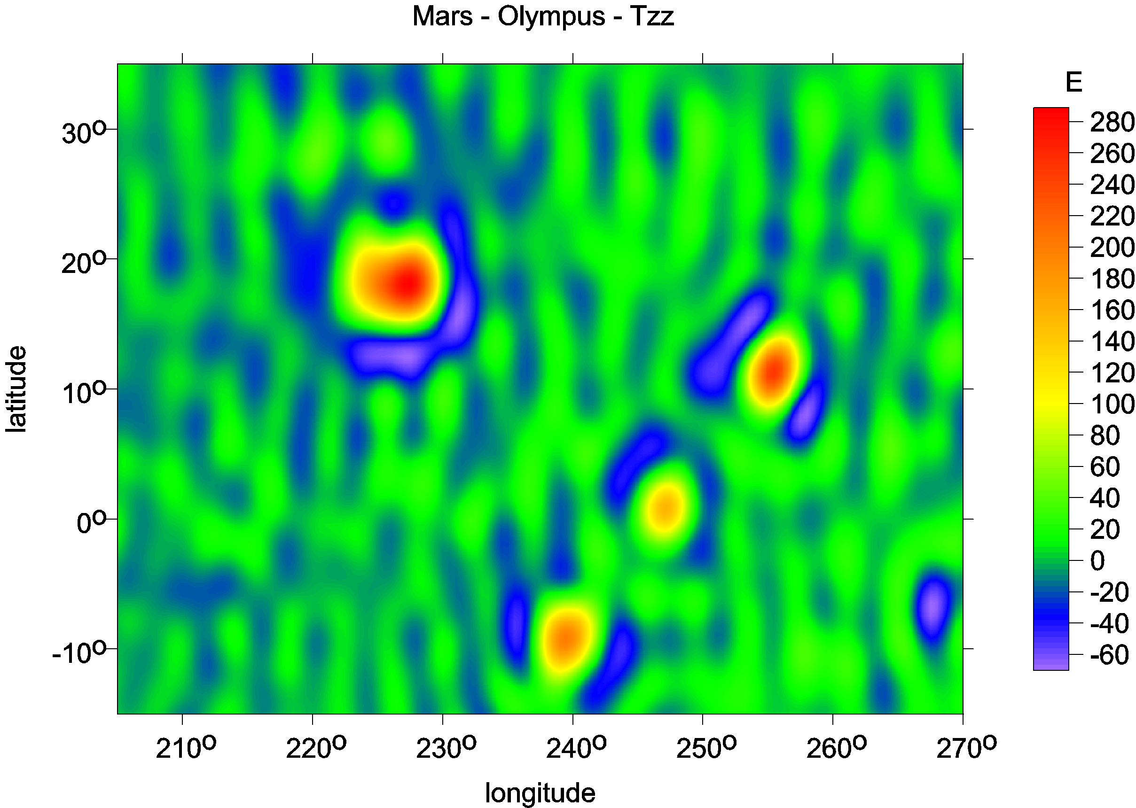
Mt Olymp, Mars
Marty et al,
potential to 95

Slide 24
Volcanoes in Antarctica
known and suspected

Slide 25
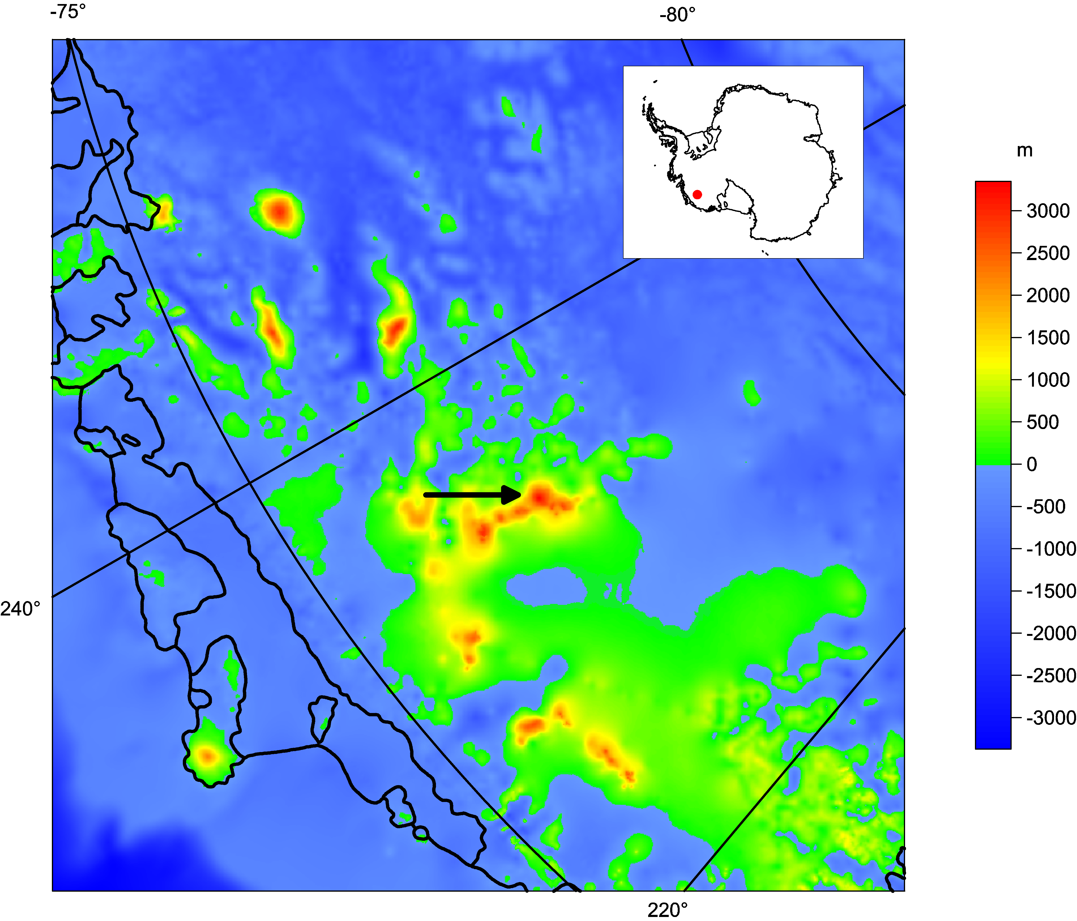

Slide 26
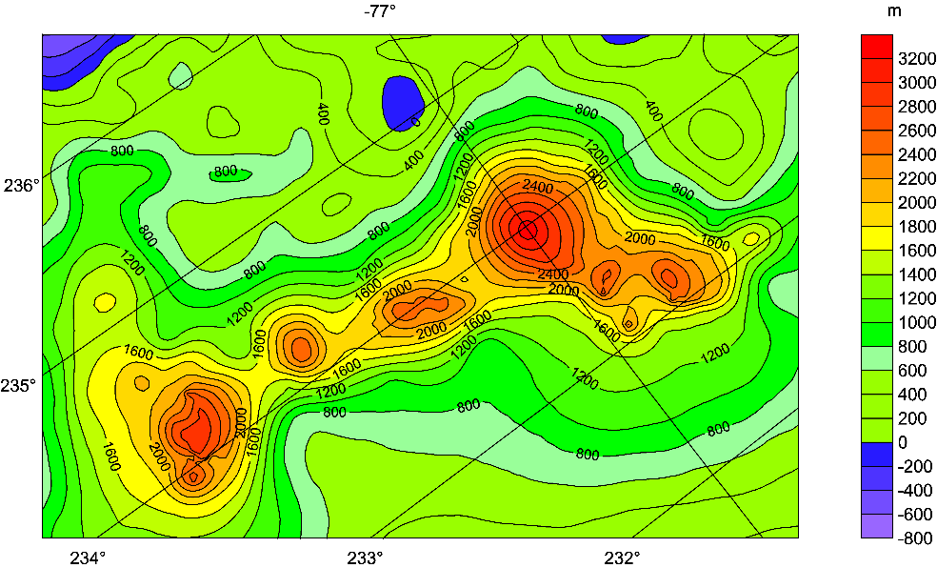
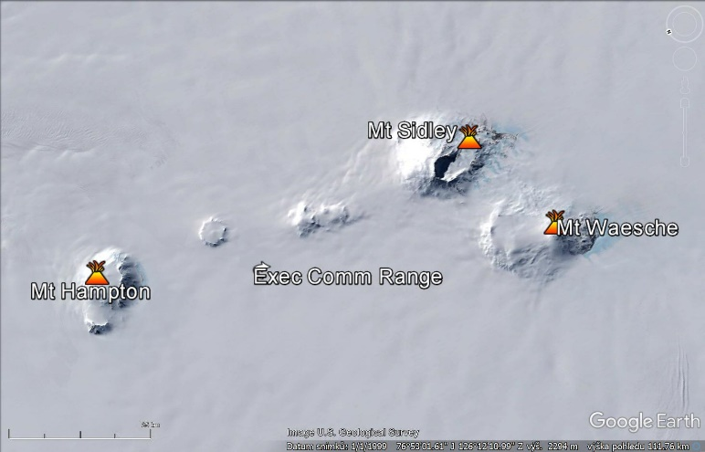
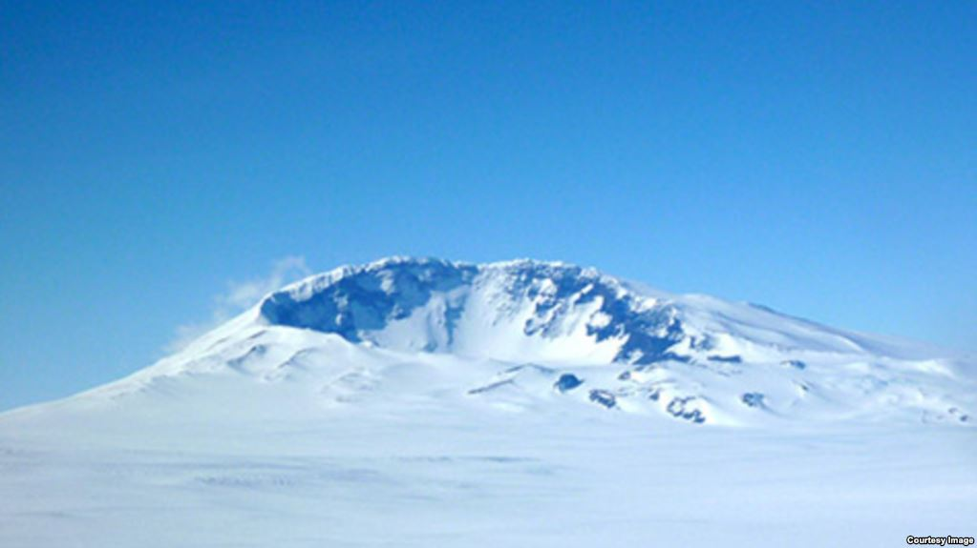
Bedmap 2 for the Executive Comm. Range with Mt Sidley (the largest mountain in the picture right up) [m asl].
VŠB-TUO
Mount Sidley, in Marie Byrd Land, is the largest volcano that rises above the surface of the ice. Seismologists has detected new volcanic activity under the ice about 60 km away. (Washington University)

Slide 27
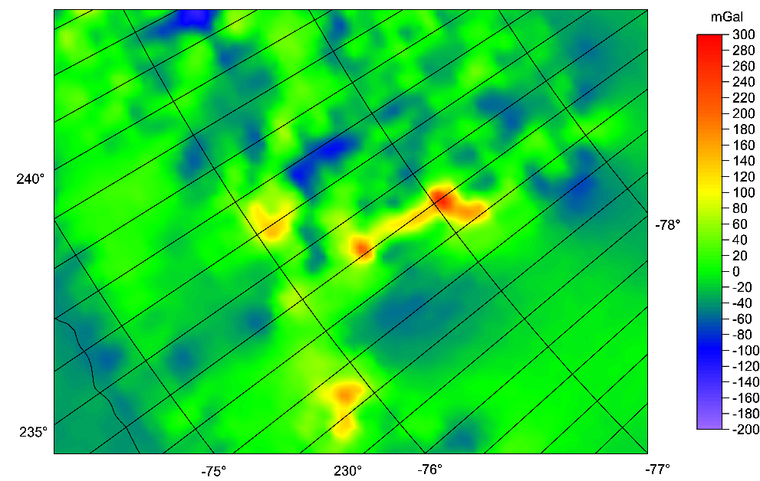
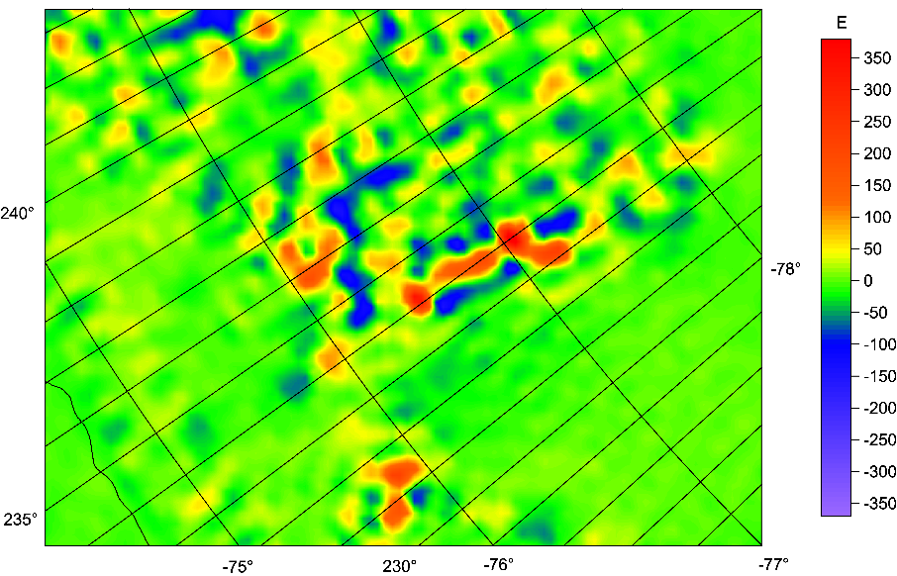

Slide 28
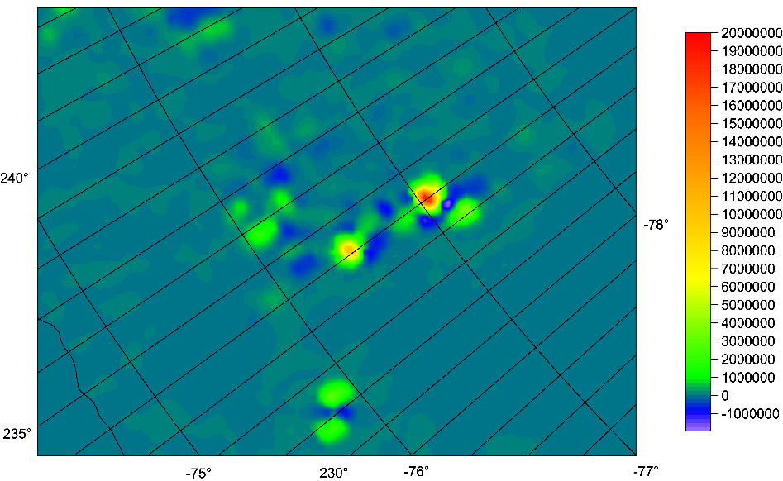
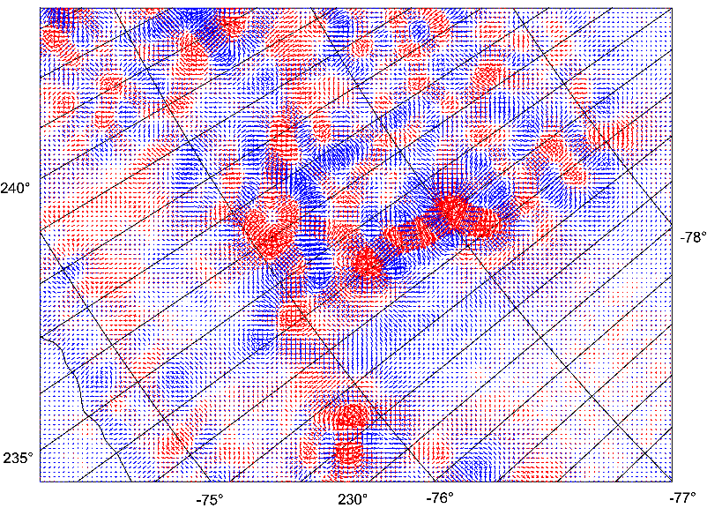

Slide 29
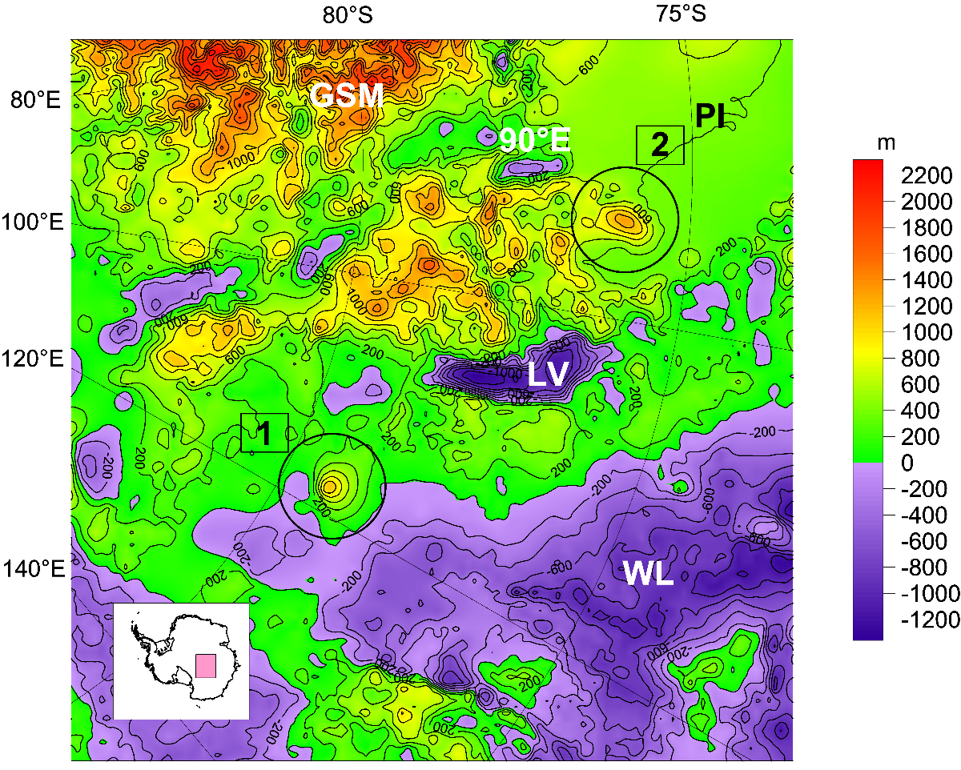
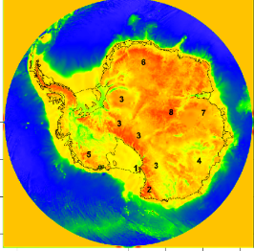
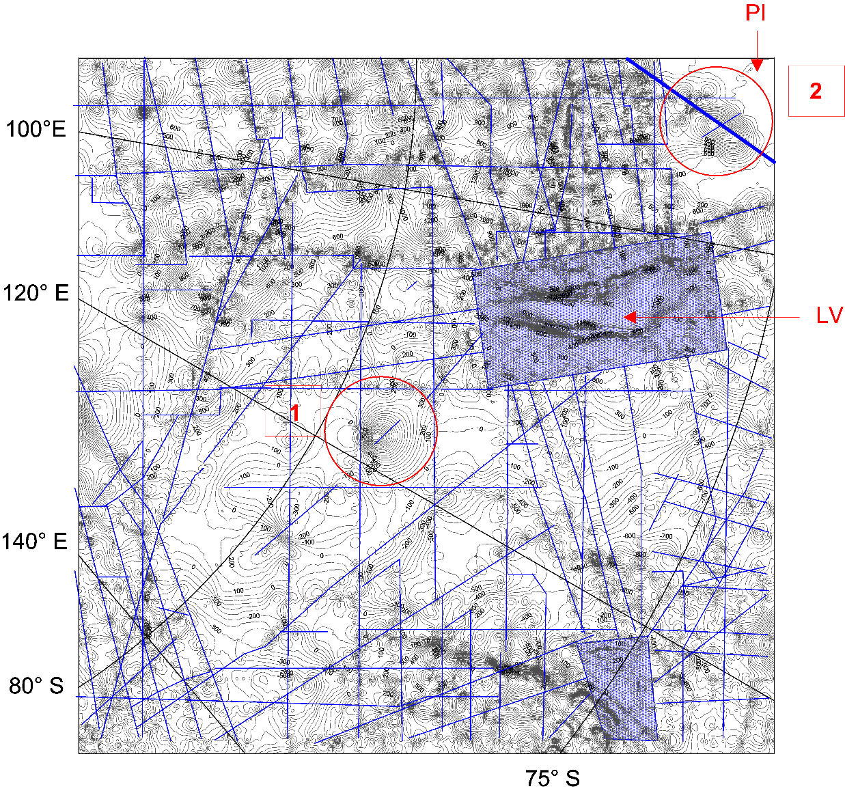
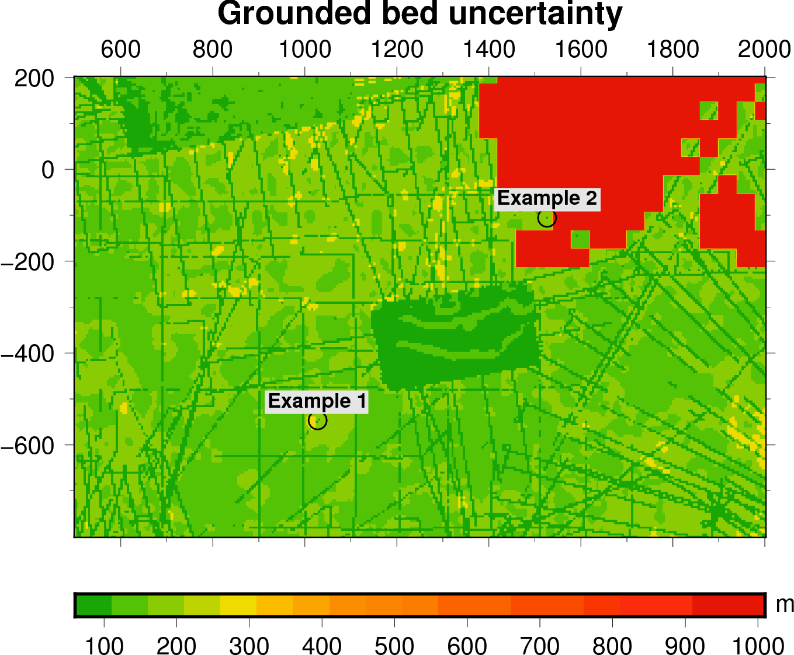
Subglacial volcanoes
Podledovcové sopky
Volcanoes in Antarctica
known and suspected

Slide 30
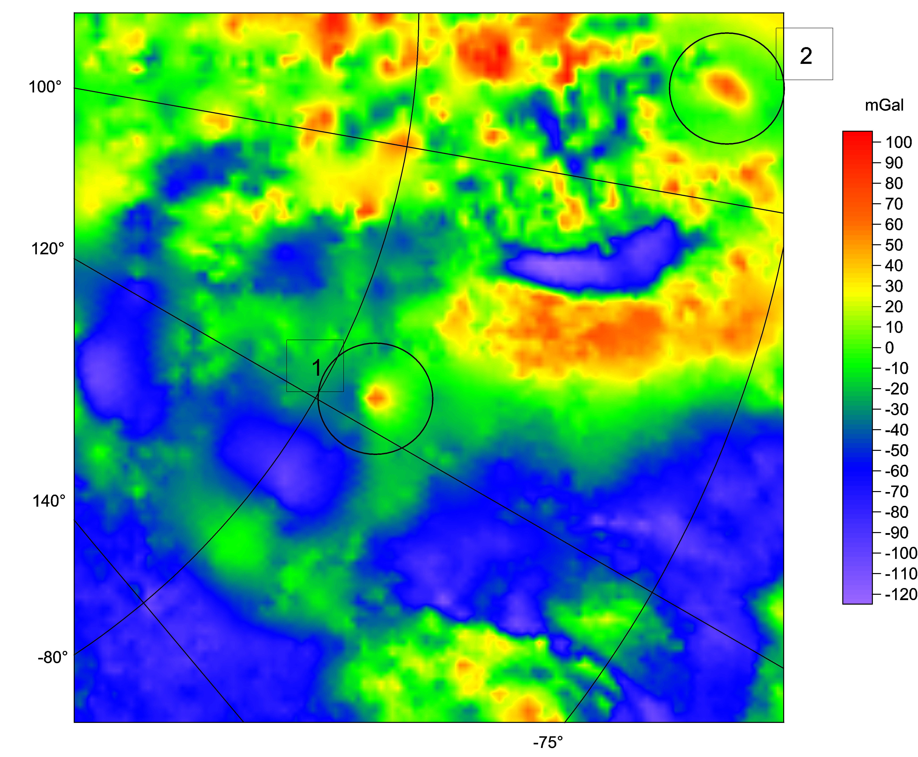

Slide 31
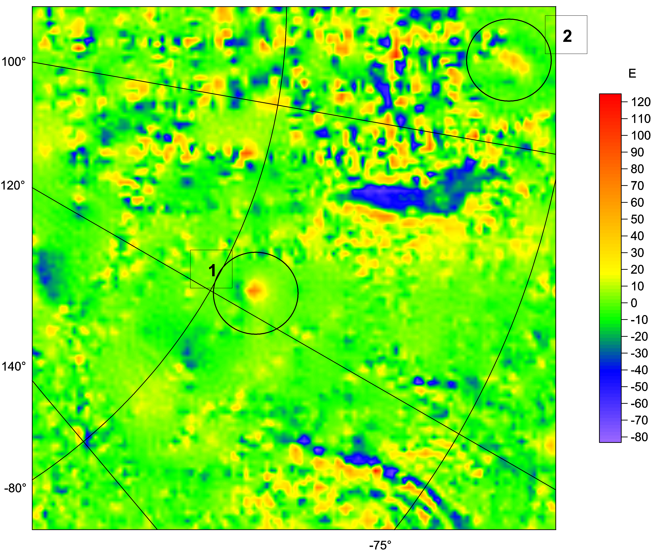

Slide 32
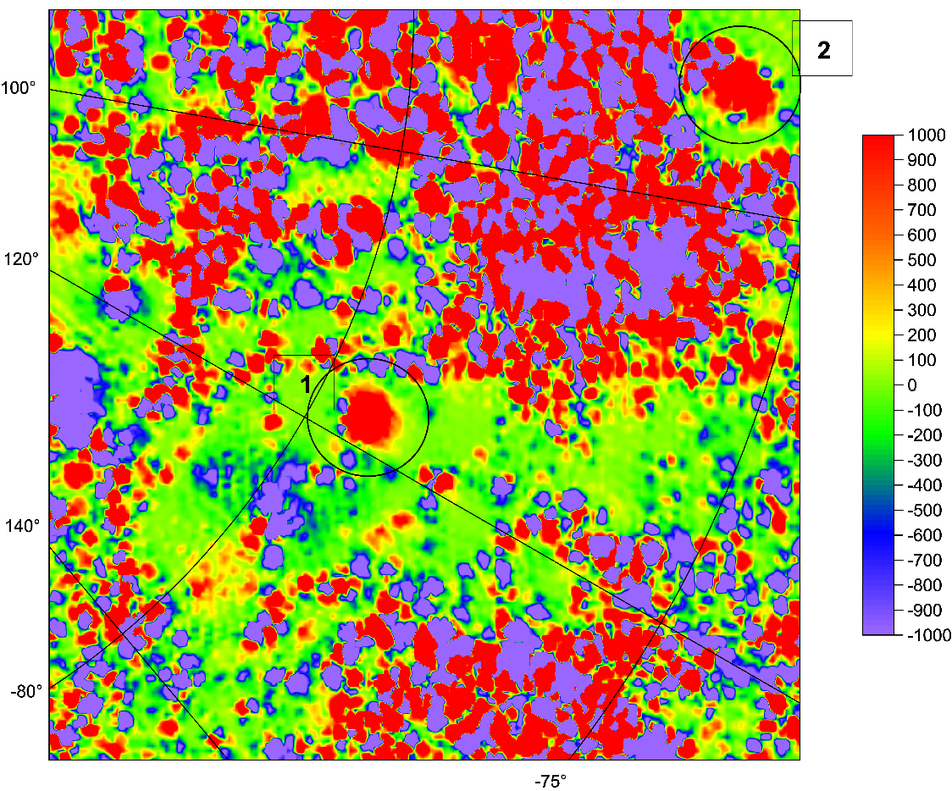
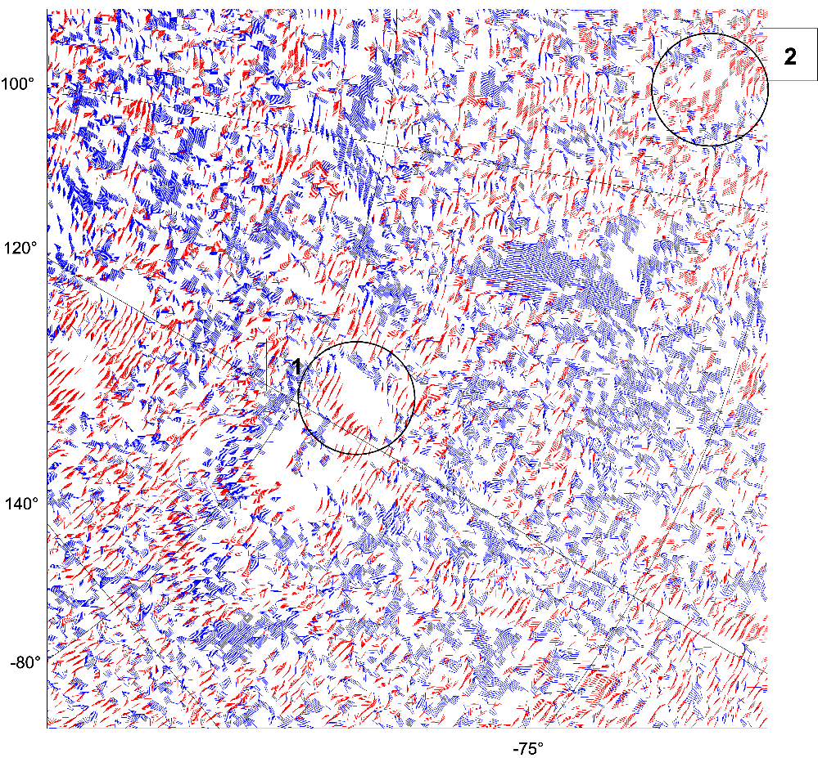

Slide 33
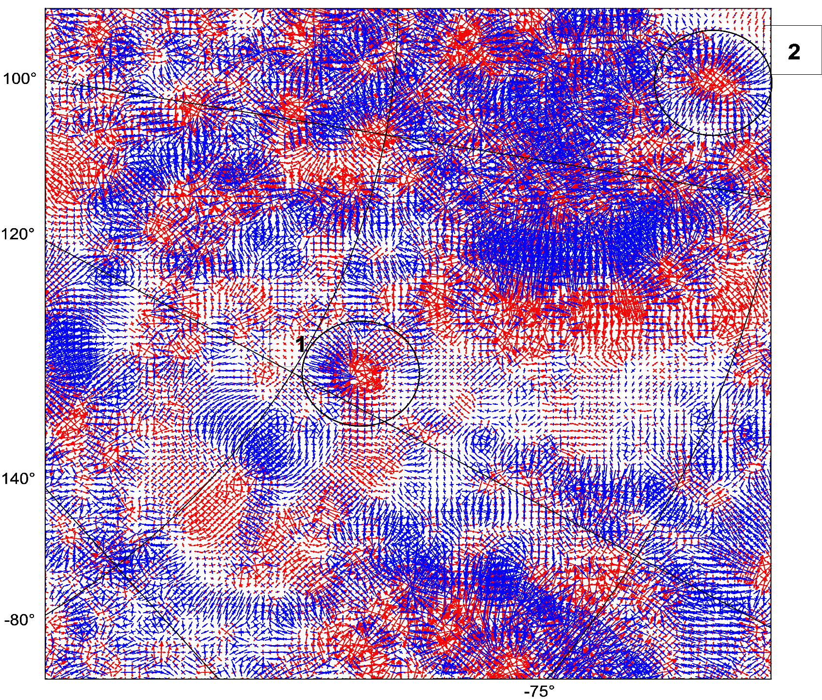

Slide 34
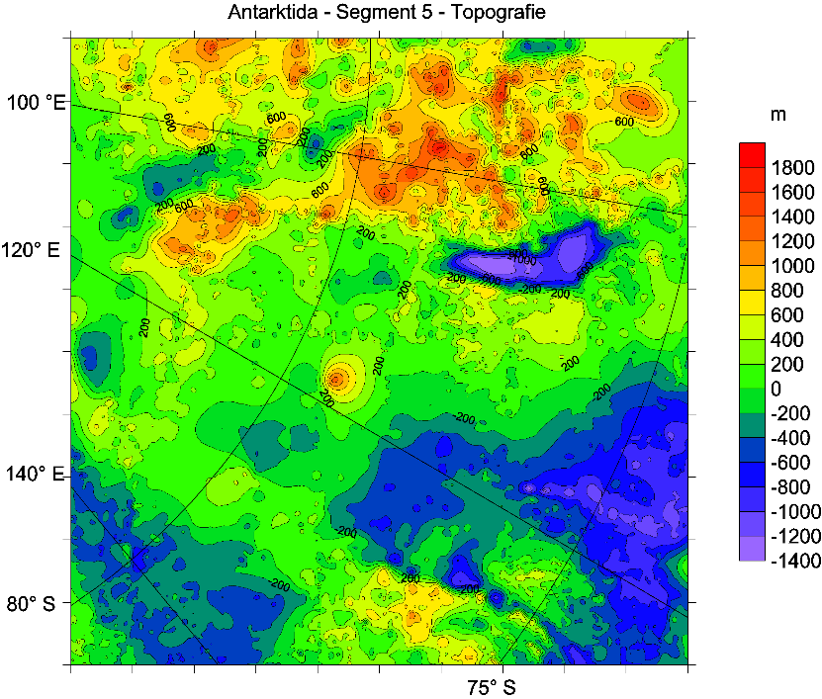
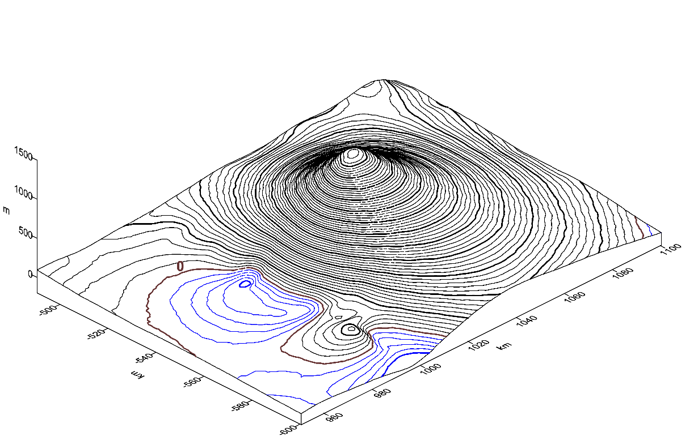
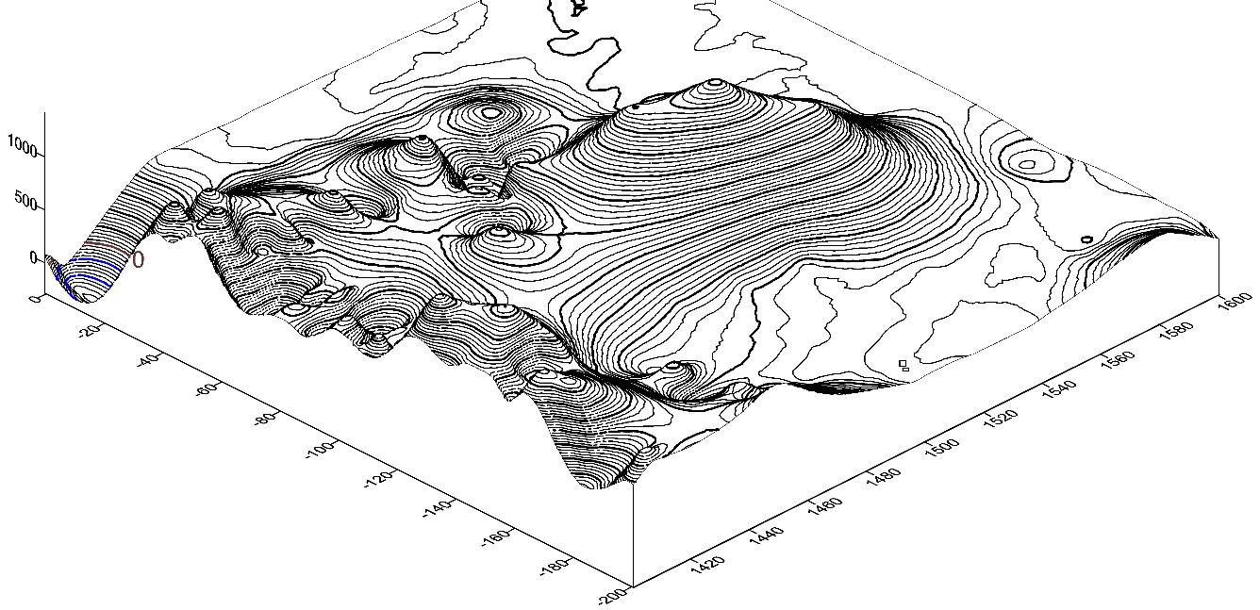
Example 1
Geographic coordinates: φ = 79⁰ 19‘ S, λ = 118⁰ 00‘ E, h = 2.3 km
Name of candidate: Dana.
Example 2
Geographic coordinates: φ = 75⁰ 59‘ S, λ = 93⁰ 57‘ E, h = 2.5 km
Name of candidate: Zuzana.

Slide 35
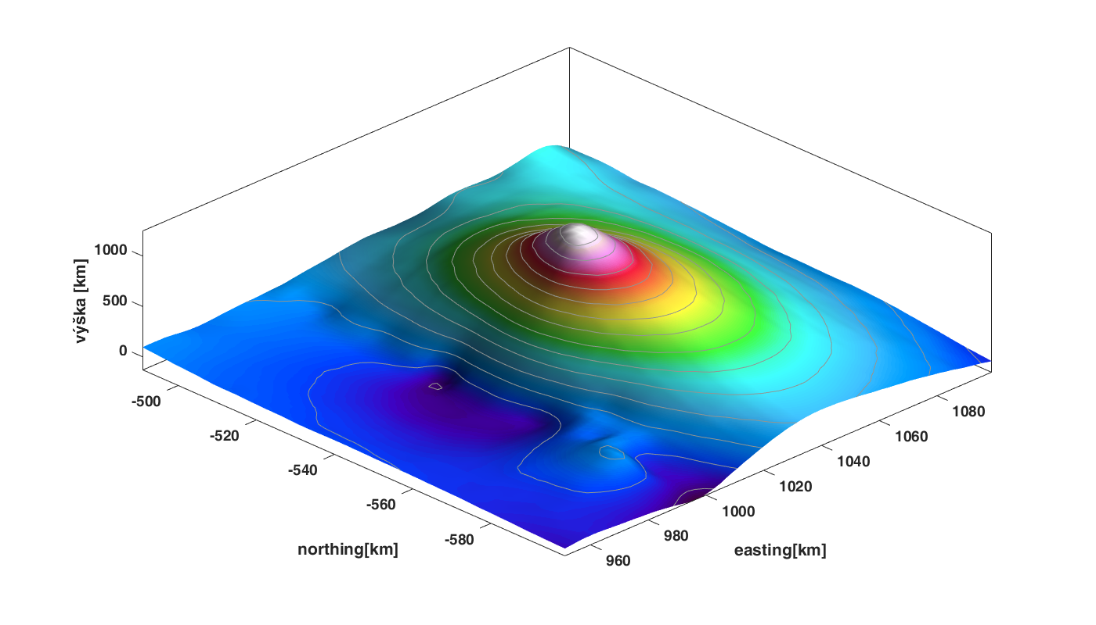

Slide 36
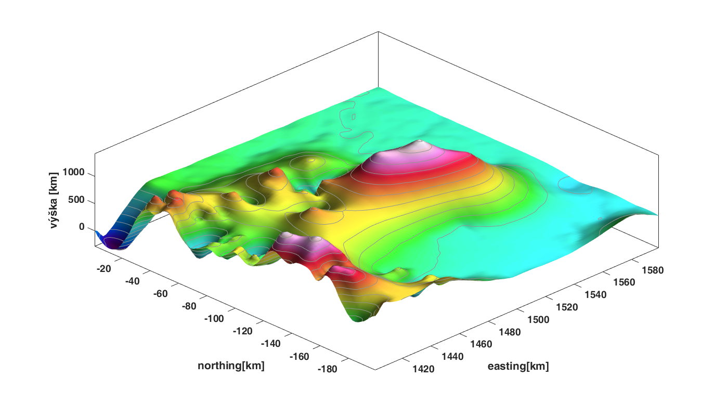

Slide 37


jklokocn@asu.cas.cz
www.asu.cas.cz/~jklokocn
www.asu.cas.cz/~jklokocn/ANTARKTIDA

