Slide 1
Chicxulub and Popigai
after 15 years*
double or multiple impact craters?
* Klokočník J., Kostelecký J., Pešek I., Novák P., Wagner C.A., Sebera J. 2010. Candidates for multiple impact craters?: Popigai and Chicxulub as seen by the global high resolution gravitational field model EGM08, Solid Earth EGU 1, 71-83; DOI: 10.5194/se-1-71-2010. See also: Is Chicxulub a double impact crater? 6th EGU A. von Humboldt Interntl. Conf. on Climate Change, Natural Hazards, and Societies, Mérida, México, Section: The Cretaceous/Tertiary Boundary and the Chicxulub Impact Crater, paper AvH6-5, 15 March 2010.

Slide 2


Supplement 2
Tutorial
© ASU & RIGTC

Slide 3
Gravitational aspects (descriptors)
Gravity aspect | Explanation
T | Disturbing static gravitational potential
Δg | Gravity anomaly or perturbation (various versions)
Γ | Marussi tensor (just 5 independent second derivatives of T)
T_{zz} | Element of the Marussi tensor (second derivative of T in the radial direction), usually most important
I_{j} | 3 gravity invariants of the Γ (I₀, I₁, I₂); preserved under any coordinate rotation
I | a ratio of I₁, I₂; when I~0, the causative body is ~2D; when I →1, causative body is 3D
θ | Strike angle is the main direction of Γ, under certain conditions
vd | Virtual deformation based on horizontal derivatives of T in latitudinal and longitudinal directions, expressing dilatation and pure sheer (compression)

Slide 4

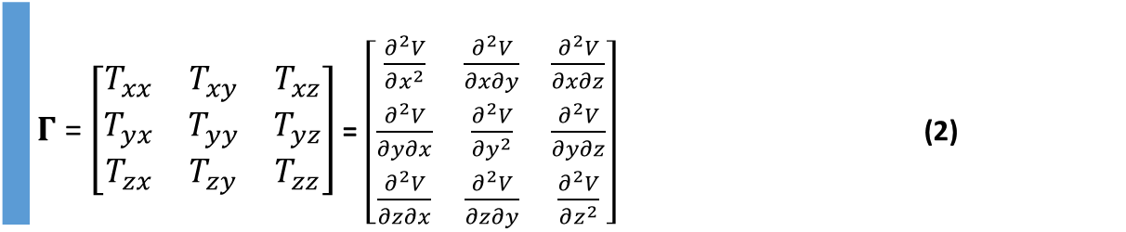
Disturbing static gravitational potential outside the Earth masses in spherical harmonic expansion
 | $$T\left(r,φ,λ\right)=\frac{GM}{r}\sum_{l=2}^{∞}{\sum_{m=0}^{l}{{\left(\frac{R}{r}\right)}^{l}\left({C^{′}}_{l,m}cos mλ+S_{l,m}sin mλ \right)}} P_{l,m}\left(sin φ\right)$$
where GM is a product of the universal gravitational constant and the mass of the Earth (also known as
the geocentric gravitational constant), r is the radial distance of an external point where T is computed,
R is the radius of the Earth (which can be approximated by the semi-major axis of a reference ellipsoid),
P_{l,m} (sin φ) are the Legendre associated functions, l and m are the degree and order of the harmonic expansion,
(φ, λ) are the geocentric latitude and longitude, C’_{l,m} and S_{l,m} are the harmonic geopotential coefficients
(Stokes parameters), fully normalized, C’_{l,m} = C_{l,m} – C^{el}_{l,m}, where C^{el}_{l,m} belongs to the reference ellipsoid.
The spherical approximation of the gravity anomaly Δg is computed
$∆g=−\frac{∂T}{∂r}−2\frac{T}{r}$
or one can use the gravity disturbance (it is the same but without the second term).
Gravity gradient tensor Γ (the Marussi tensor) is a tensor of the second derivatives of
the disturbing potential T:
 | $Γ$ = $\left[\begin{matrix}T_{xx} & T_{xy} & T_{xz} \\ T_{yx} & T_{yy} & T_{yz} \\ T_{zx} & T_{zy} & T_{zz}\end{matrix}\right]$ = $\left[\begin{matrix}\frac{∂^{2}V}{∂x^{2}} & \frac{∂^{2}V}{∂x∂y} & \frac{∂^{2}V}{∂x∂z} \\ \frac{∂^{2}V}{∂y∂x} & \frac{∂^{2}V}{∂y^{2}} & \frac{∂^{2}V}{∂y∂z} \\ \frac{∂^{2}V}{∂z∂x} & \frac{∂^{2}V}{∂z∂y} & \frac{∂^{2}V}{∂z^{2}}\end{matrix}\right]$ (2)
Notes:
Legendre associated functions,… free-air gravity anomaly, gravity disturbance

Slide 5
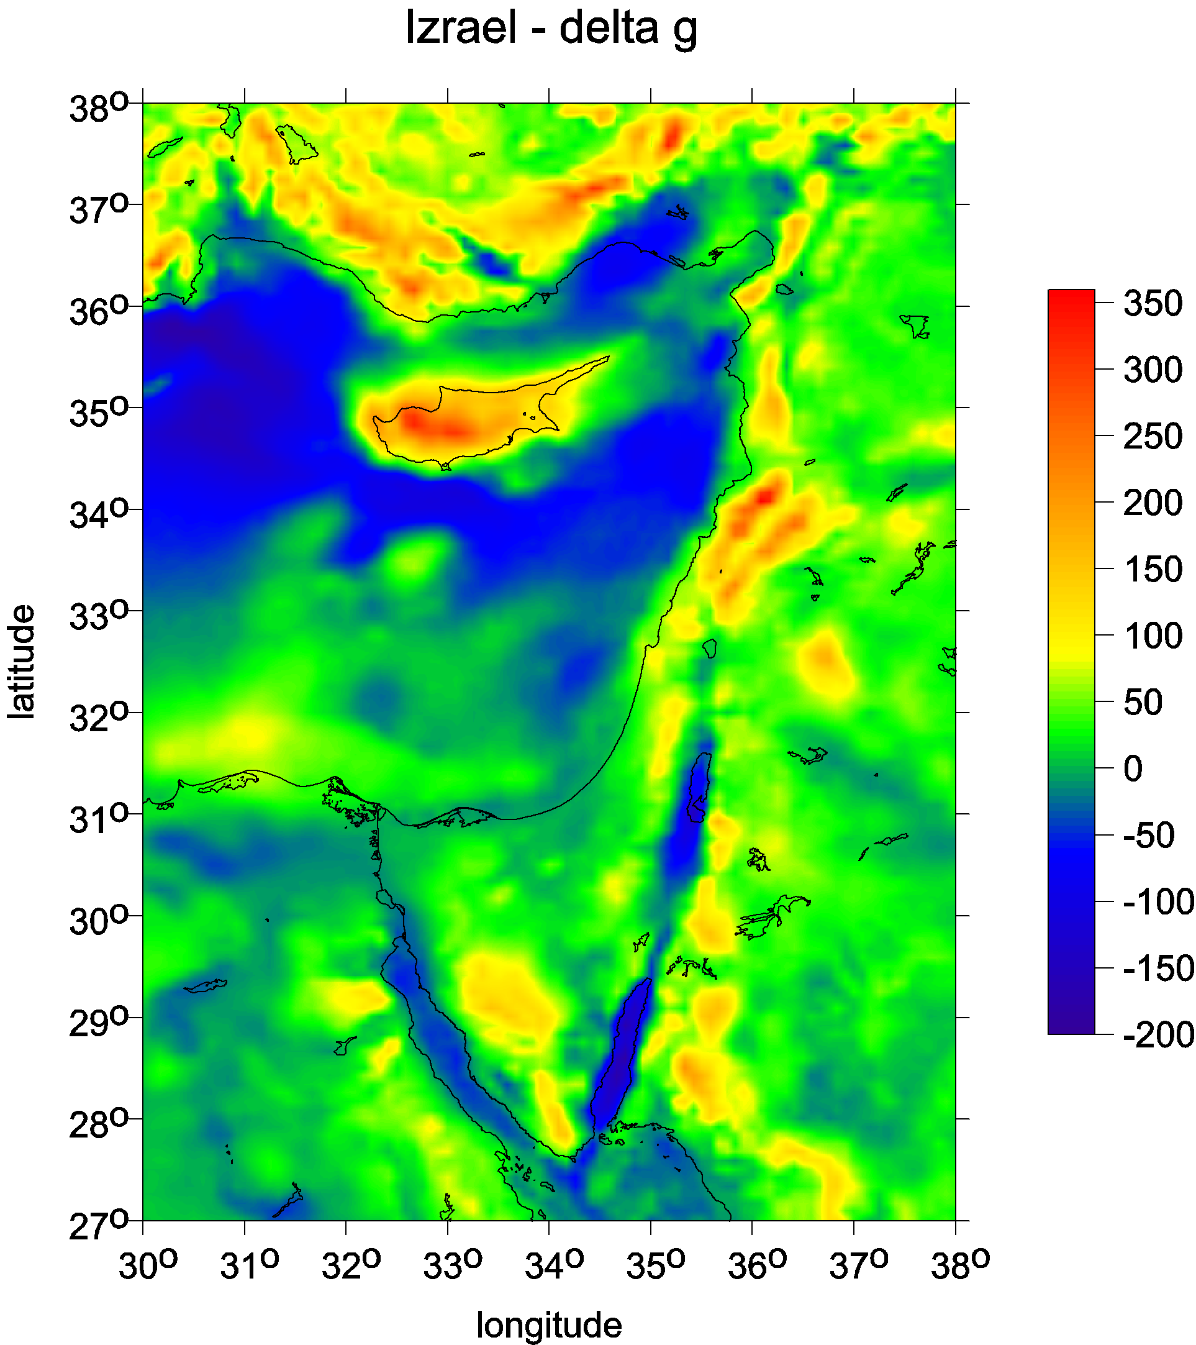
example ∆g
[mGal]

Slide 6
∆g
full
Marussi tensor
A.H.Saad, The Leading Edge, 942-950, Aug. 2006

Slide 7
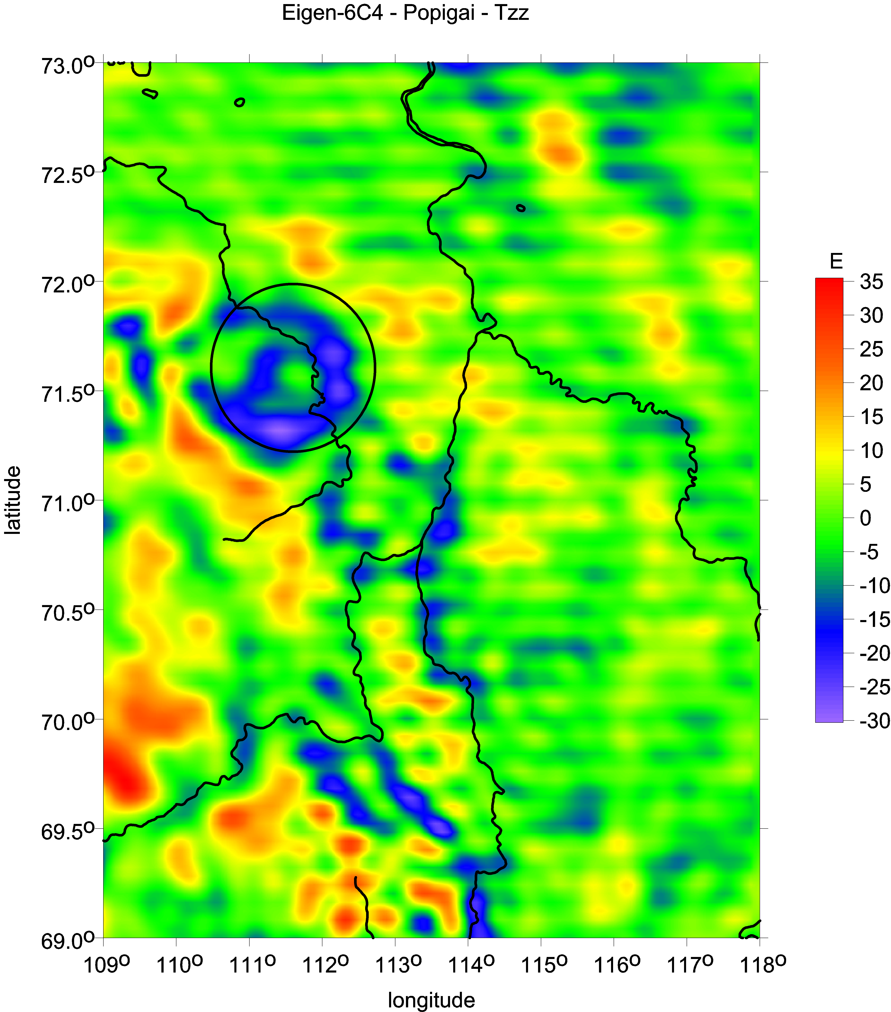

Slide 8


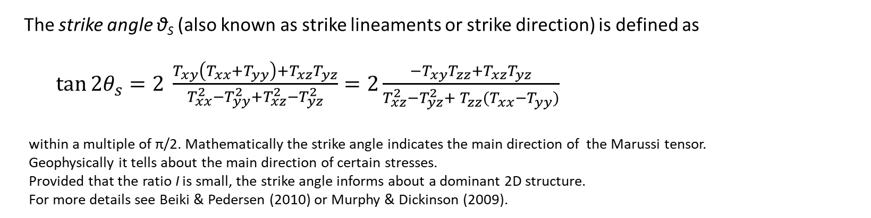
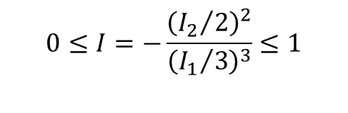
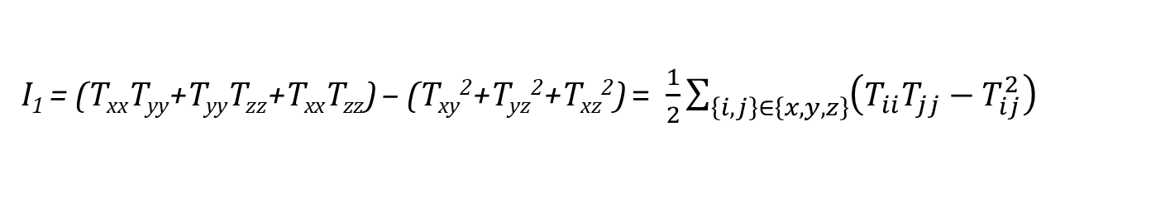
Under any coordinate transformation, Γ preserves
just 3 INVARIANTs
$I_{0}=trace \left(Γ\right)=T_{xx}+T_{yy}+T_{zz}=$ 0
I₁ = (T_{xx}T_{yy}+T_{yy}T_{zz}+T_{xx}T_{zz}) – (T_{xy}²+T_{yz}²+T_{xz}²) = $\frac{1}{2}\sum_{\left\{i,j\right\}∈\left\{x,y,z\right\}}{{\left(T_{ii}T_{jj}−T_{ij}^{2}\right)}_{}}$
I₂ = det (Г) = (T_{xx}(T_{yy}T_{zz}-T_{yz}²) + T_{xy}(T_{yz}T_{xz} – T_{xy}T_{zz}) + T_{xz} (T_{xy}T_{yz}-T_{xz}T_{yy}).
Pedersen & Rasmussen (1990) showed that
the ratio I of I₁ and I₂ (dimensionless) defined as
$$0≤I=−\frac{{\left({I_{2}}/2\right)}^{2}}{{\left({I_{1}}/3\right)}^{3}}≤1$$
lies between 0 and 1 for any potential field. If the causative body is strictly 2D, then I = 0.
The strike angle θ_{S} (also known as strike lineaments or strike direction) is defined as
$\tan{2θ_{s}}=2 \frac{T_{xy}\left(T_{xx}+T_{yy}\right)+T_{xz}T_{yz}}{T_{xx}^{2}−T_{yy}^{2}+T_{xz}^{2}−T_{yz}^{2}}=2\frac{{−T}_{xy}T_{zz}+T_{xz}T_{yz}}{T_{xz}^{2}−T_{yz}^{2}+{{ T}_{zz}^{}(T}_{xx}^{}−T_{yy}^{})}$
within a multiple of π/2. Mathematically the strike angle indicates the main direction of the Marussi tensor.
Geophysically it tells about the main direction of certain stresses.
Provided that the ratio I is small, the strike angle informs about a dominant 2D structure.
For more details see Beiki & Pedersen (2010) or Murphy & Dickinson (2009).

Slide 9
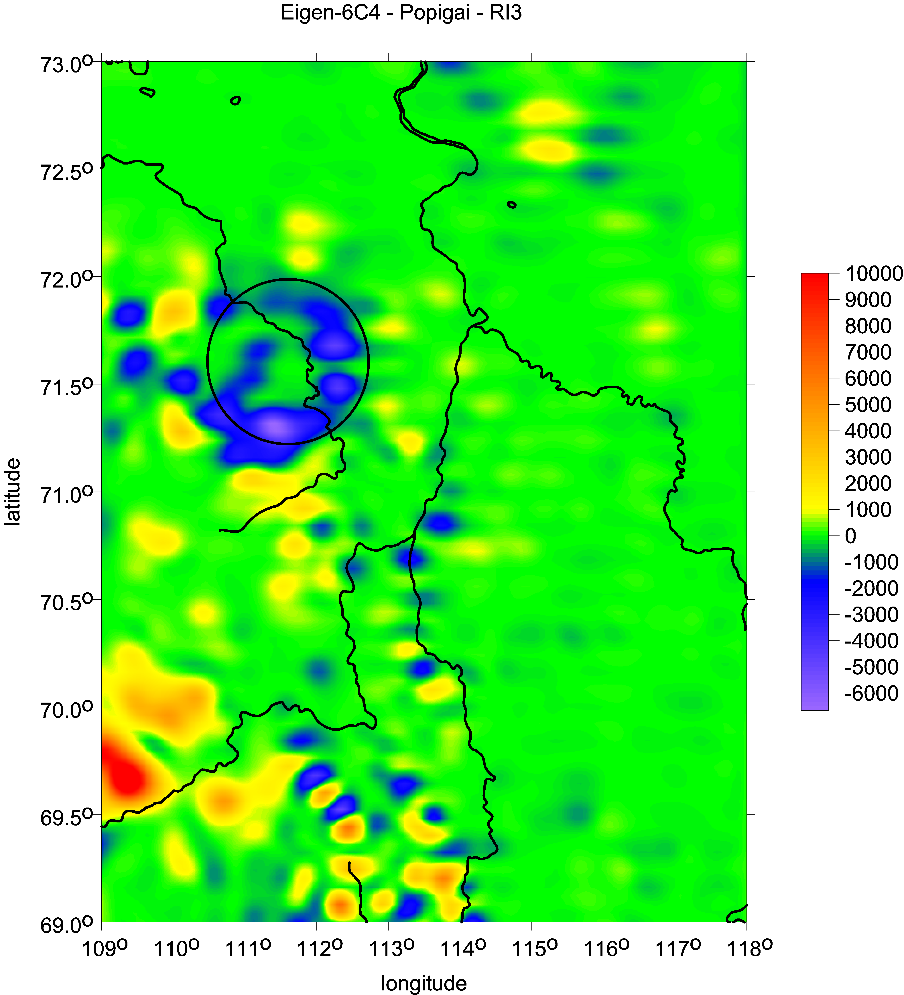
example
invariant
I2
[s-6]
example of strike angles θ [deg]
impact crater Vredefort, South Africa
halo from the combed strike angles
impact
crater
Popigai
Siberia

Slide 10
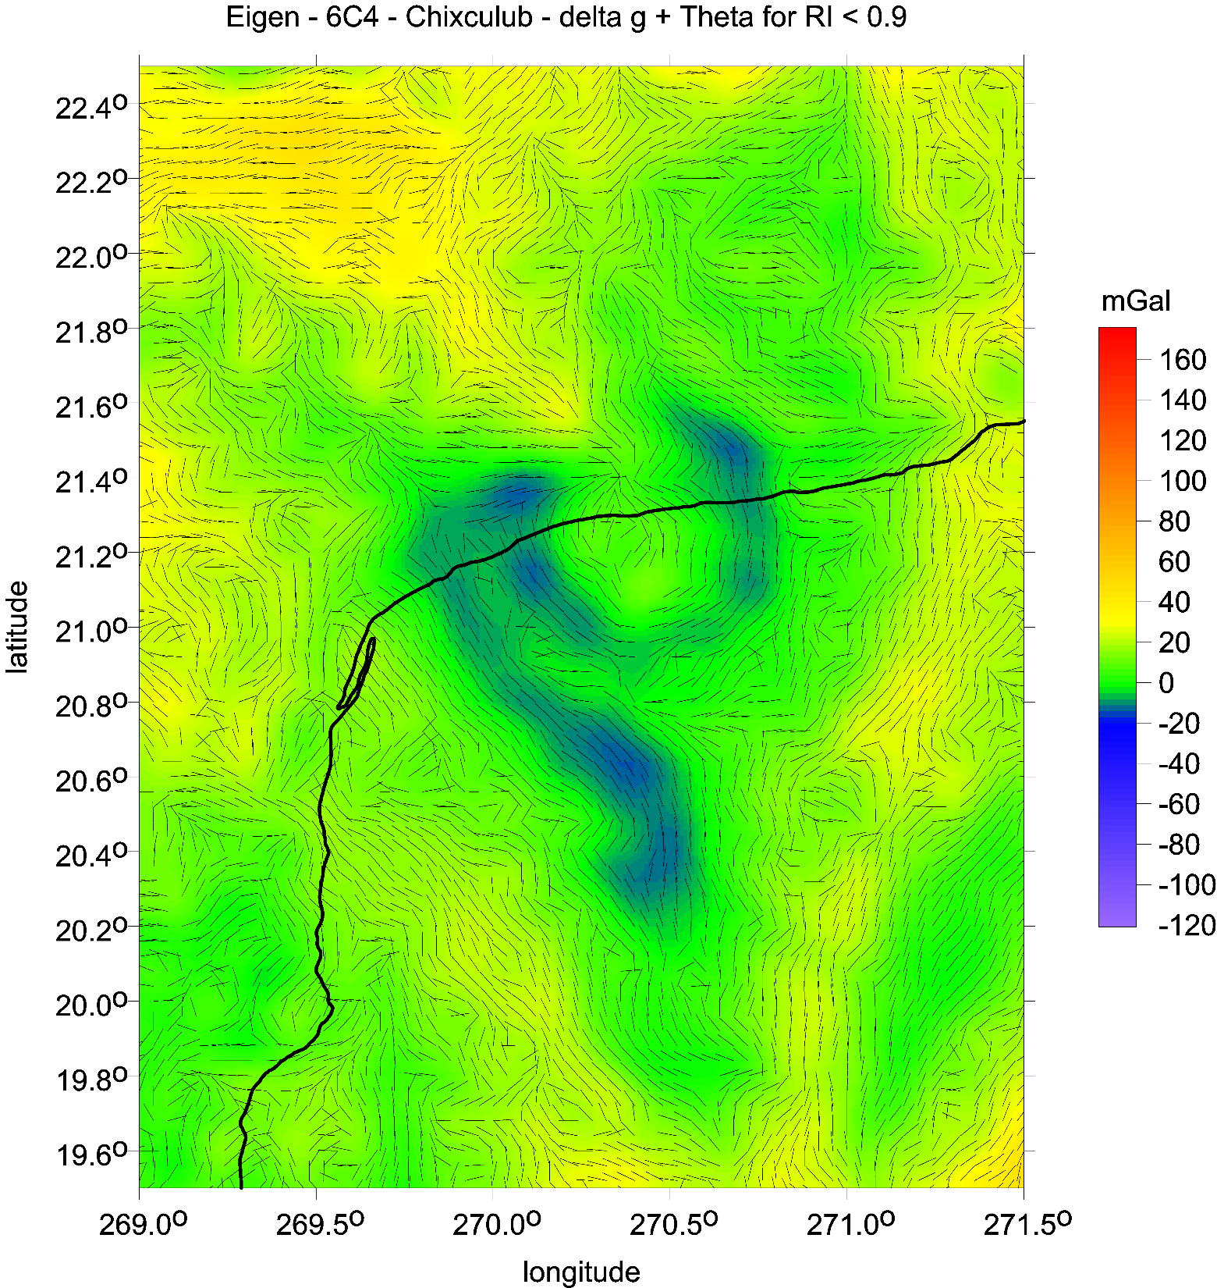
example
∆g and θ
[mGal], [deg]

Slide 11
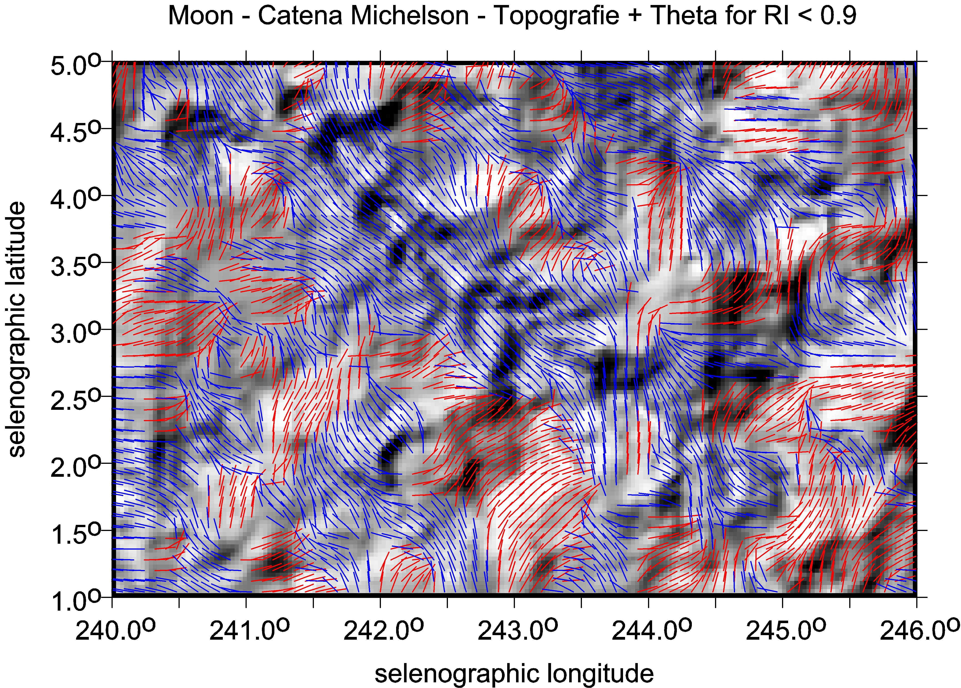
The Moon
example of θ
[deg]
plus topography

Slide 12
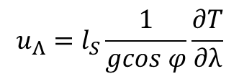



Virtual deformations (Kalvoda et al. 2012, Klokočník et al. 2013)
directions of such a deformation due to “erosion” brought about solely by “gravity origin”.
If there would be a tidal potential T, then the horizontal shifts (deformations) would exist due to it
and they could be expressed
in north-south direction (latitude direction) … [left] and in east-west direction (longitudinal direction) … [right]
where g is the gravity acceleration 9.81 m⋅s⁻²,
l_{S} is the elastic coefficient (Shida number) expressing the elastic properties of the Earth as a planet (l_{S} = 0.08),
φ and λ are the geocentric coordinates (latitude and longitude) of a point P where we measure T
The apparatus of mechanics of continuum to derive the main directions of the tension is applied (see, e.g., Brdička et al. 2000).
The tensor of (small) deformation E is defined as a gradient of shift. It holds that
The tensor E can be separated into two parts:
where e is the symmetrical tensor and Ω the anti-symmetrical tensor of deformation, respectively. The symmetrical tensor is
and the parameters of deformation are:
Δ = e₁₁ + e₂₂ total dilatation a = ½ (Δ + γ) major semi-axis of ellipse of deformation
γ₁ = e₁₁ - e₂₂ pure cut b = ½ (Δ – γ) minor semi-axis of ellipse of deformation
γ₂ = 2e₁₂ technical cut α = ½ atan(γ₂ / γ₁) direction of main axis of deformation
γ = (γ₁² + γ₂²)^{1/2} total cut
.
$$u_{Φ}=l_{S}\frac{1}{g}\frac{∂T}{∂φ}$$
$$u_{Λ}=l_{S}\frac{1}{gcos φ}\frac{∂T}{∂λ}$$
$$E=\left(\begin{matrix}ε_{11} & ε_{12} \\ ε_{21} & ε_{22}\end{matrix}\right)=\left(\begin{matrix}\frac{∂u_{x}}{∂x} & \frac{∂u_{x}}{∂y} \\ \frac{∂u_{y}}{∂x} & \frac{∂u_{y}}{∂y}\end{matrix}\right)$$
$$E=e+Ω= \left(e_{ij}\right)+\left(Ω_{ij}\right)$$
$e=\left(\begin{matrix}e_{11} & e_{12} \\ e_{21} & e_{22}\end{matrix}\right)=\left(\begin{matrix}ε_{11} & {(ε}_{12}+ε_{21})/2 \\ {(ε}_{12}+ε_{21})/2 & ε_{22}\end{matrix}\right)$

Slide 13
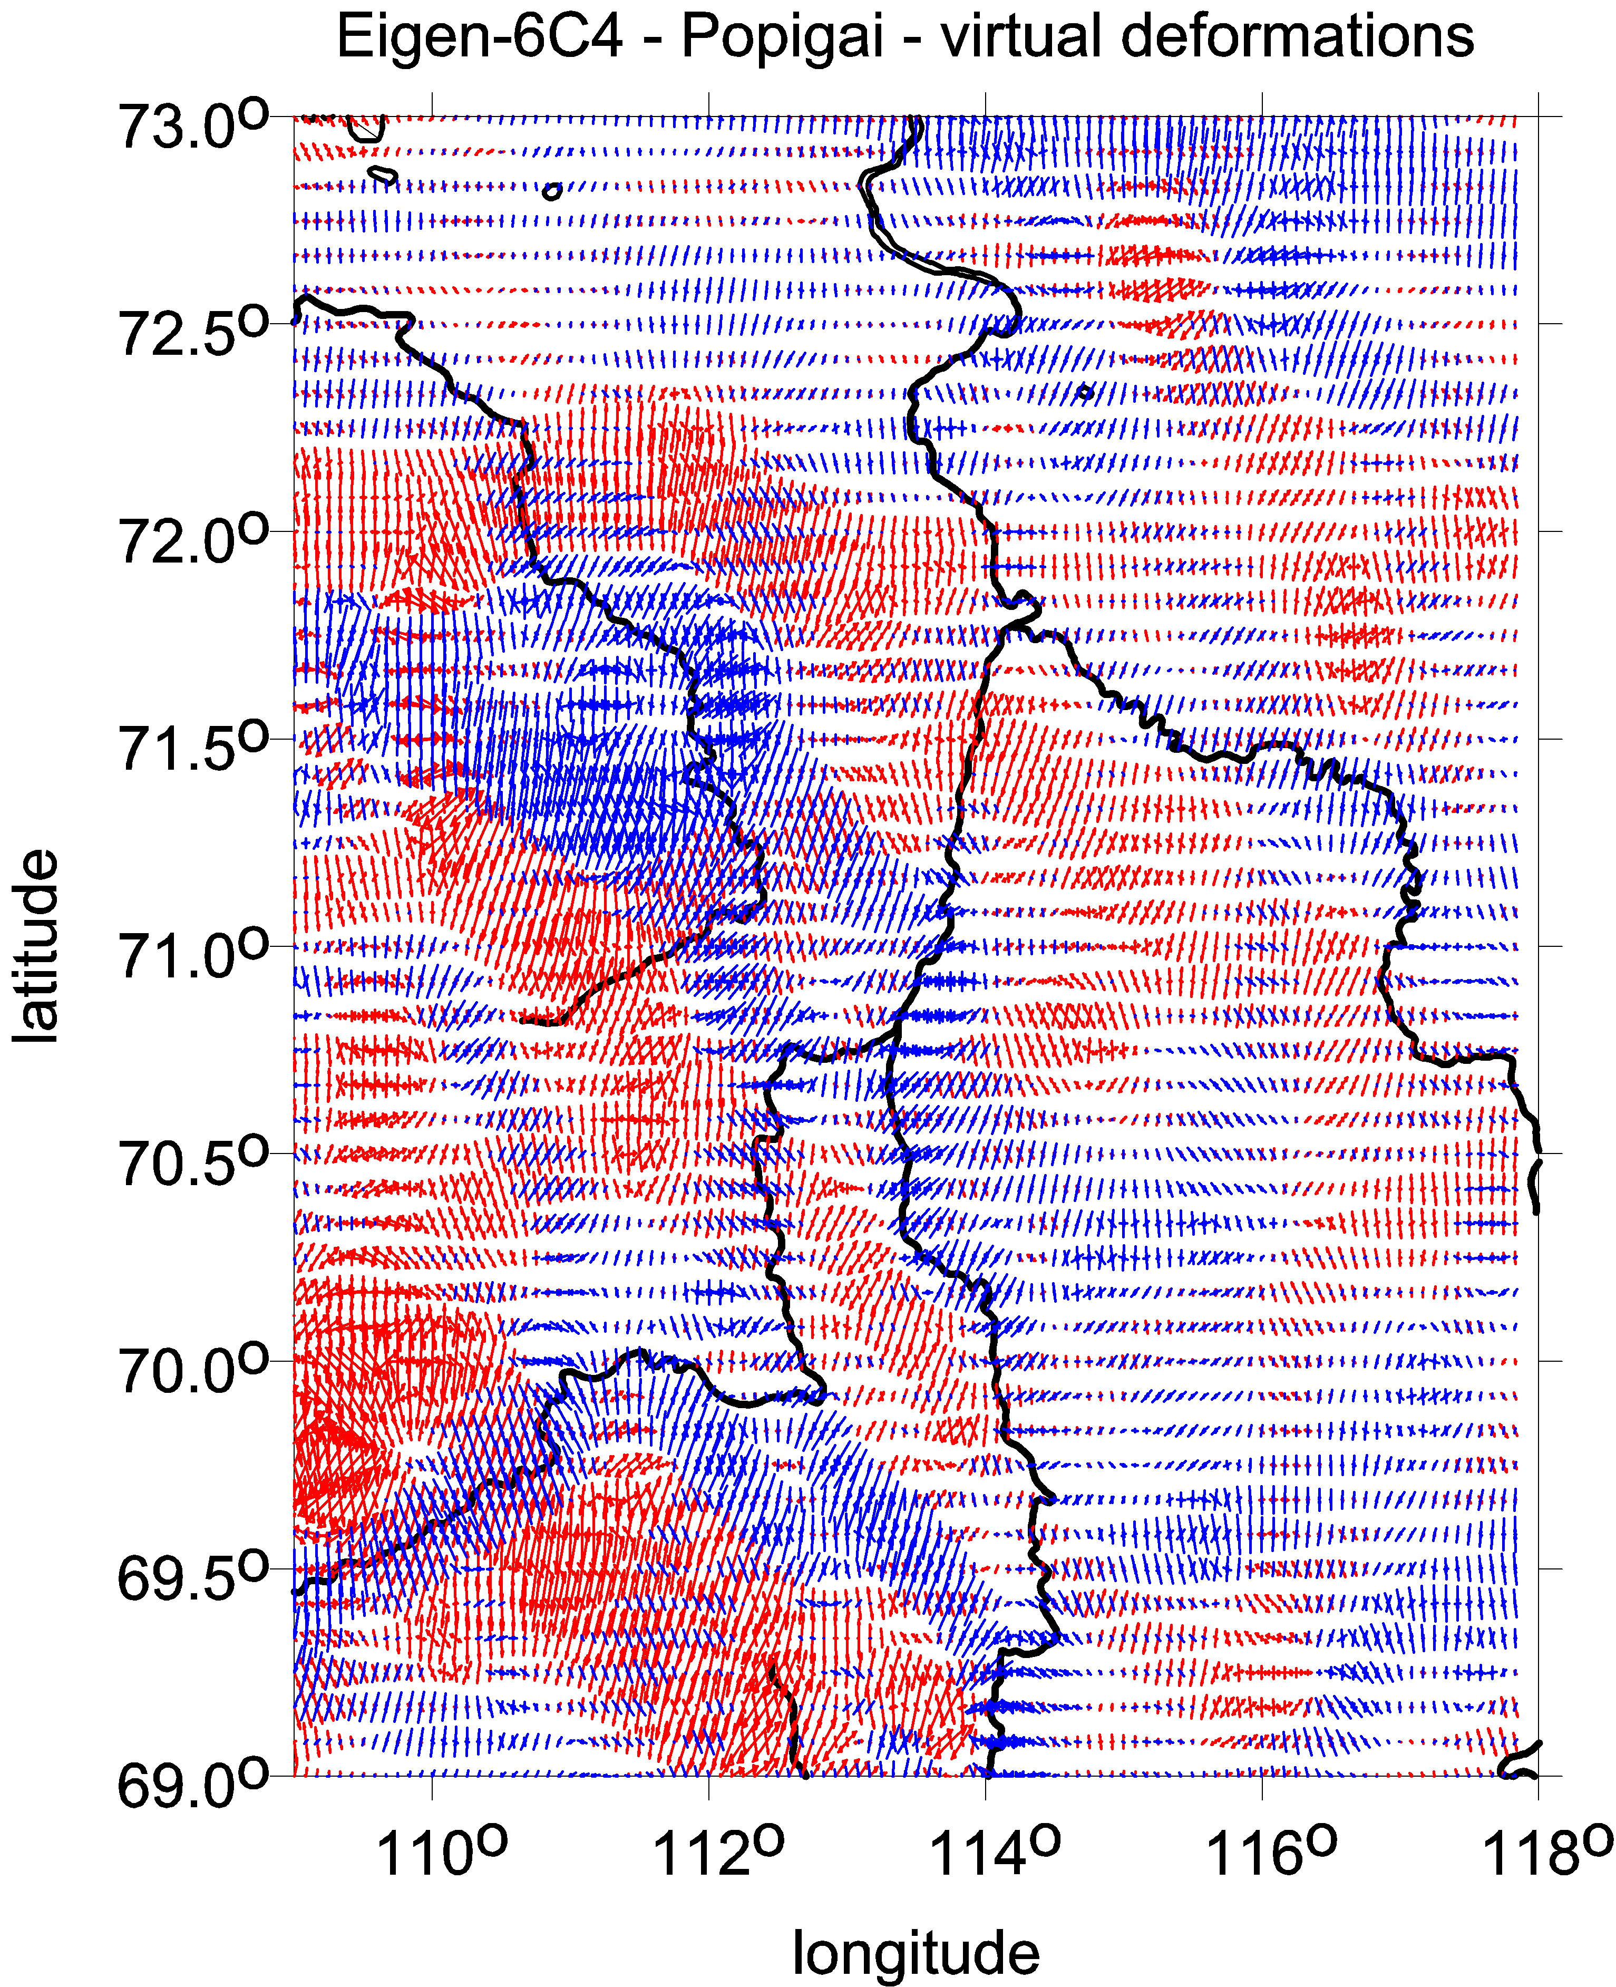

Slide 14
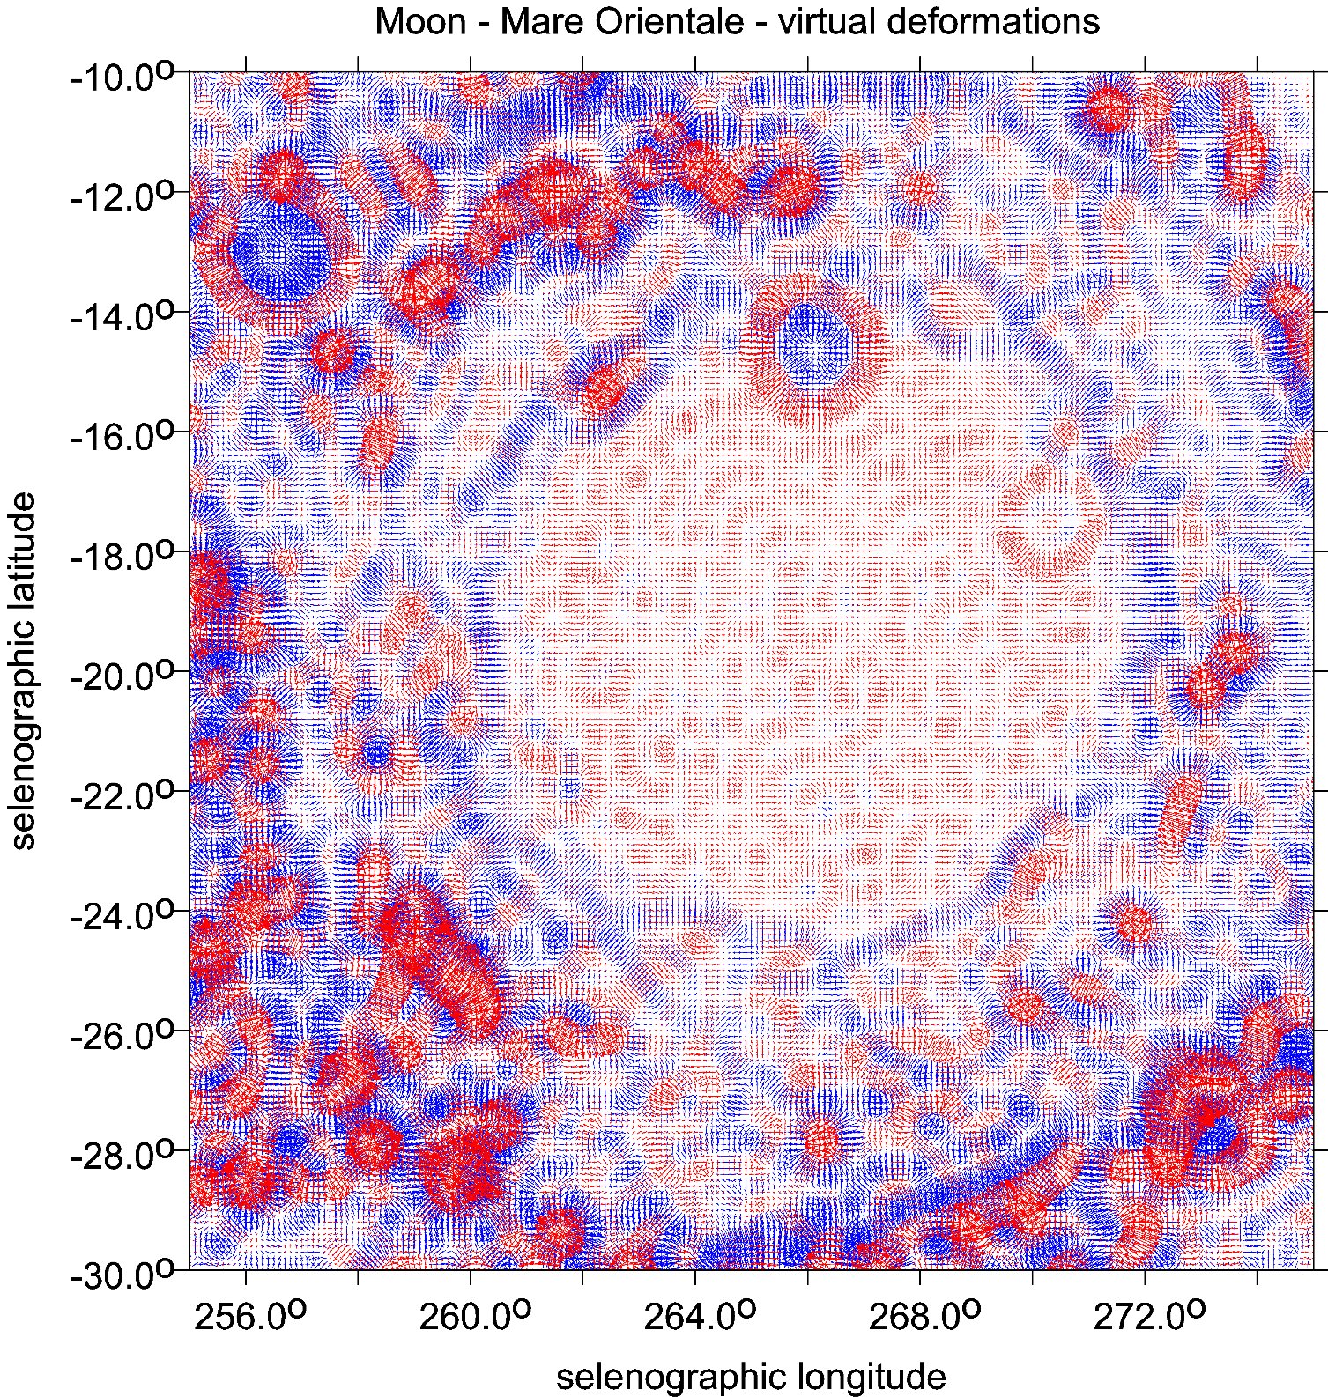
Mare Orientale
virtual deformations
example vd
[-]
dilatation in red
compression in blue

Slide 15
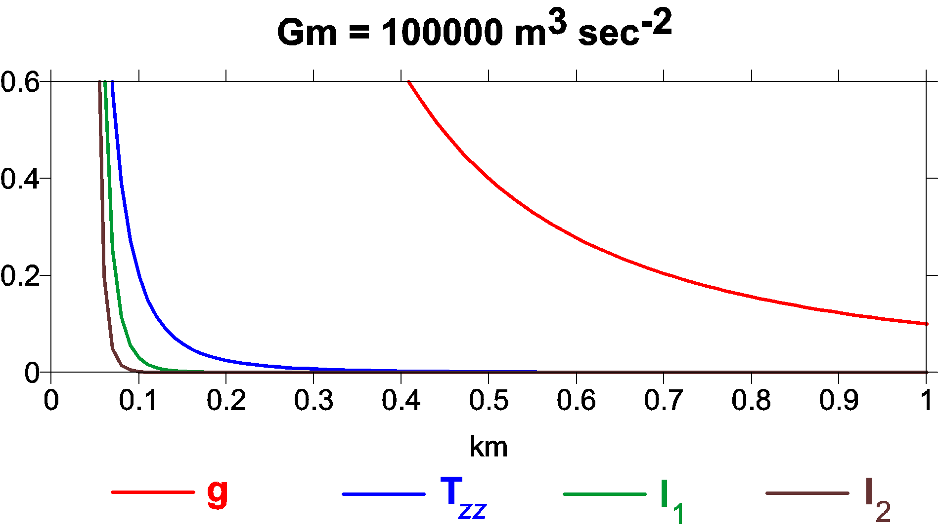
An example of decrease of the values of the gravity aspects of a spherical model of gravitational potential with increasing distance (depth) from their source (density anomaly, causative body).
On the x axis,there are depths in kilometres, on the y axis, there is an arbitrary quantity
(for a simple intercomparison). This is an illustrative case for a mass point with randomly selected value of GM (here Gm, representing a spherical ground density anomaly).

Slide 16
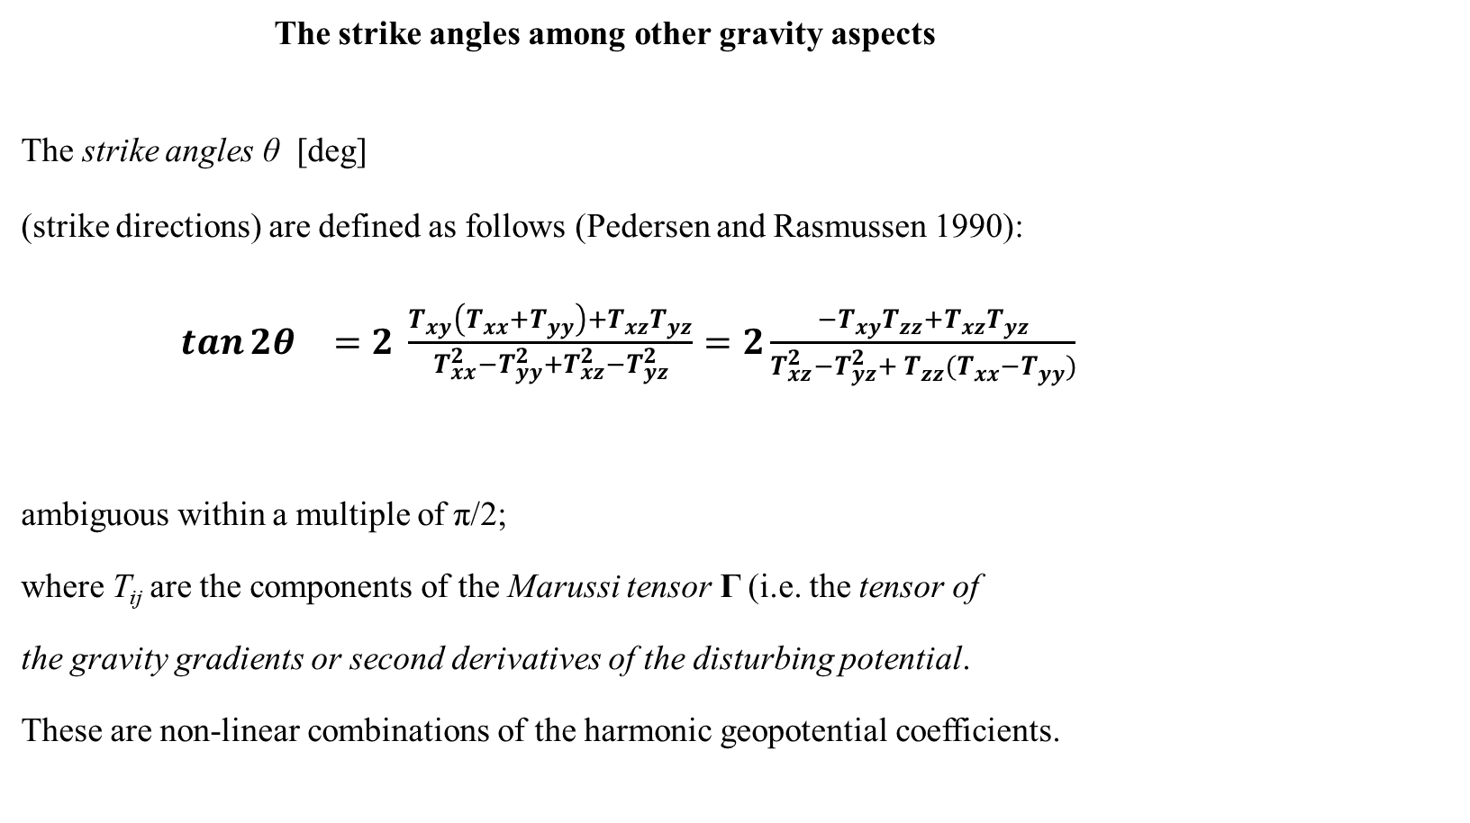
  The strike angles among other gravity aspects
The strike angles θ [deg]
(strike directions) are defined as follows (Pedersen and Rasmussen 1990):
$\tan{2θ_{}}=2 \frac{T_{xy}\left(T_{xx}+T_{yy}\right)+T_{xz}T_{yz}}{T_{xx}^{2}−T_{yy}^{2}+T_{xz}^{2}−T_{yz}^{2}}=2\frac{{−T}_{xy}T_{zz}+T_{xz}T_{yz}}{T_{xz}^{2}−T_{yz}^{2}+{{ T}_{zz}^{}(T}_{xx}^{}−T_{yy}^{})}$
ambiguous within a multiple of π/2;
where T_{ij} are the components of the Marussi tensor Γ (i.e. the tensor of
the gravity gradients or second derivatives of the disturbing potential.
These are non-linear combinations of the harmonic geopotential coefficients.

Slide 17
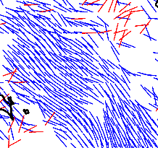
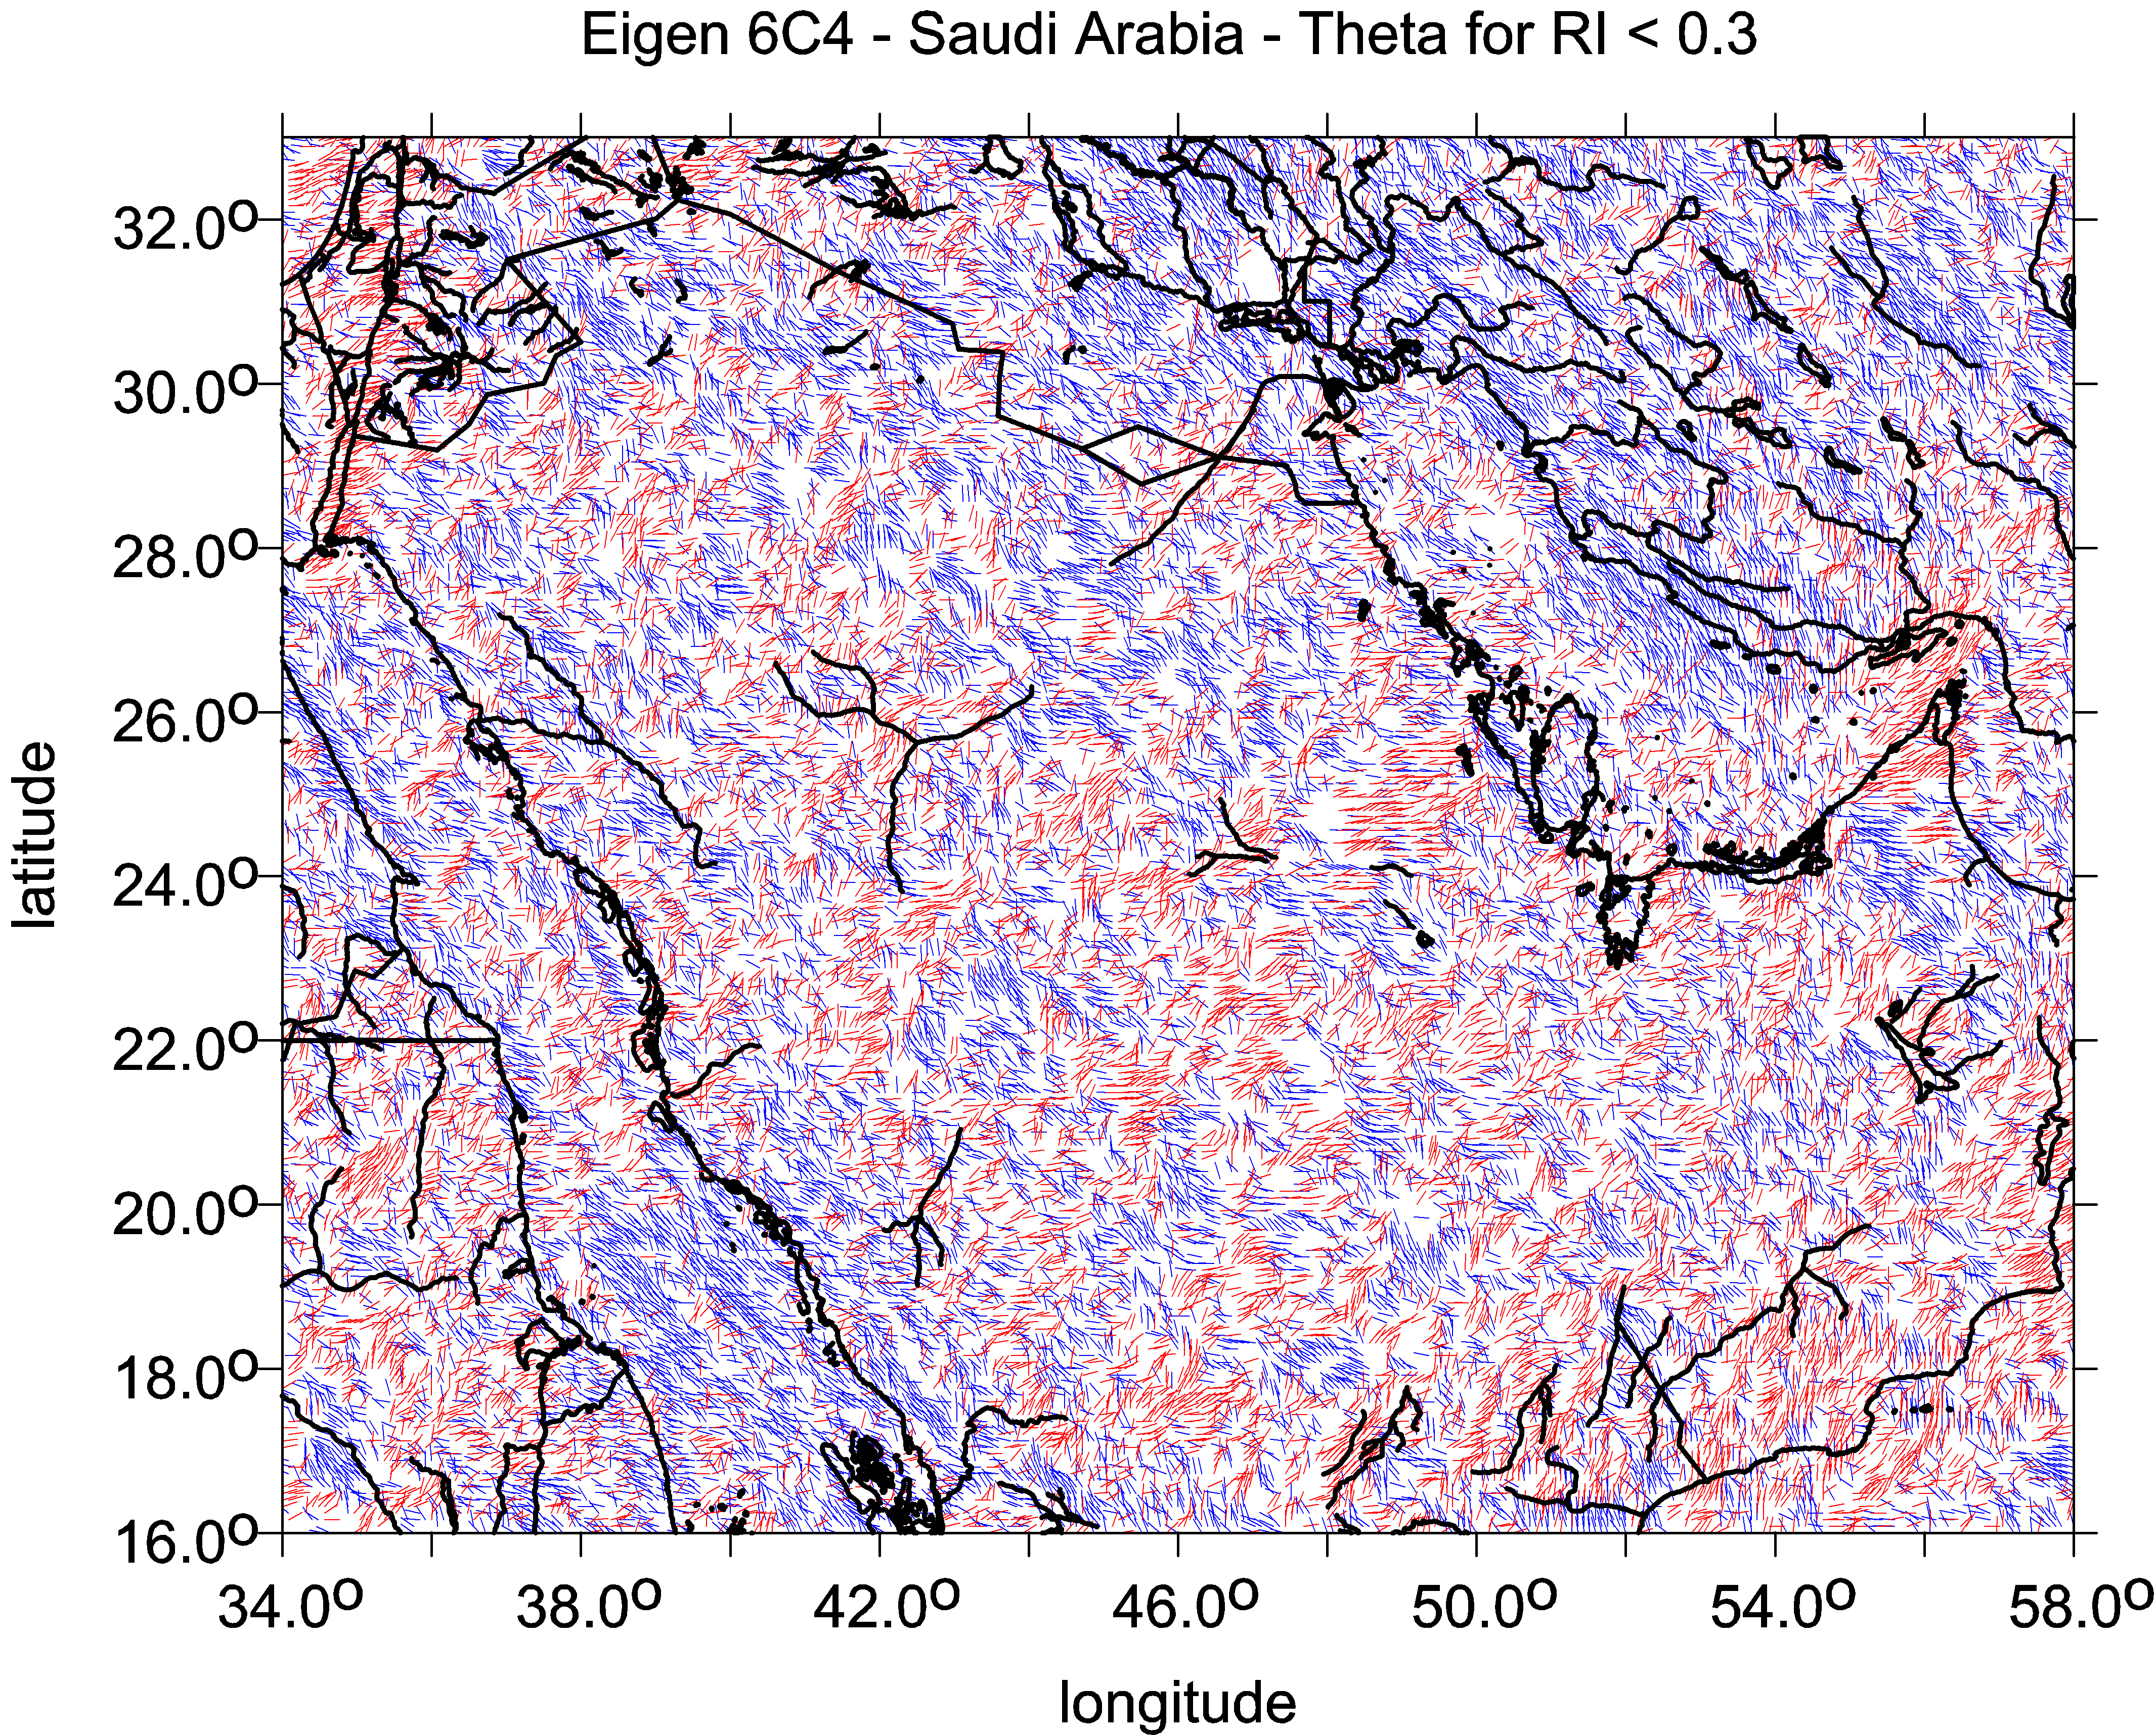
The combed strike angle
Strike angles aligned. Being combed, the strike angle indicates existence of impact craters, or task deposits, but yields no proof of them; the indication is not unambiguous as for oil&gas, it may indicate water, ground water, wadi, deep valley, trench, may be also coal; further information needed (topography, geology,…) for specific decision…
combed strike angles in the studied area, disheveled strike angles in the studied area = one way oriented strike angles = strike angles are in diverse directions
comb factor → 1 comb_factor → 0
For statistical use we defined the comb coefficient Comb as a relative value in the interval 〈0,1〉, where 0 means „not combed“ (totally disheveled, the vectors θ are in diverse directions) and 1 „combed“ (perfectly kempt, the vectors of θ are oriented into one prevailing direction). If Comb is smaller than 0.55, we say that θi of the given region are „not combed“; if Comb>0.65, we say θi are „combed“.

Slide 18
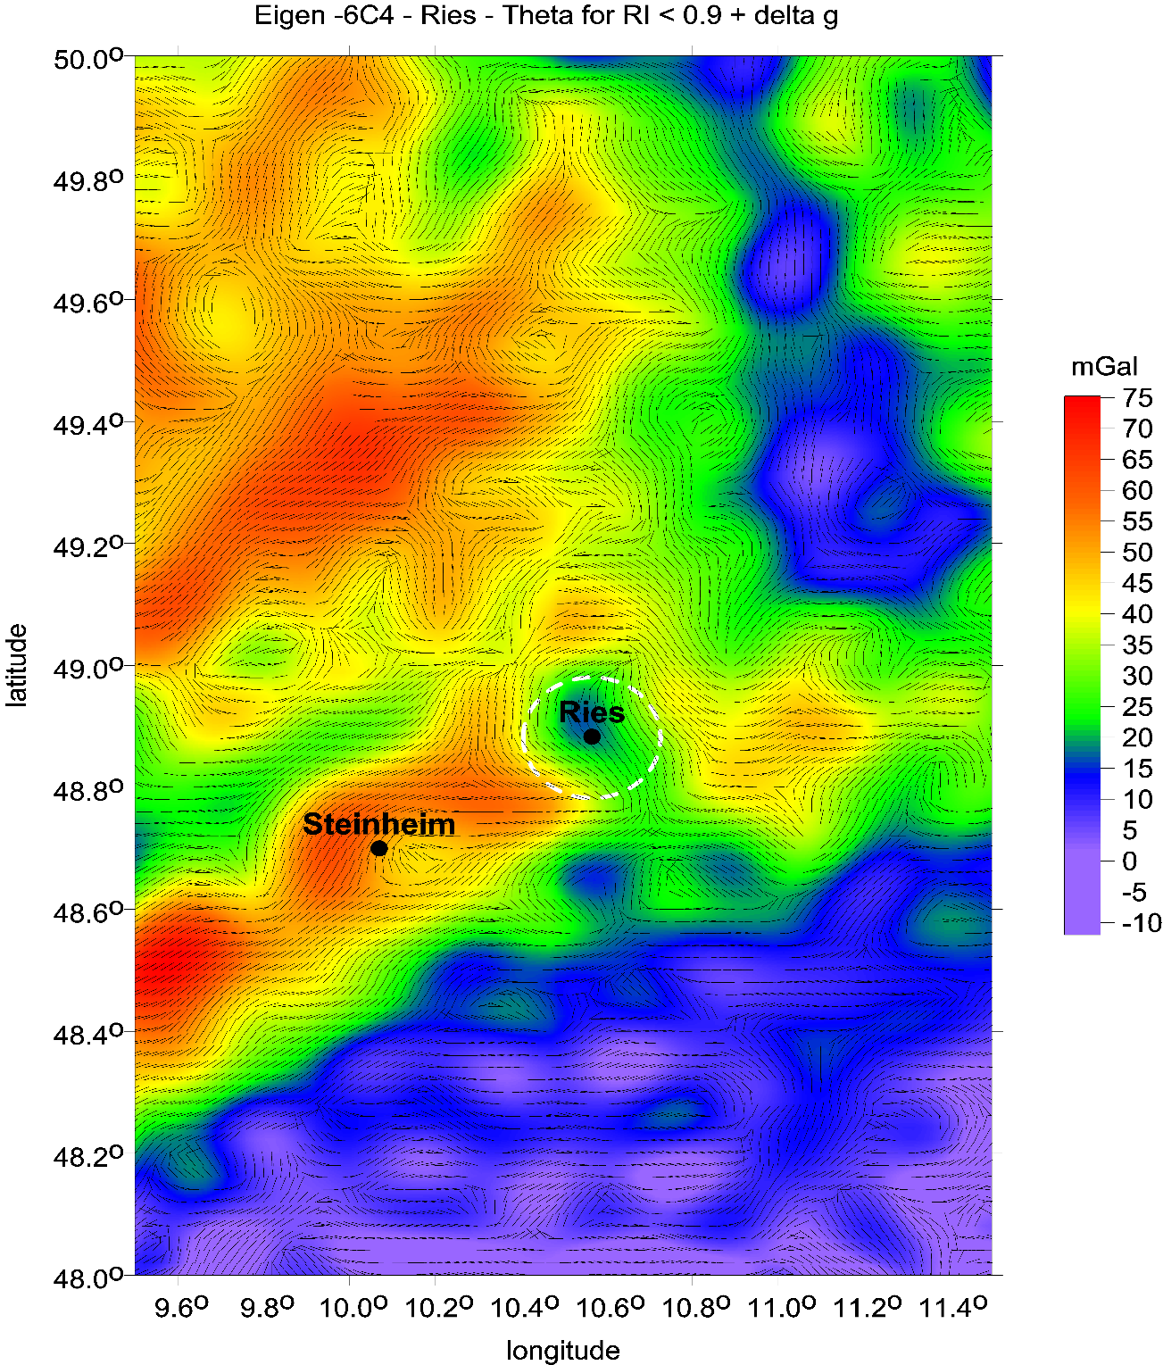
The combed strike angles are oriented roughly in one direction, linearly or around a circular structure.
Steinheim and Ries impact craters (Germany)
as depicted by the combed strike angles
with the gravity anomalies
EIGEN 6C4

Slide 19
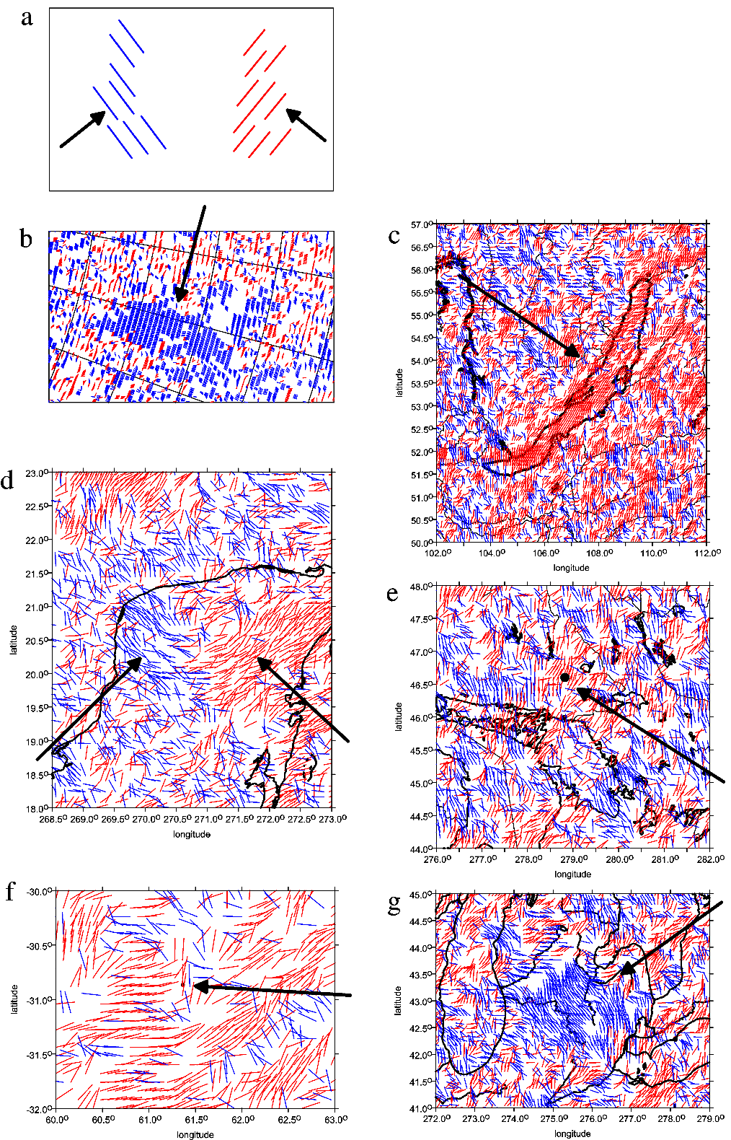
Strike angles for the impact angle – tutorial
a theory
b Lake Vostok, Antarctica
c Lake Bajkal, Russia
d impact crater Chicxulub, north Yucatan
e impact crater Sudbury, Canada
f probable impact crater Burckle, Indian Ocean
g Saginaw Bay, the Great Lakes, USA
The arrows show direction rectangular to the direction
of the strike angles
red colour means their direction to the west and
blue to the east of the local meridian

Slide 20
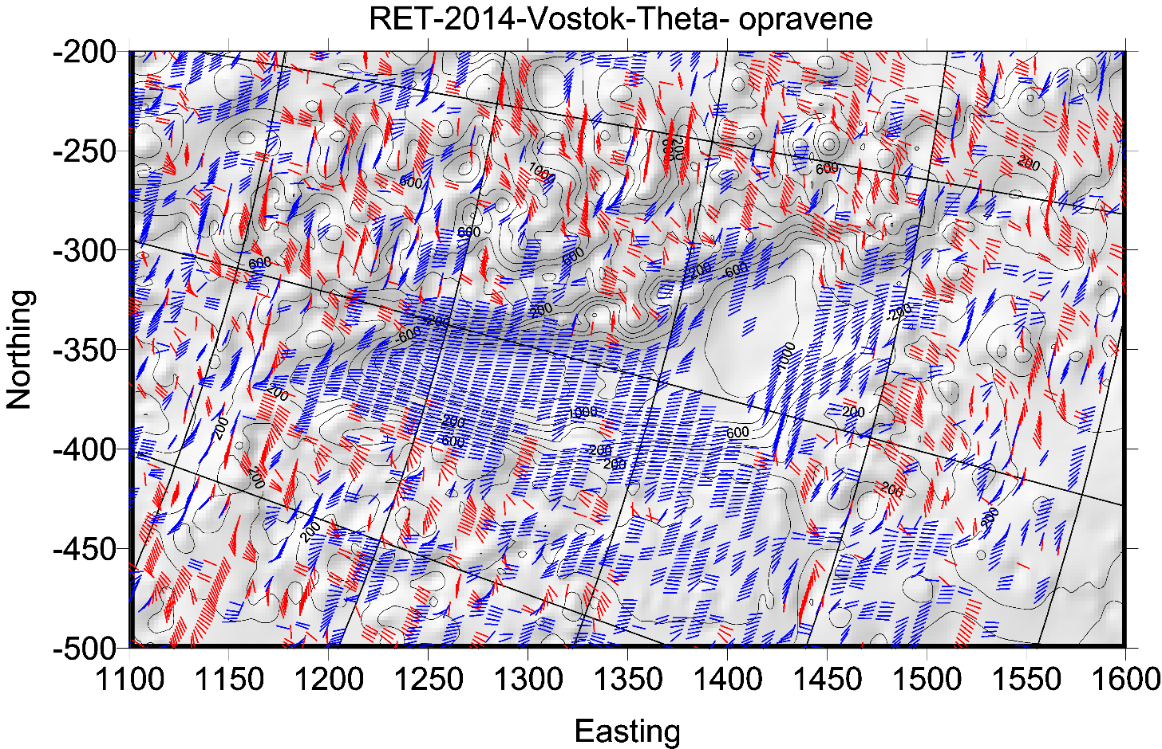
sever vpravo

Slide 21
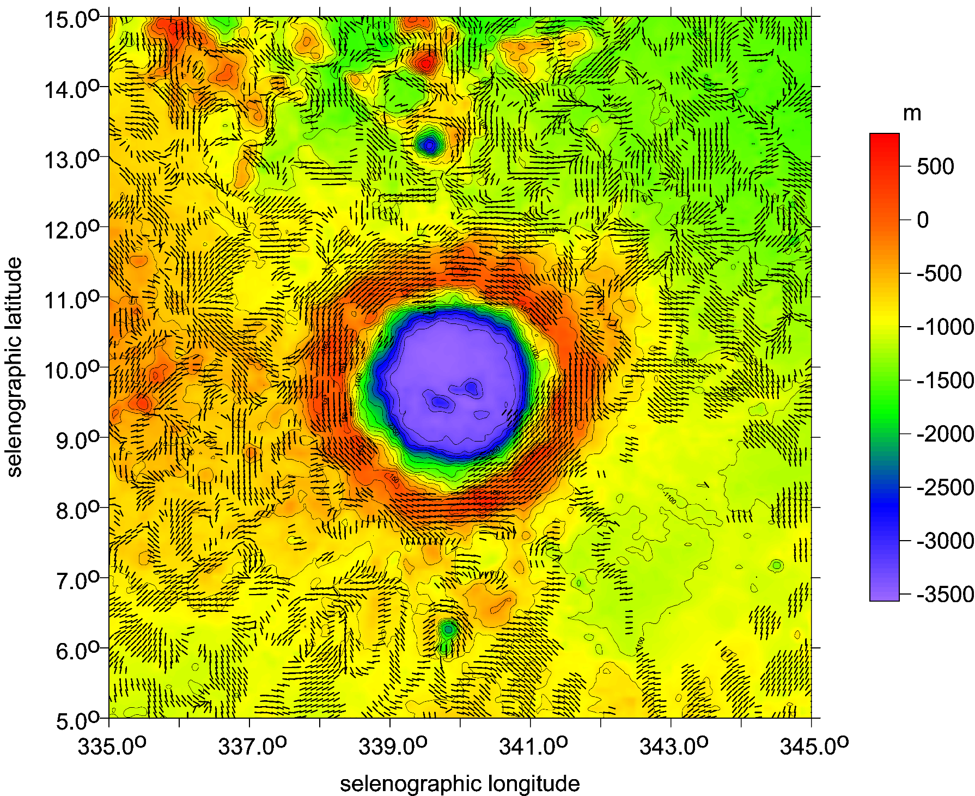
Copernicus
strike angles
θ [deg]
and topography

Slide 22
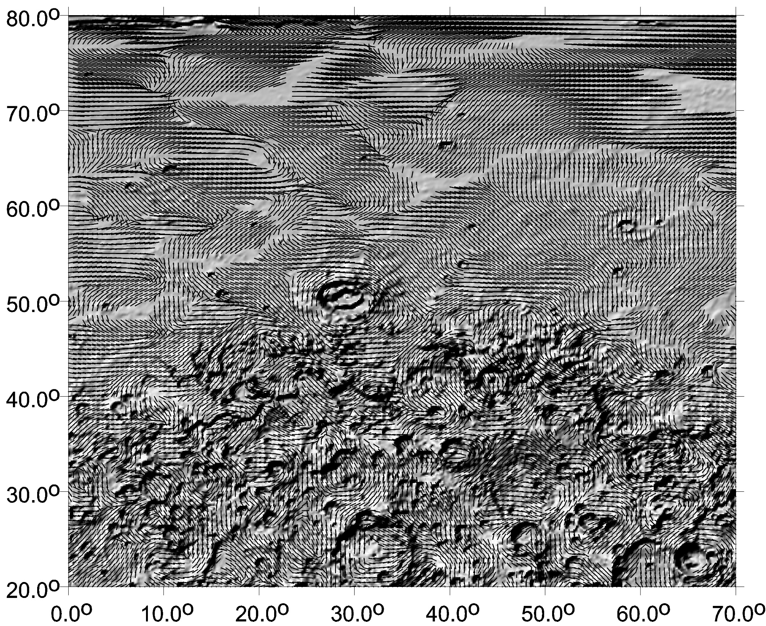

Slide 23
Ground Resolution
A usual simple estimate of the smallest representable feature of the gravity field or the shortest half-wavelength L_{half} (as a distance on a sphere) that can be resolved with all C_{lm}, S_{lm} to L_{max}, is
L_{half} = π R/ L_{max}
or equivalently, taking the circumference 2πR = 40 050 km for the Earth:
L_{half} = 2 π R/ (2 L_{max}) = 40 050/ (2 L_{max}).
This L_{half} is what we call the “ground resolution”. For L_{max}= 300 and 2190, we have L_{half} = 67 and 9 km, respectively. The former limit roughly corresponds to the resolution of the GOCE data alone, and the latter belongs to the combined models, EGM 2008, EIGEN 6C4 or SatGavRET2014 (in the case of the Earth).
Body R [km] max d/o of resolution [km]
rounded model used
-----------------------------------------------------------------
Earth 6380 2190 9
Moon 1740 600 9
Mars 3400 80-120 130-90
Venus 6050 120 160

Slide 24
We quote from Klokočník et al. (2021), where we distinguished various types of artefacts:
Graining of the signal when increasing the resolution of the computed parameter from the data set of not sufficient quality. The graining is increasing with increasing demands leading to a total disintegration, break-up, dispersion of the signal. The graining can be understood as an indicator of a forthcoming failure in the “high resolution” result. The artefact is defined by graining and that a failure of a presenting the calculations. For example, there is a spherical harmonic expansion of quantity V to certain maximum degree and order (d/o), but beyond certain d/o the calculation solutions start diverging and the artefacts will appear.
Phantoming - odd, bizarre, fantastic, looking, for example, like long walls of various forms, pyramids, circles and other ghosts, partly due to lack of data, partly from processing procedures and software.
Data gapping (for example, regions with missing bedrock topography, regions with data from ice penetrating radars in Antarctica) may yield false smoothed signal, expressing featureless areas.
Aliasing appears when we attempt reconstructing the original waveform from its samples and we have not sufficient amount of such samples. Aliasing represents a long-wave artefact due to not sufficient sampling in frequency space (insufficient data density); the shorter frequencies can have real context but hidden due to aliasing. Aliasing produces features like barriers, bulwarks, mounds, valleys, lakes, pyramid-like objects.
Striping, organized along-track of satellite orbit bearing the instrument providing the data. They originate due to the irregular satellite altitude, different instrument condition (night vs. day radiation exposure conditions, solar wind activity) data coverage and gaps. When we compare density of the data along-track to that cross-track orbital components, we see remarkable differences between these two: one is high, one is low. In the case of specialised, nearly polar geodetic satellites used for gravity field studies, the along-track component is roughly in SN/NS direction while the cross-track goes along longitudes WE/EW.
Artefacts - theoretical notes Truncation error tests Danger of misinterpretations

Slide 25
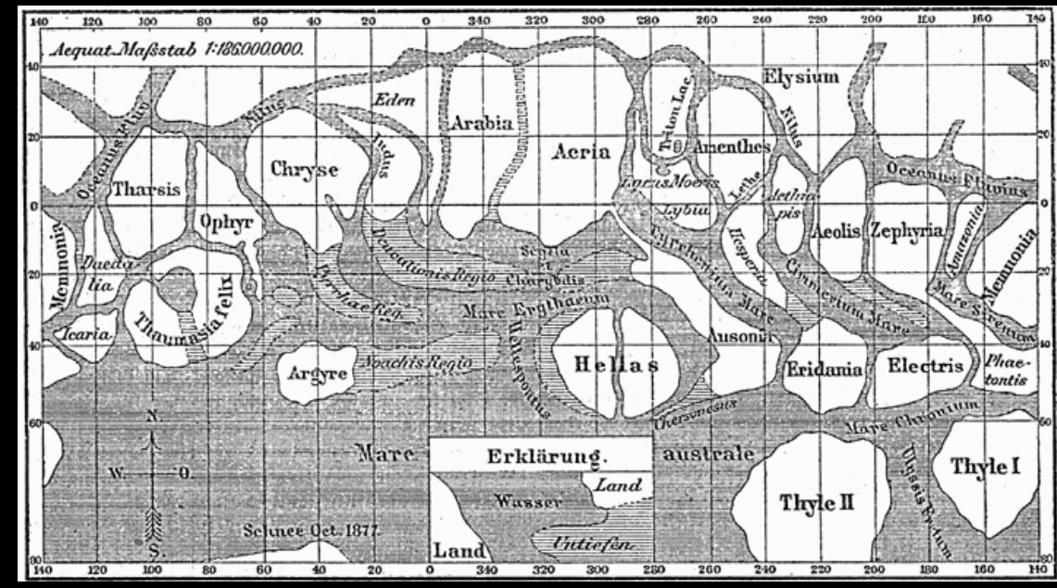
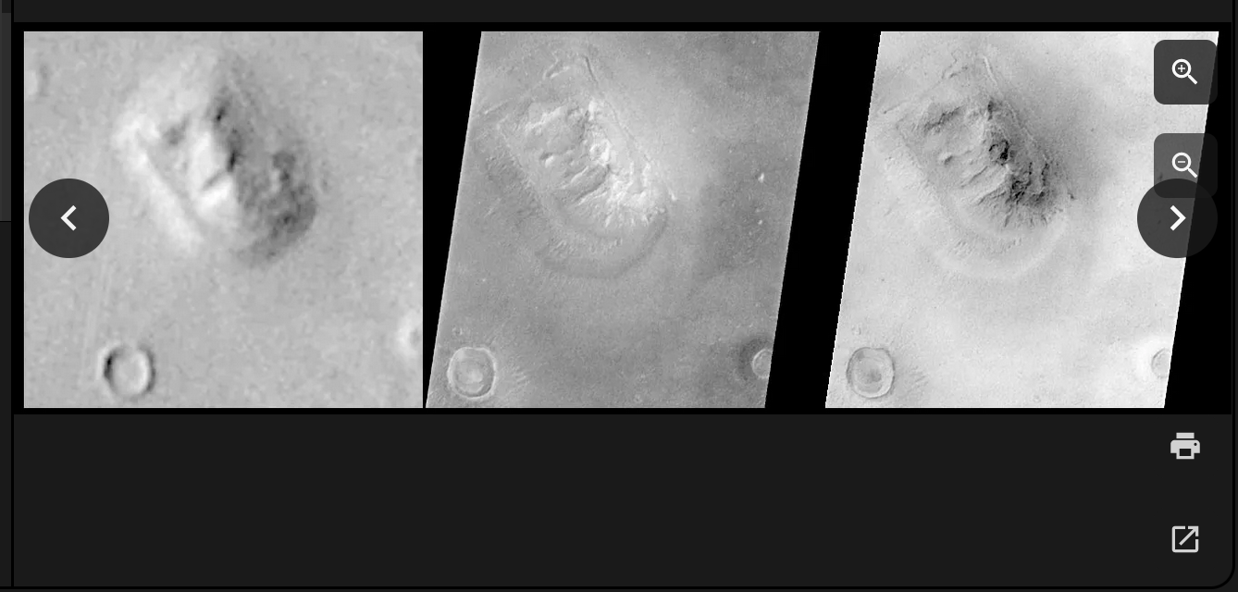
Low resolution
Historical map of planet mars from Giovanni Schiaparelli

Slide 26
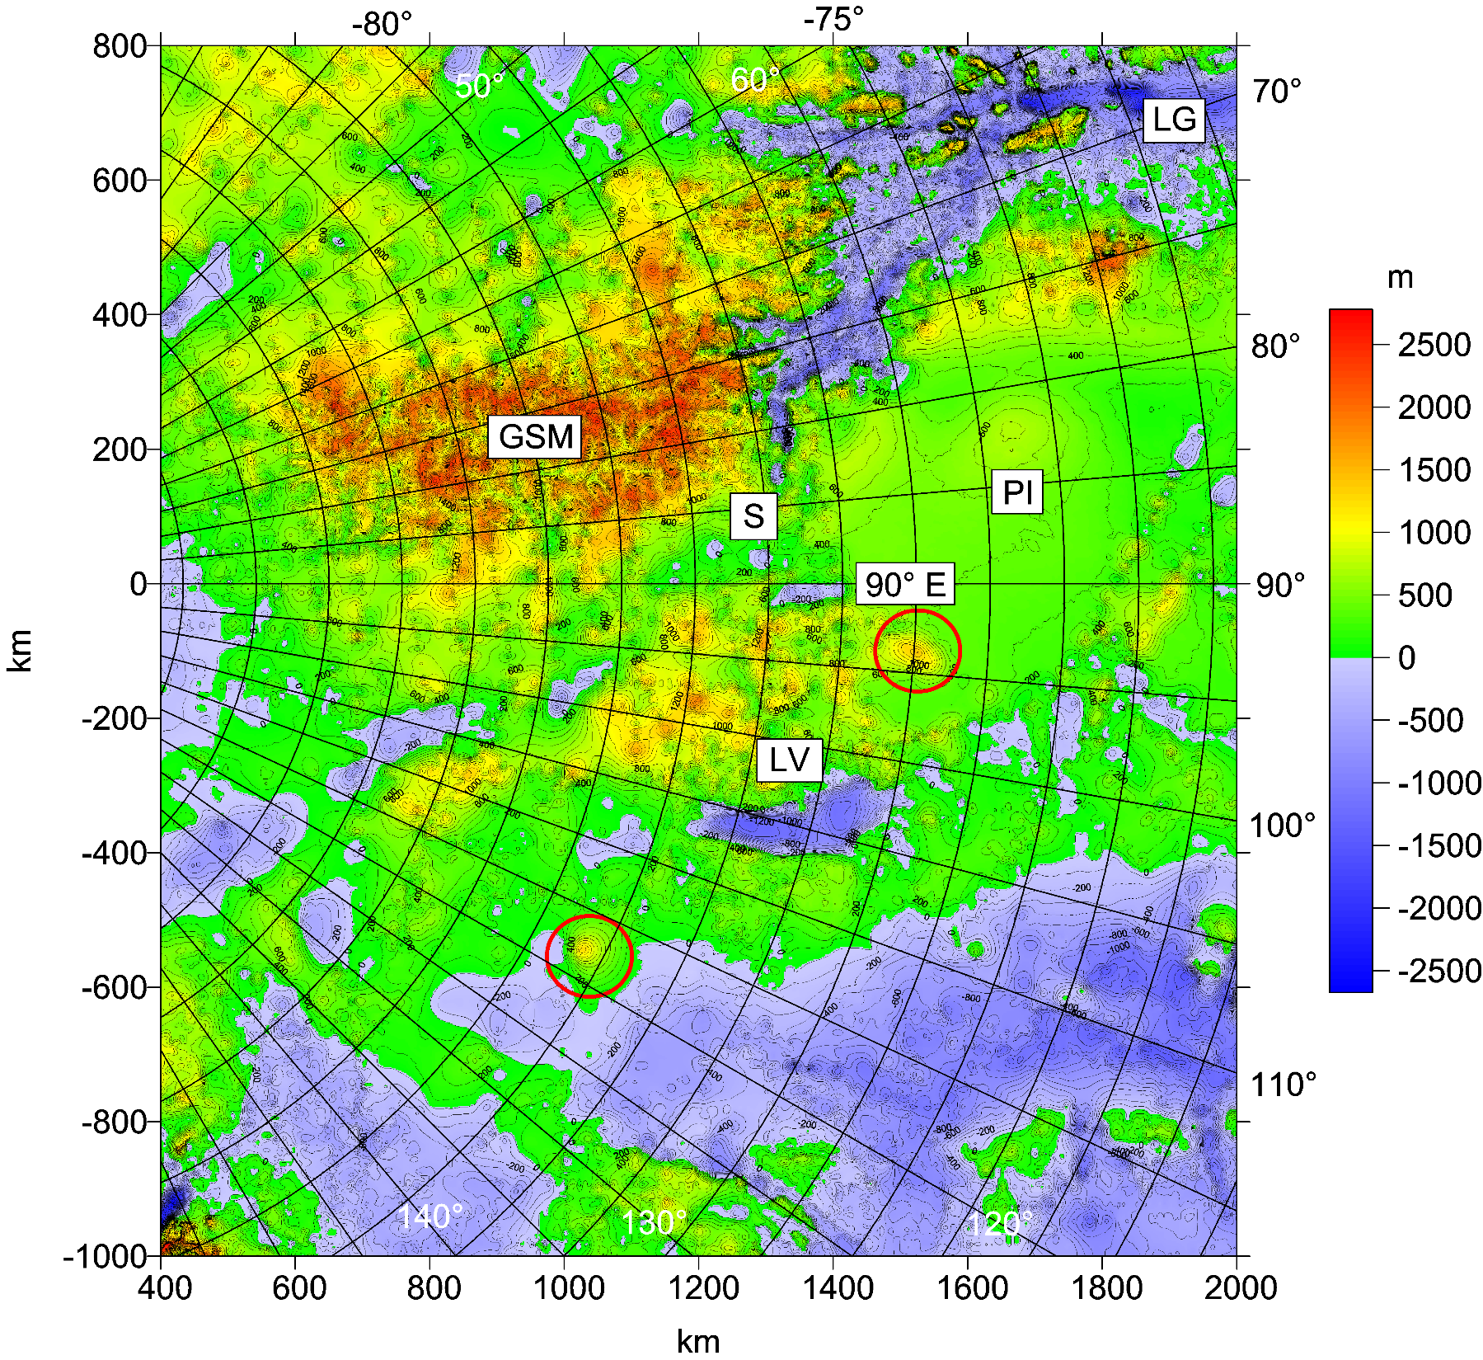
WL

Slide 27
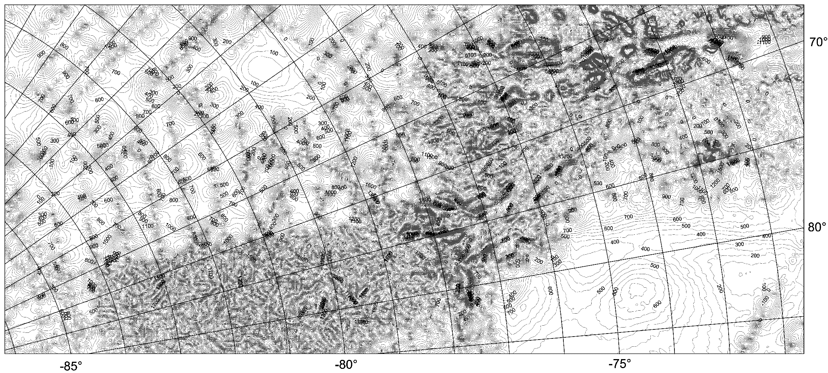
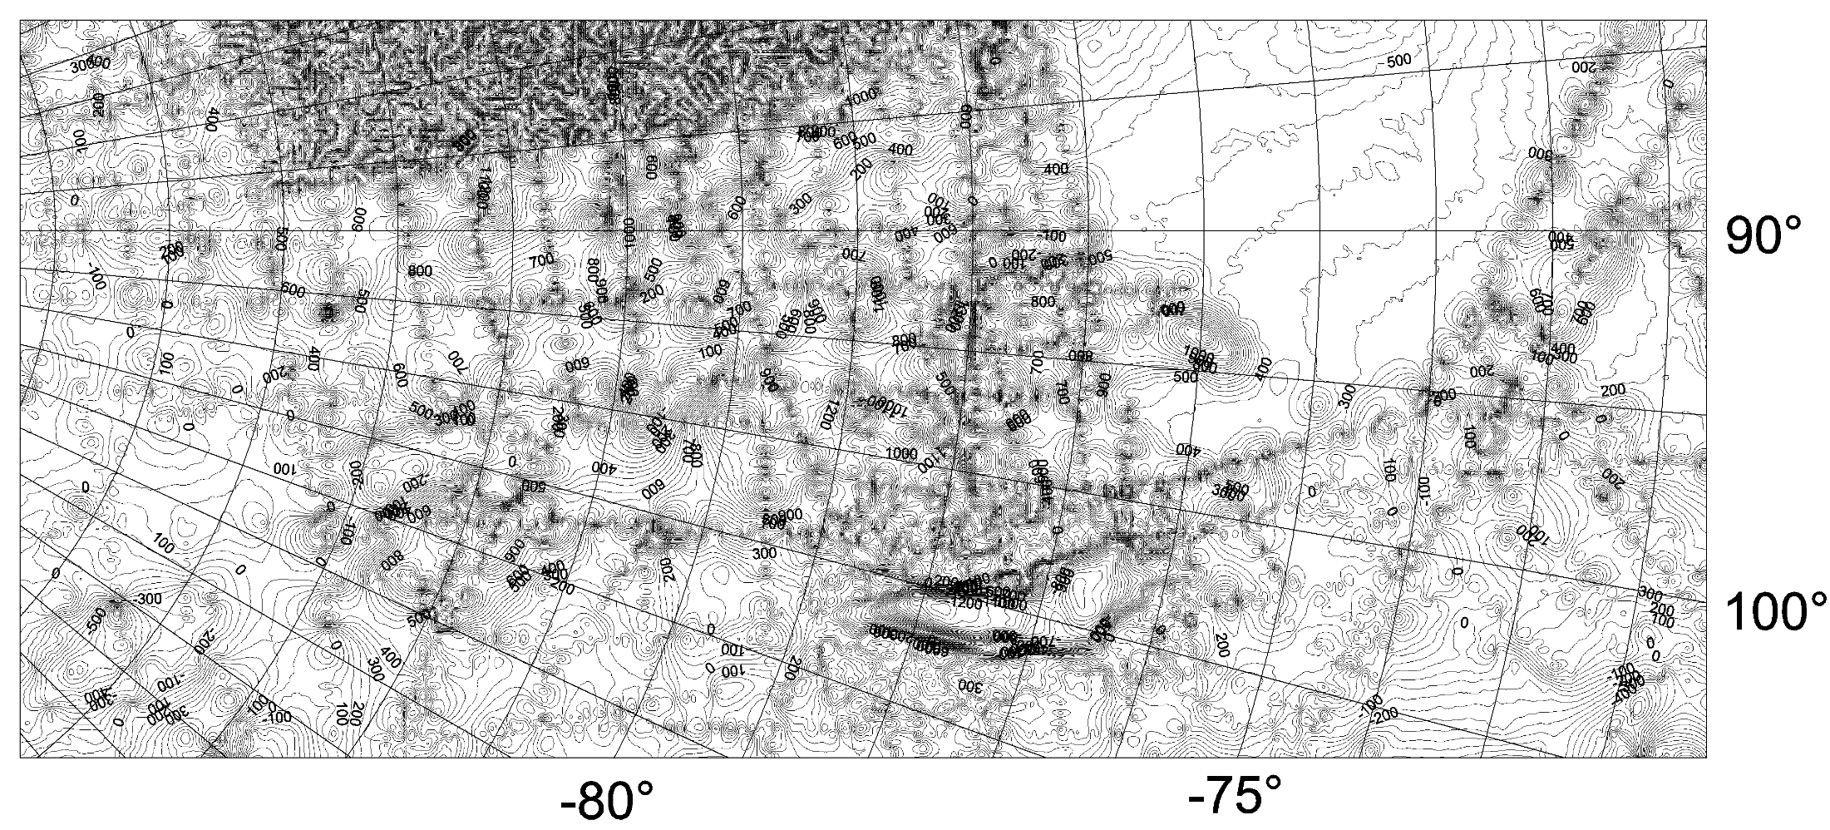
we ask too much
than the data
may provide

Slide 28
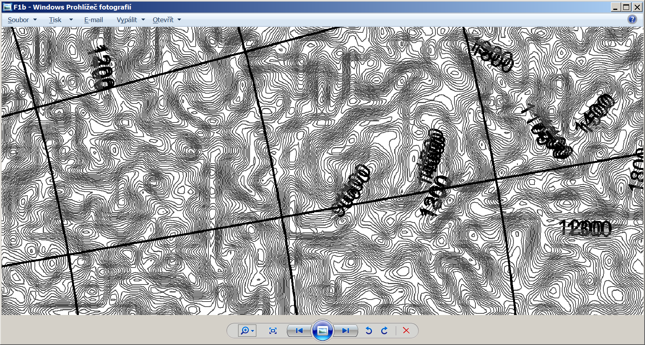
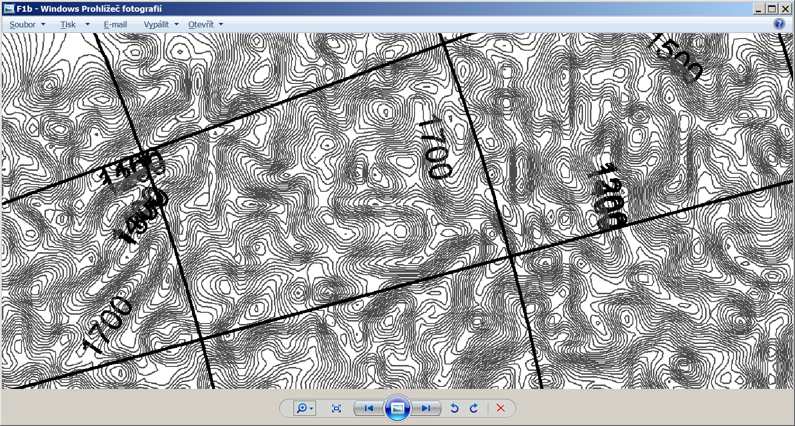
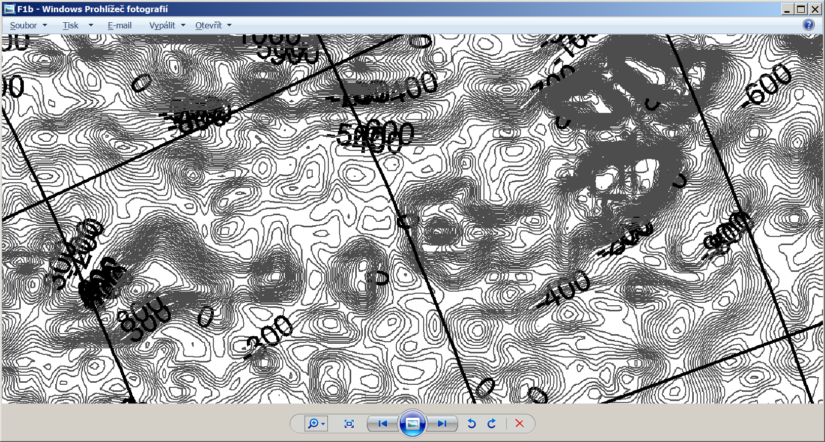
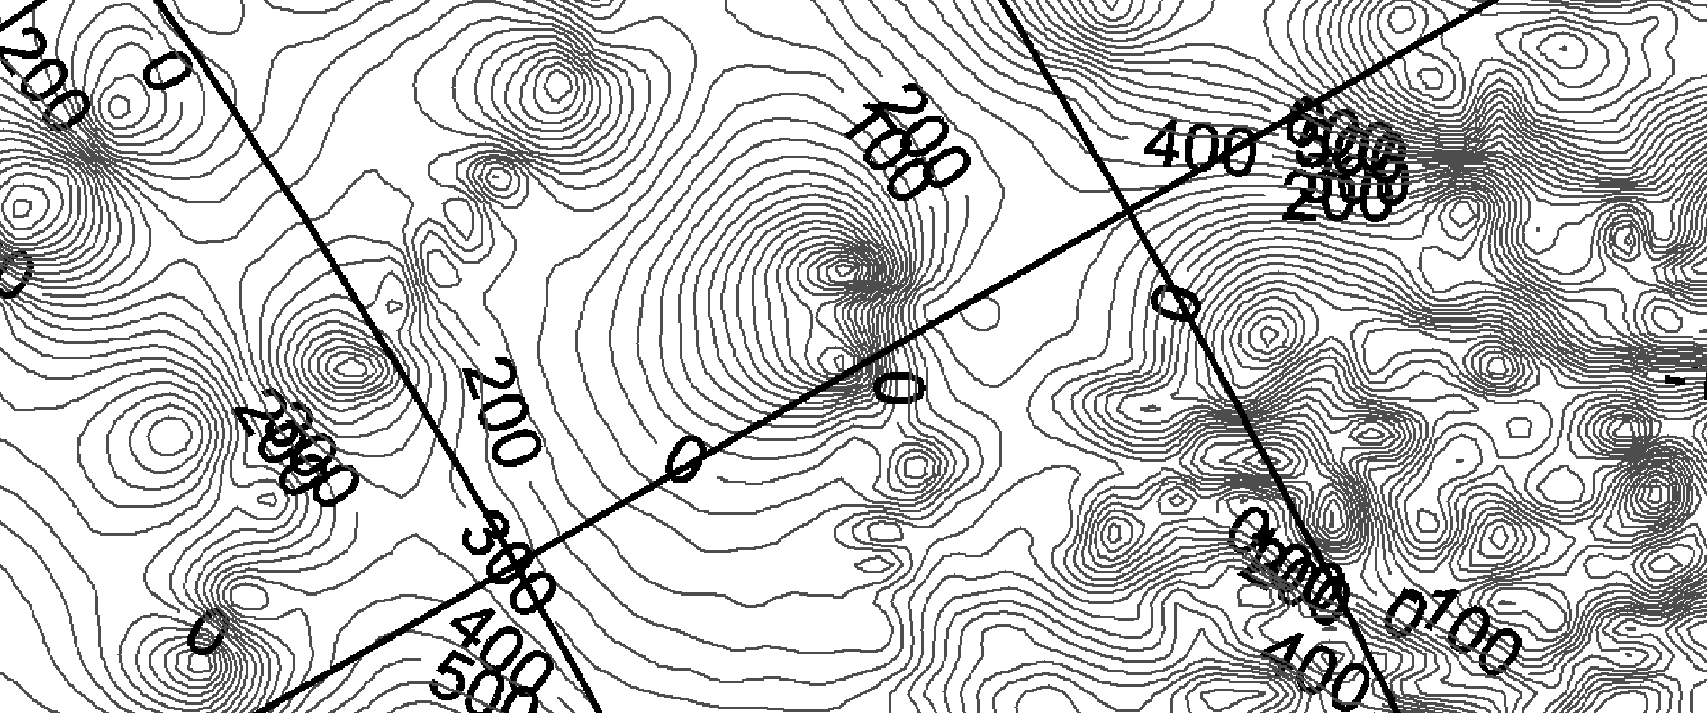

Slide 29
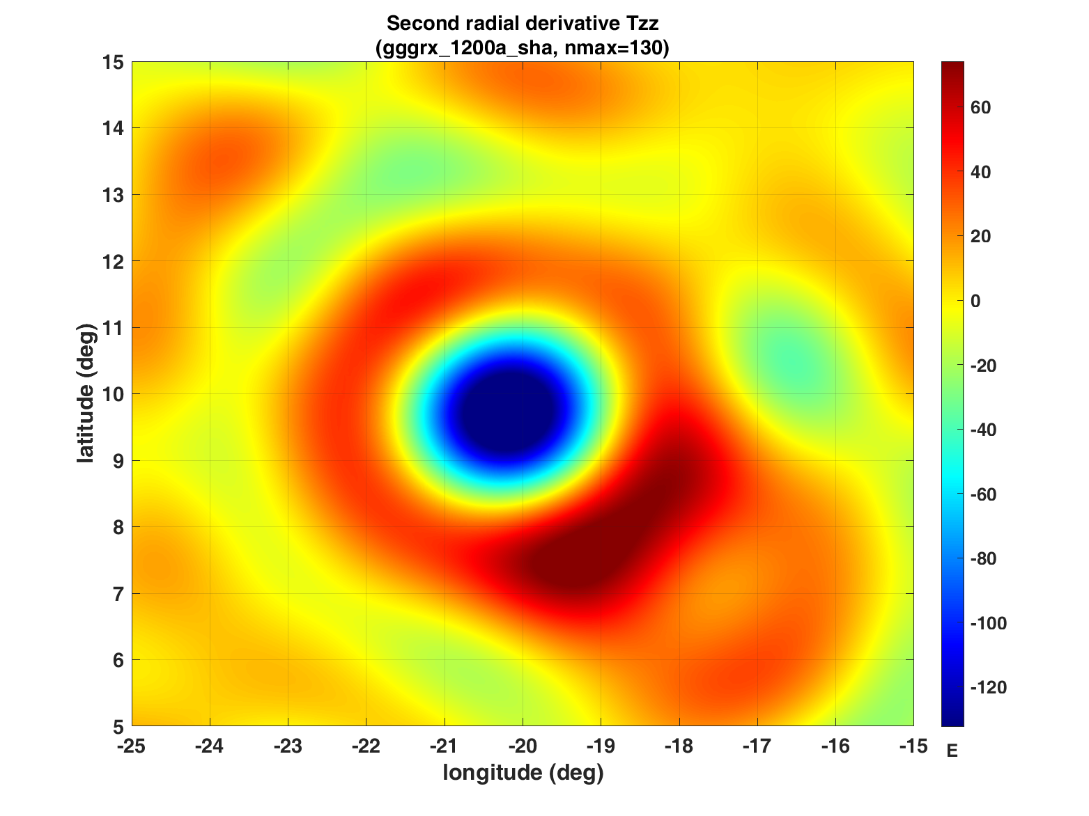
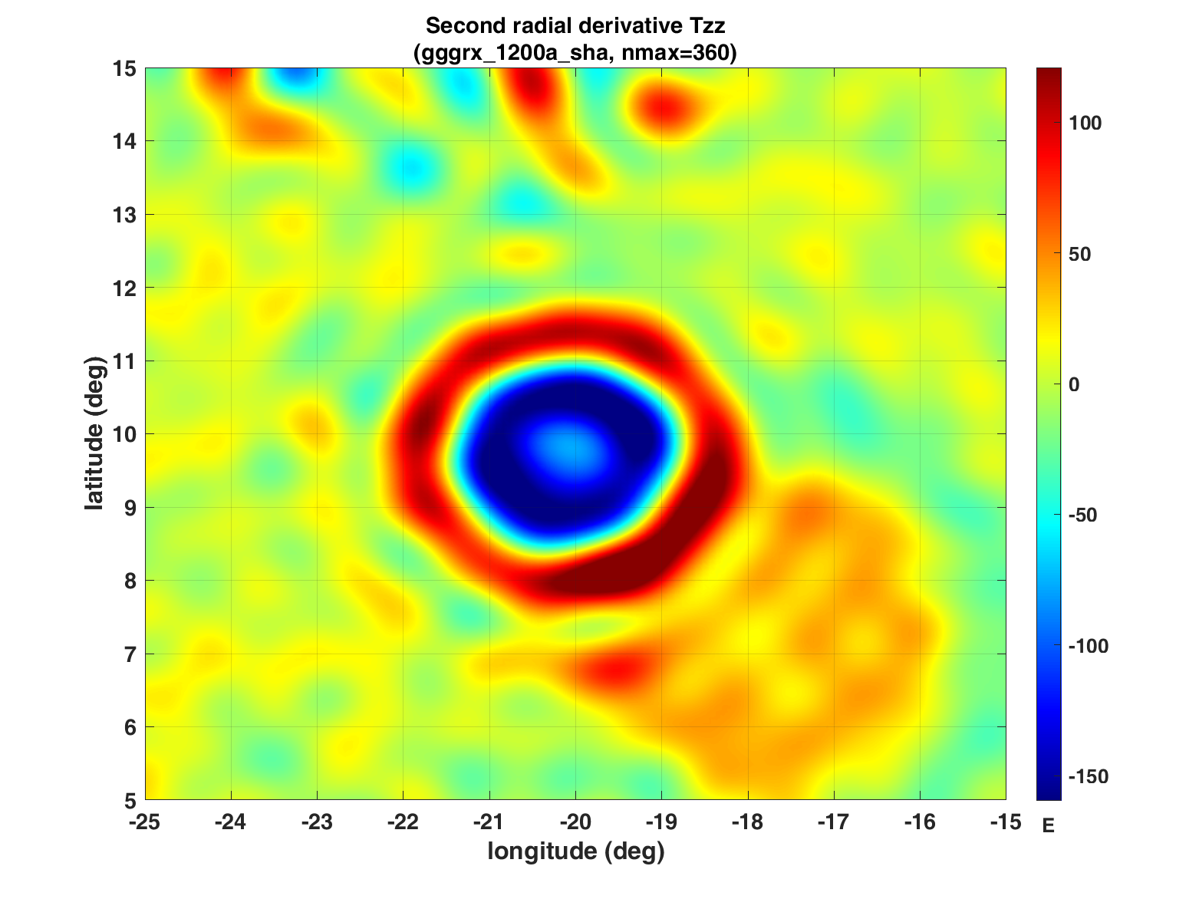
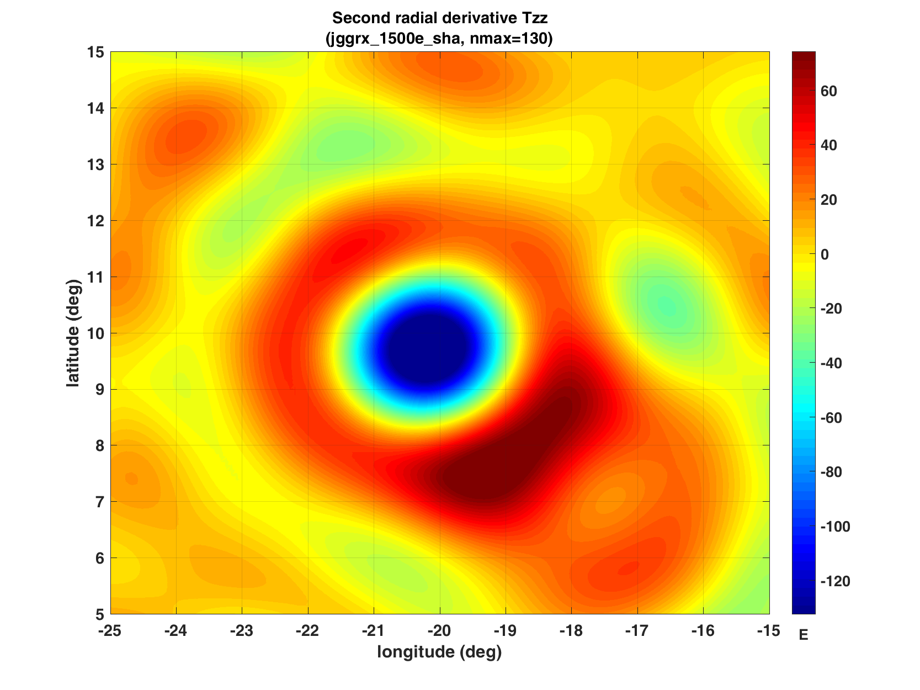
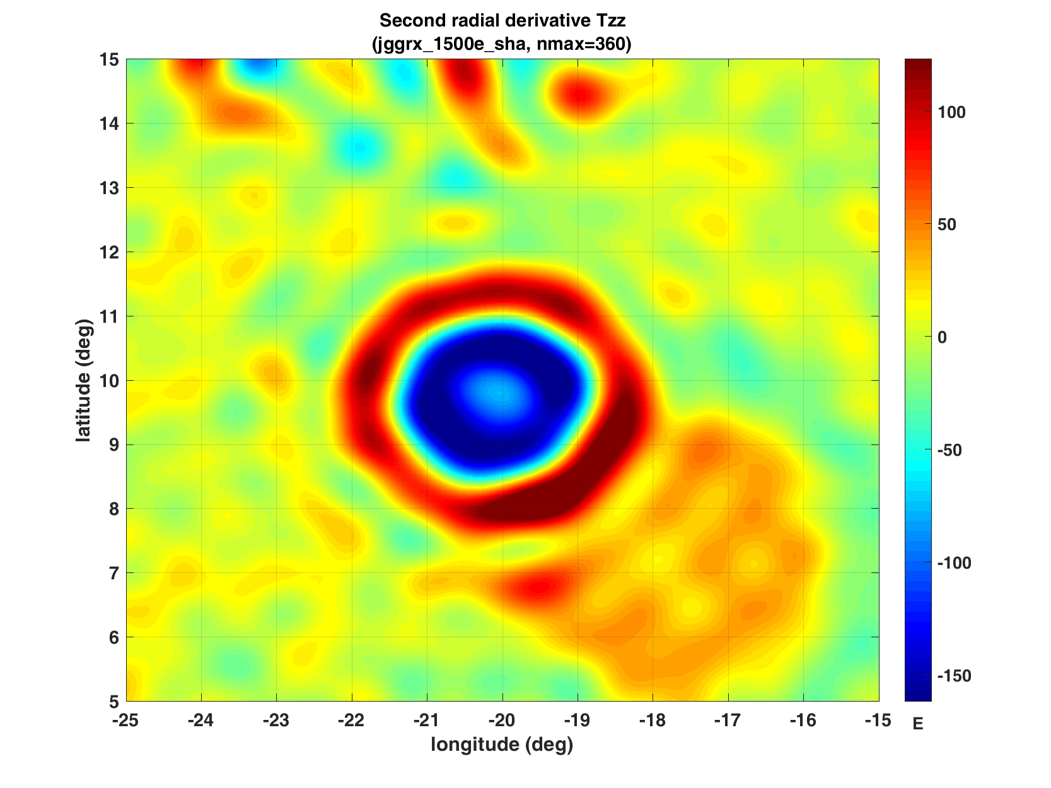
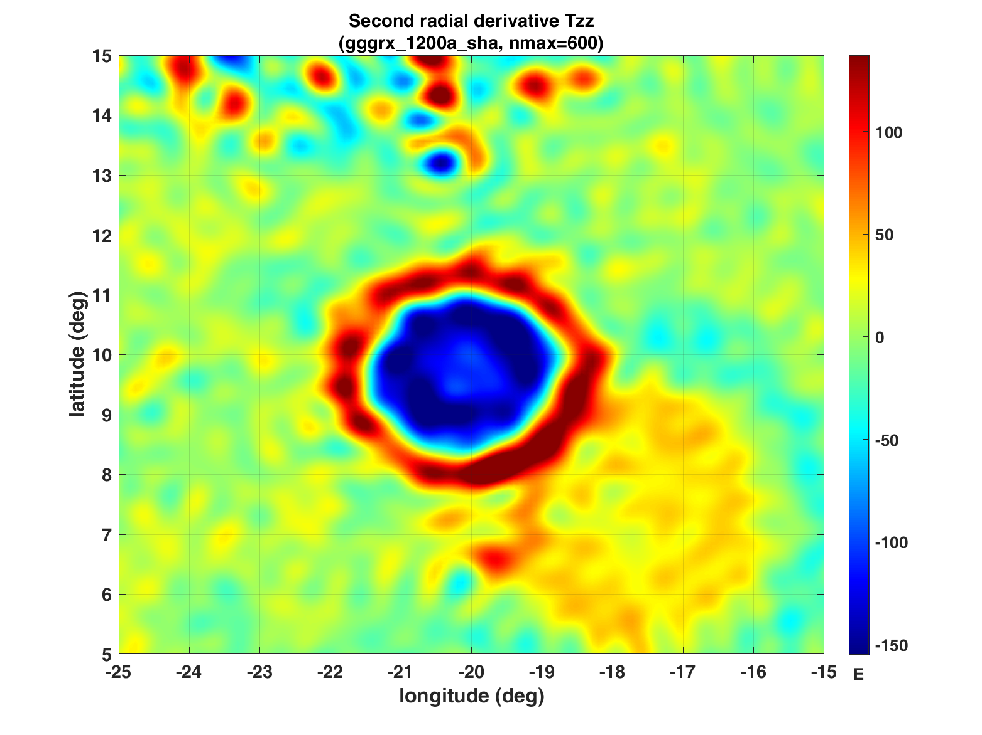
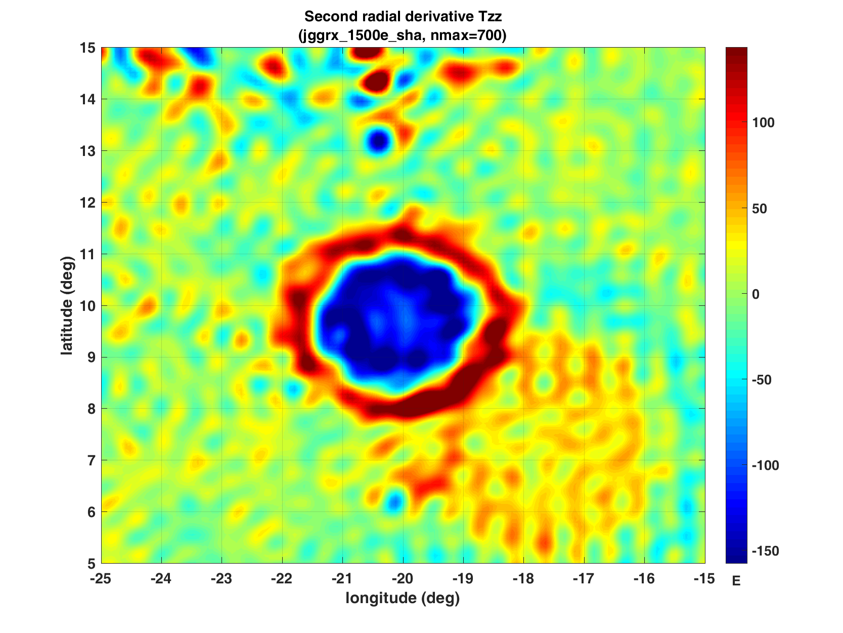
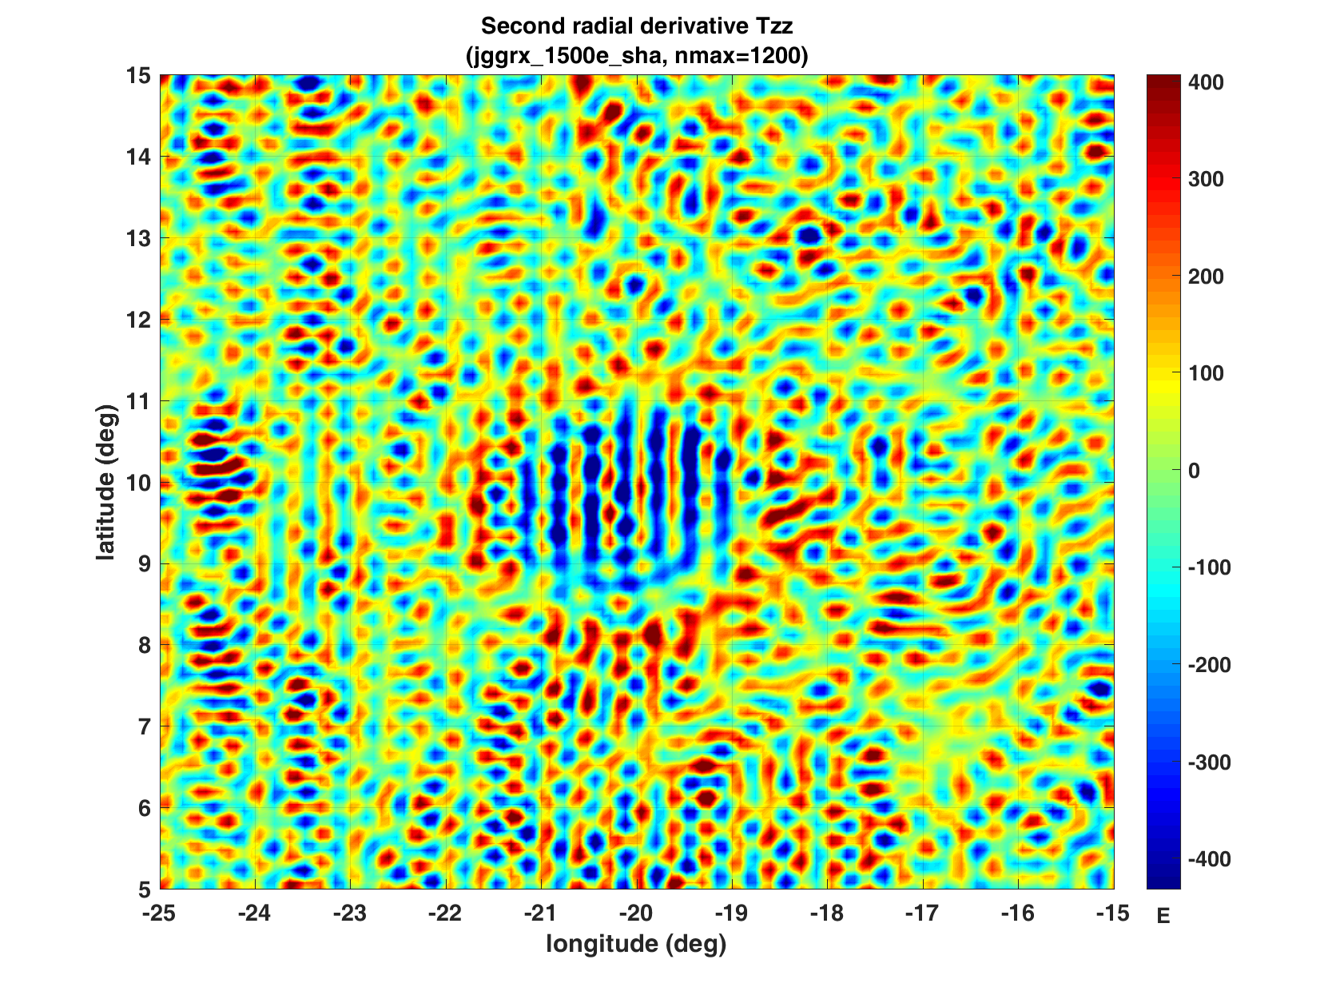
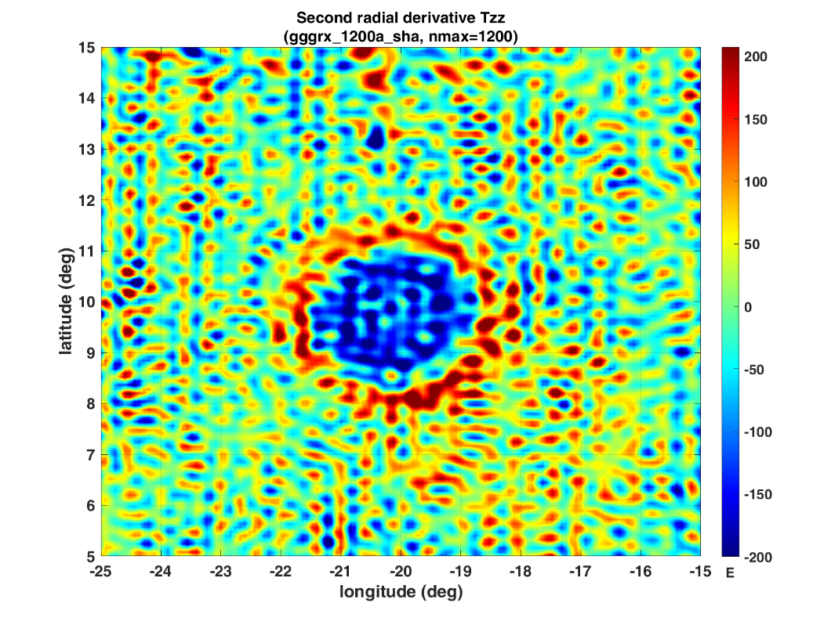
d/o
360
600 1200
respect maximum degree and order d/o of harmonic expansion in
the given gravity field model
recommended for practical use
(by the authors of the model and based on truncation error tests)

Slide 30
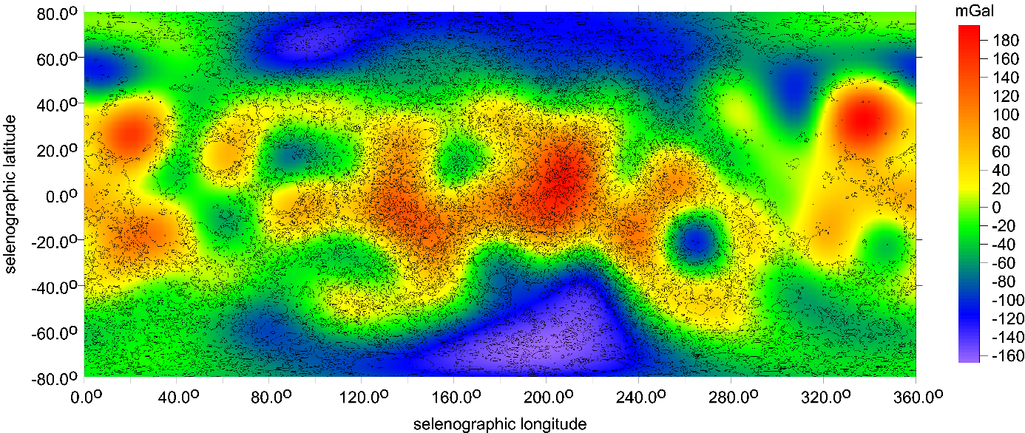
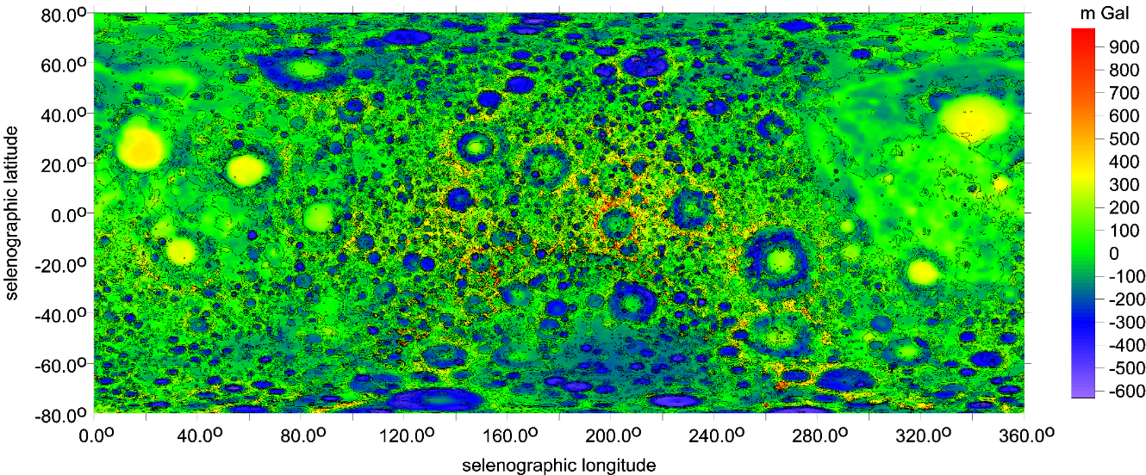
misinterpretations when we would have at our disposal only such a limited knowledge.
Truncation error test
for the Moon
with gravity anomalies
The main characteristics of the gravity field of the Moon, in terms of ∆g [mGal], with the GRGM1200A model, but only to maximum d/o=10. The higher terms are cut. Compare to Fig. 81.2 or Fig. 3.3.2. The near side of the Moon has longitudes 0-90⁰ and 270-360⁰ E. LOLA topography [m] included.
The gravity field of the Moon; ∆g [mGal] with GRGM1200A to d/o=600.. Many features on these two maps are similar,
further features and many details are missing in the upper figure; they are below the relevant resolution, of course.
Sometimes, however, we can register artefacts – false waves which are removed when the “true” full field (d/o=600) is employed.
Now we can imagine what all with the solution to d/o=10 only would be lost, would remain hidden to us from the “real gravity world”
of the Moon. Moreover, we can see that some false features would be created owing to the long-wavelengths (a form of aliasing).
This might lead to various misinterpretations when we would have at our disposal only such a limited knowledge.

Slide 31
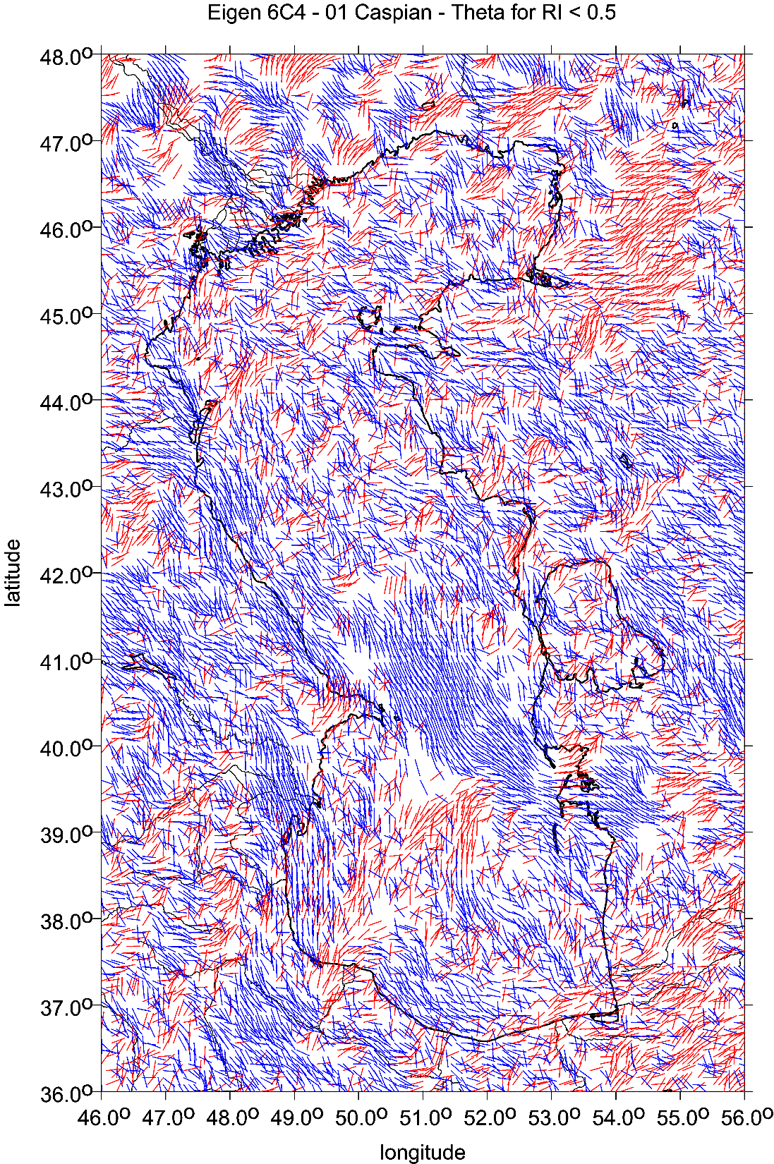
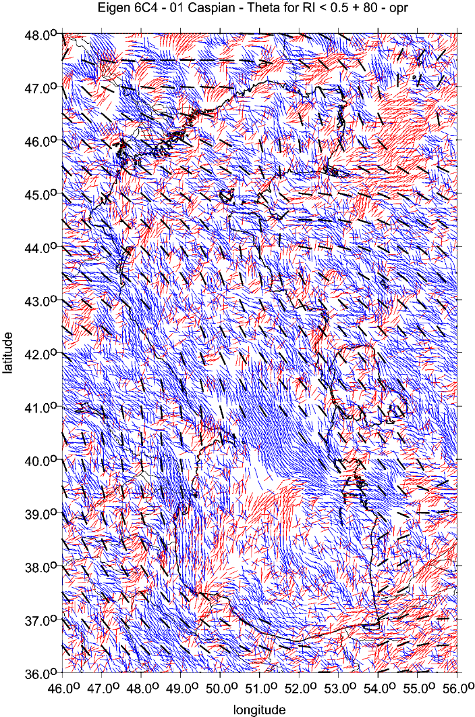

Slide 32
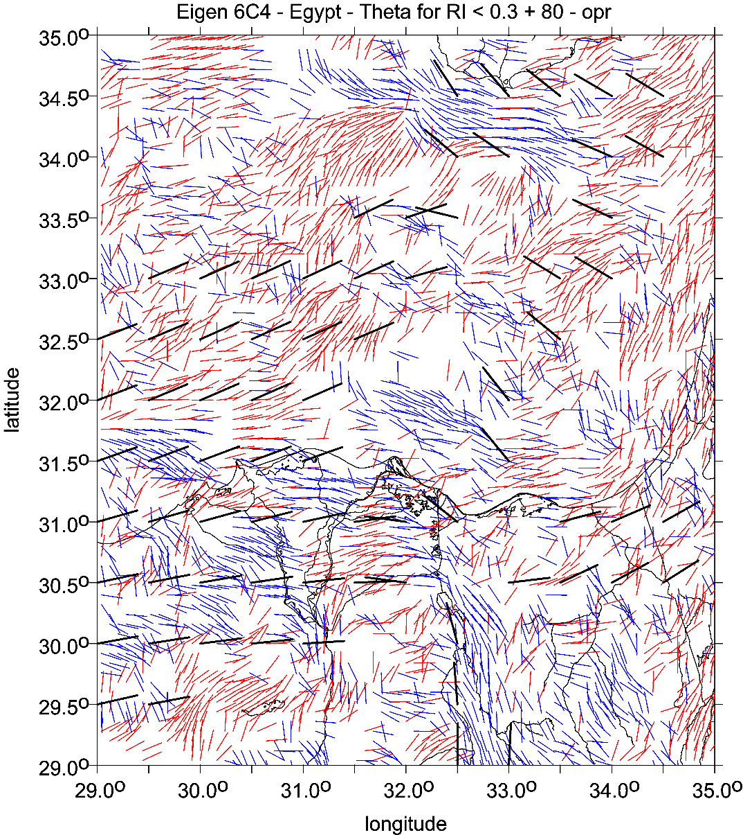
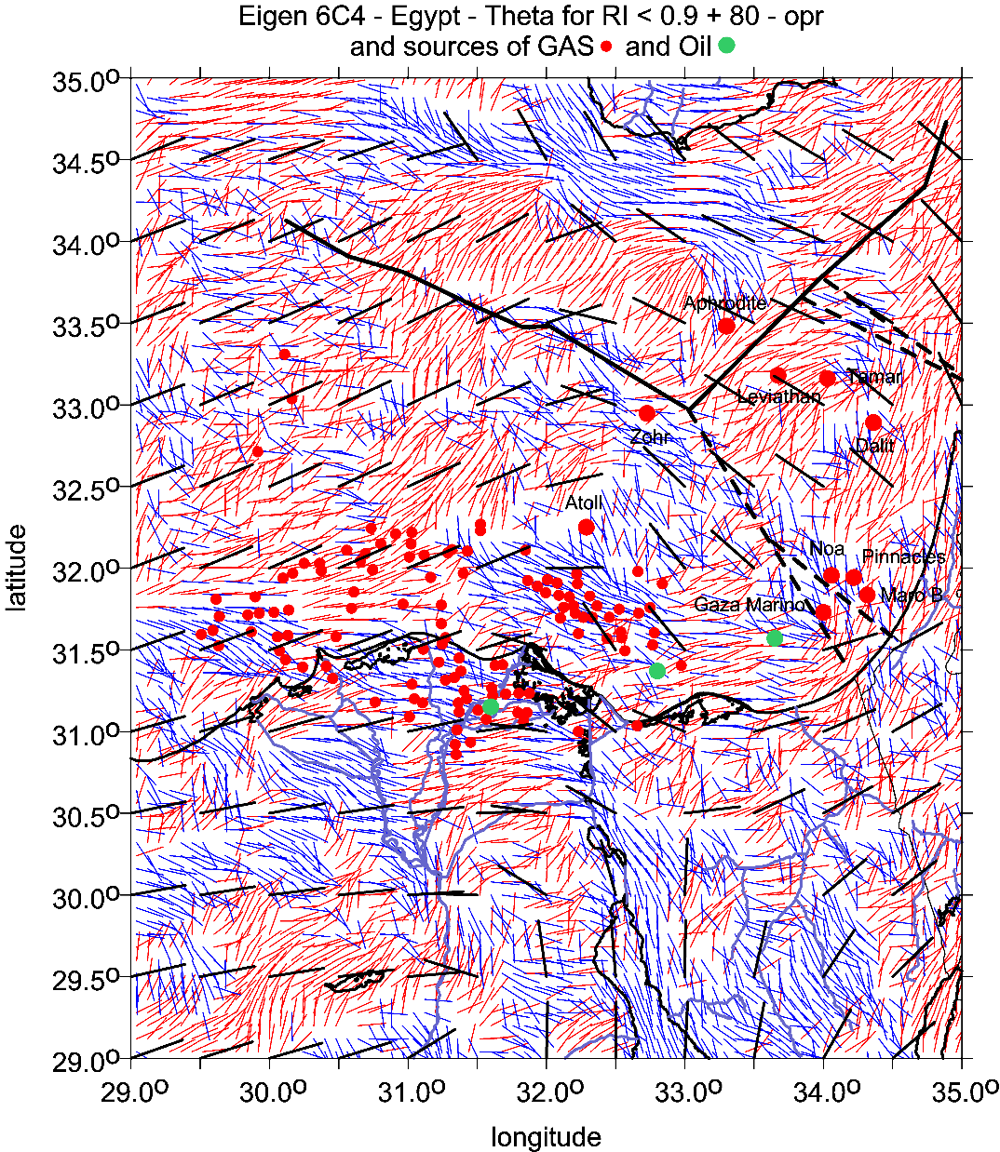

Slide 33
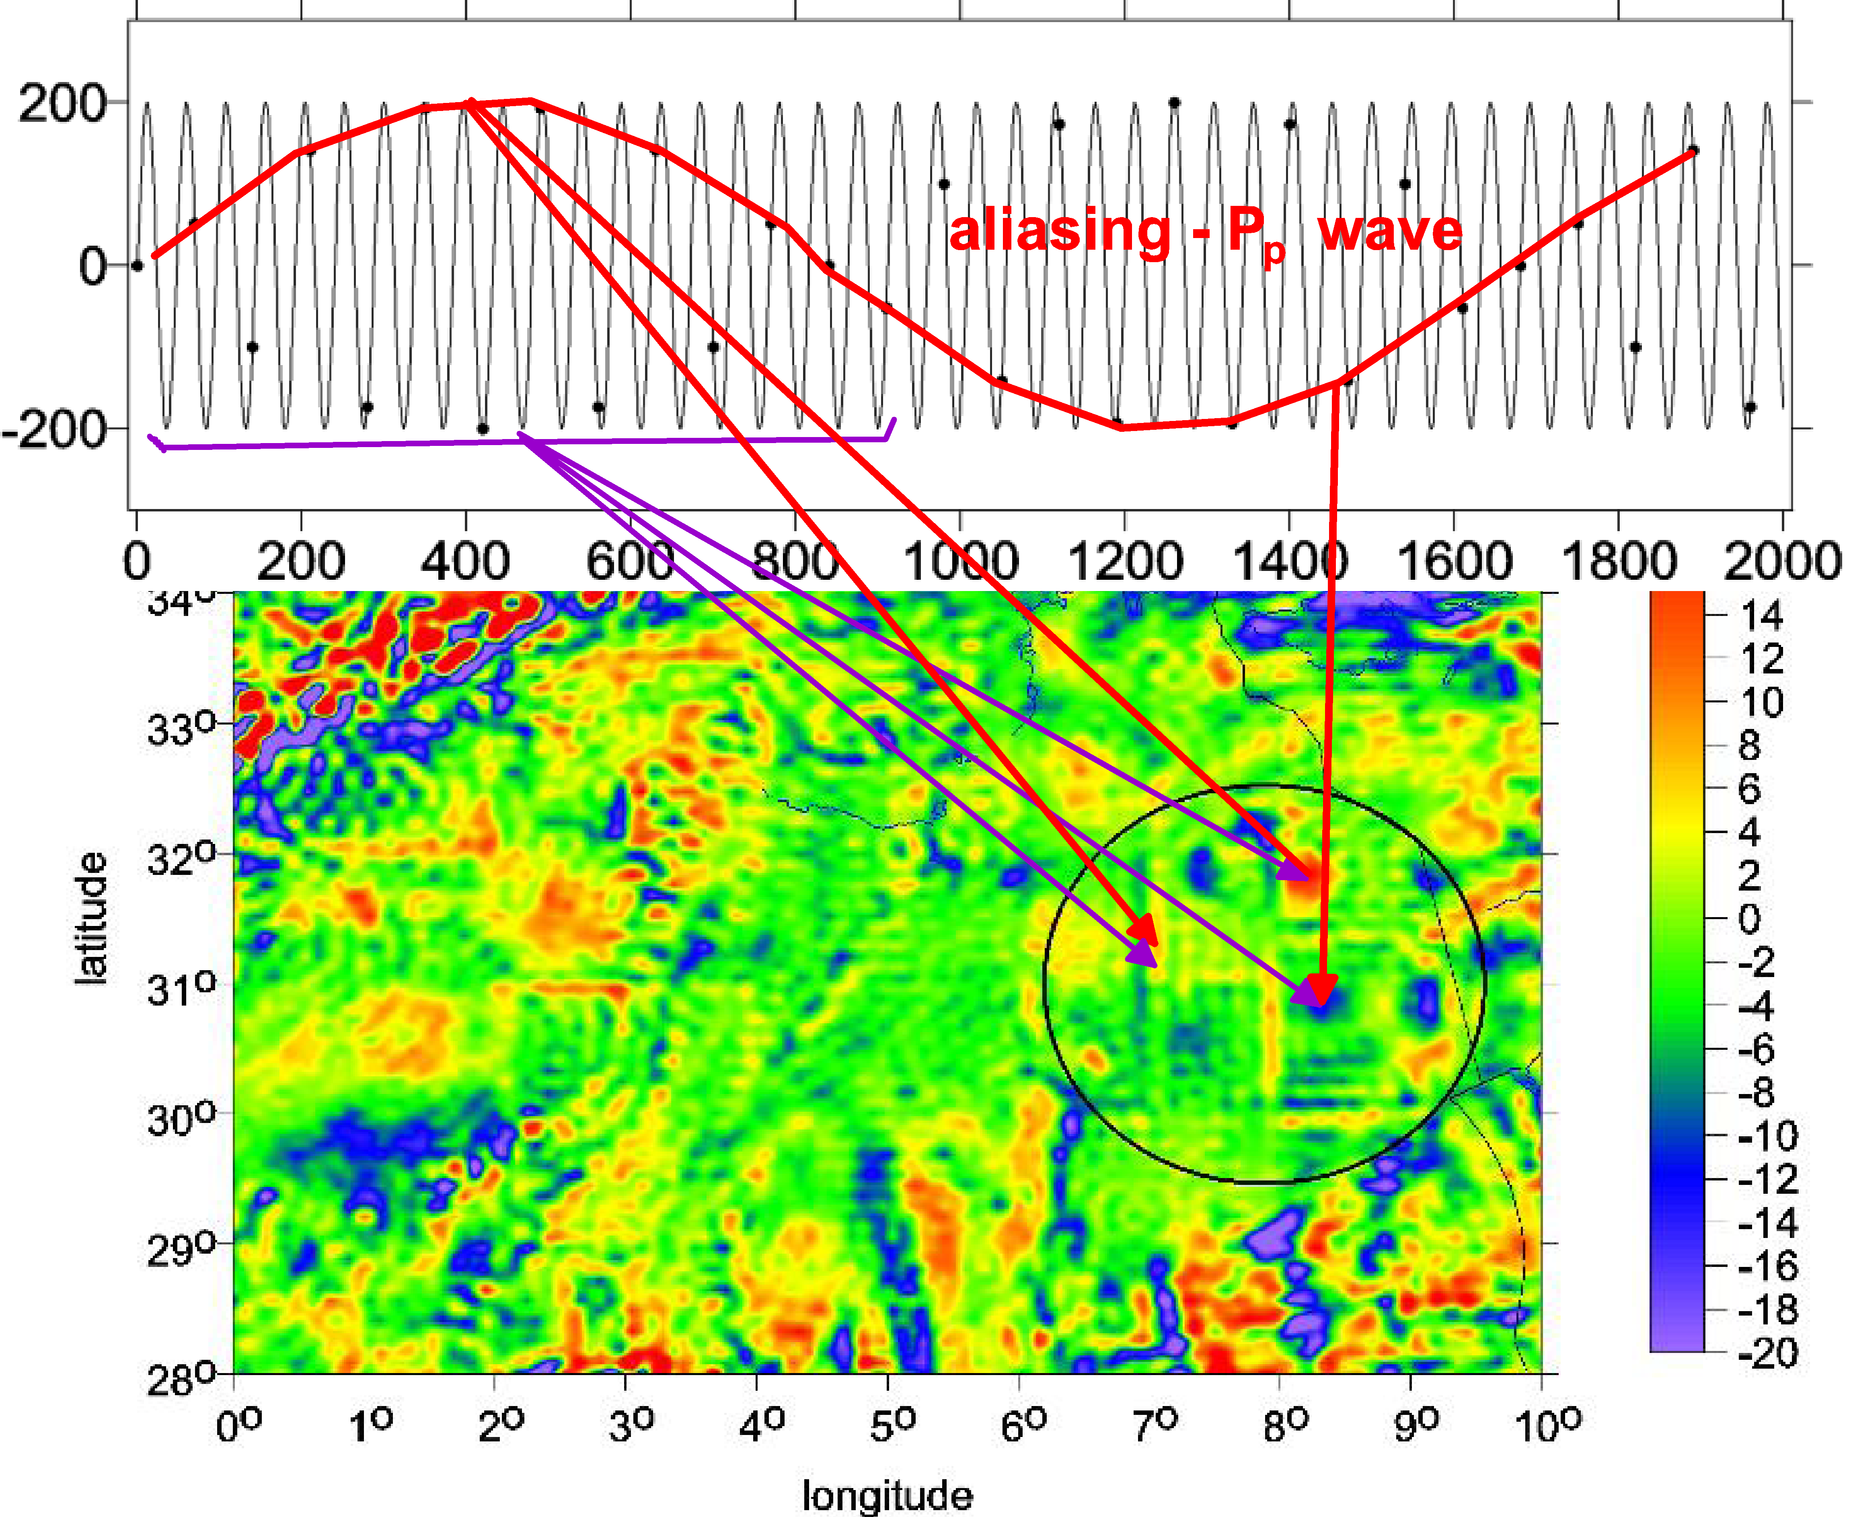
aliasing,
one type of the artefacts
the Earth, Sahara
Tunisia-Algeria,
the Chotts paleo-megalake.
Tzz [E] with EIGEN6C4 to d/o=2190
the peculiar artefacts in desert (encircled) and graining are discussed in Klokočník et al. (2021):

Slide 34
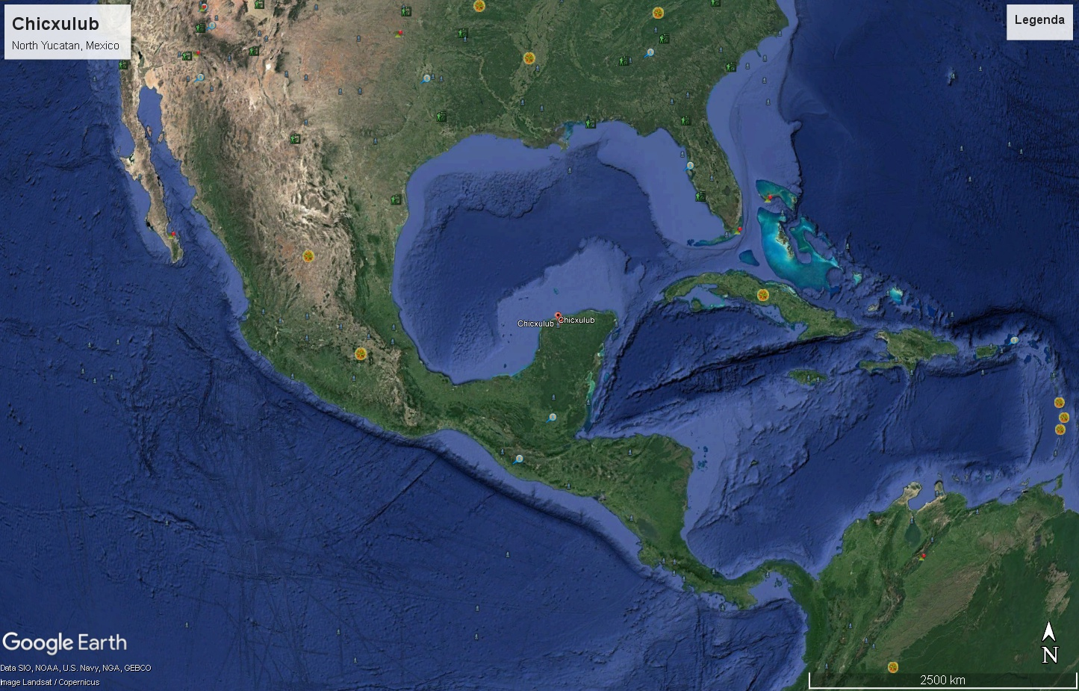
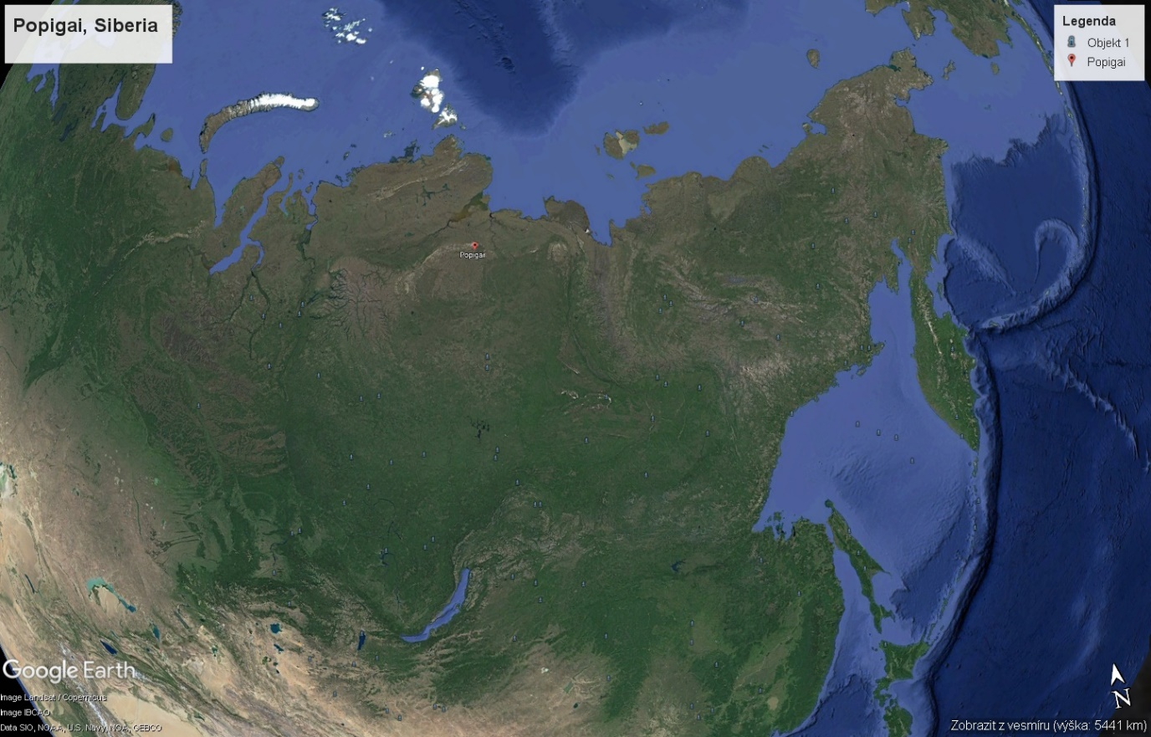
Chicxulub and Popigai on a globe
see Supplements 3 and 4

Slide 35
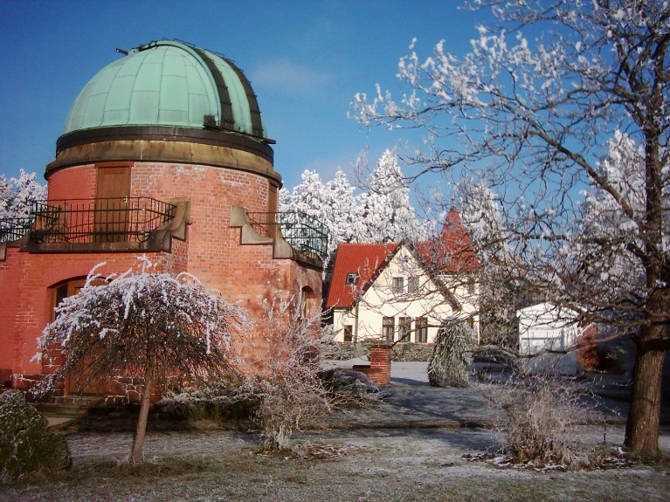
www/asu.cas.cz/~jklokocn
jklokocn@asu.cas.cz
The End of S2

